Slide 1

Helping my child to succeed at GCSE
‘Let your Light Shine’
Welcome

Slide 2

Key Staff
Mrs Salmon: Senior Assistant Head Teacher (Achievement)
Mr McHale: Senior Assistant Head Teacher (Pastoral)
Mr Green: Assistant Head Teacher
Head of House: Mr Thompson, Mr Green/Mr Davis (Mrs Duncan), Mrs McHale, Mrs Hilburn
Mr Clark: Assistant Head Teacher
Mrs Dunn: Assistant Head Teacher
Mr Brettell: Head of English
Mr Medd: Head of Maths
Mr Wylam: Head of Science & Physics
Mr Davis: Head of RE
Mrs Bruce: Head of MFL

Slide 3
GCSE Reform
Why?
In order to promote a more holistic learning experience and relieve demands of too much coursework, we have moved to linear assessment.
What?
Modular exams are exams that are taken at the end of each unit or part of the GCSE, while linear exams are exams taken at the end of the course.
(DfE 2014)

Slide 4
Assessment
Change in assessment at GCSE from grades to numbers.
Current Y11 (examined in 2018)
  2018 all subjects will be assessed using numbers (except Product Design, electronic Products, Engineering, Business Studies, ICT and H&S)

Slide 5
Pupil Targets
KS2 | Autumn Y7 | Spring Y7 | Summer Y7 | Autumn Y8 | Spring Y8 | Summer Y8 | Autumn Y9 | Spring Y9 | Summer Y9 | Autumn Y10 | Spring Y10 | Summer Y10 | Autumn Y11 | Spring Y11 | Summer Y11 | New GCSE Grades | Old GCSE grades
 |  |  |  |  |  |  |  |  |  |  |  |  |  |  |  | 9 | ^
 |  |  |  |  |  |  |  |  |  |  |  |  |  |  |  | 8 | A*
 |  |  |  |  |  |  |  |  |  |  |  |  |  |  |  | 7 | A
8A
8B |  |  |  |  |  |  |  |  |  |  |  |  |  |  |  | 6 | B
8C
7A
7B |  |  |  |  |  |  |  |  |  |  |  |  |  |  |  | 5 | C
7C
6A
6B |  |  |  |  |  |  |  |  |  |  |  |  |  |  |  | 4 | D
6C
5A
5B |  |  |  |  |  |  |  |  |  |  |  |  |  |  |  | 3 | E
5C
4A
4B |  |  |  |  |  |  |  |  |  |  |  |  |  |  |  | 2 | F
4C
3A
3B |  |  |  |  |  |  |  |  |  |  |  |  |  |  |  | 1 | G
3C
2A
2B
2C
The ‘Aspirational target grade’ is the GCSE grade that your child should achieve based on their progress from KS2.
These grades are given to your child at the beginning of Year 10 for each subject studied.
They should be recorded in their planner.

Slide 6
Pupil Targets

Slide 7
Student Progress Against Targets
The progress of your child is tracked throughout their GCSE courses.
September 2017: (Year 11) - Teachers assess progress
October 2017 (Year 11) – Grade report to parents
November 2017: (Year 11) - Examinations
January 2018: (Year 11) – Full Report and Parents’/Carers’ Evening
March 2018: (Year 11) – Teacher assess progress & grade report to parents
May 2018: (Year 11) – Formal examinations begin
…………………………………………………………………………
N.B. As a result of monitoring progress, student class moves may occur at our discretion

Slide 8
Achieving Potential
Support from subject teachers for the highest achievement.
All pupils will experience study skills and preparation for exams with revision techniques.
Planning and revision materials supplied to pupils throughout the course.
Tutorial time spent planning a revision programme.
Revision classes and Booster classes.
  N.B. Revision attendance is not considered optional!

Slide 9
In school ‘Revision Booster’ sessions in May (Example only)
Students attend revision booster sessions for subjects they are studying.
· All other times pupils are revising with their teachers in lesson.
· When they have completed the exams for a subject they are to use this lesson time to revise for other subjects and are supported by their class teacher.
Mon | Tue | Wed | Thu | Fri | Sat | Sun
 |  |  | 1 | 2 | 3 | 4
5 | 6 | 7 | 8 P5 and 6 MFL | 9 P1 and 2 RE P5 and 6 Biology | 10 | 11
12 | 13 8-9 am Pre exam Prep—Biology 11-12pm Pre exam Prep—Geography | 14 P5 and 6 Chemistry | 15 8-9am Pre exam Prep Chemistry P5 and 6 History | 16 P3 Pre exam prep PE | 17 | 18
19 P1, 2 , 3 - Physics | 20 8-9am pre exam prep—Physics | 21 P1 and 2 Geography P 5 and 6 History | 22 P3—pre exam prep English Lit | 23 | 24 HALF TERM | 25
26 | 27 | 28 | 29 | 30 | 31

Slide 10
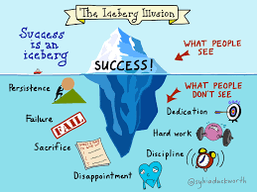
Expectations
Behaviour
Equipment
Personality
Revision
Effort
Persist
Aspire
Resilience
Engage
Dedication
Notes:
Behaviour: highest standard; mature approach to school within and outside of classrooms
Equipment: Pen, pencil, calculator, compass, protractor, ruler, green pen
Personality: Enquiring mind to learning to develop analysis and evaluation assessment objectives; treat internal assessments e.g. practical assessment in Science, just as seriously as external assessments
Revision: Ownership of your workload; use revision resources; create a revision timetable; start now not just before the exams
Effort: Give 100%; try your best
Persist: Try and try again
Aspire: to be the very best; look ahead to 6th form subjects; employment; apprenticeship requirements
Resilience: will find it hard; use the support around you at home and school; 2 years of learning and challenging concepts
Engage: in the learning in and out of the classroom; homework tasks complete to prepare, consolidate, extend learning do best standard first time on time e.g. RE takeaway homework
Dedication: to yourself and your aspirations through your work

Slide 11
Mr Davis
Head of Department: RE

Slide 12

Details of 2 YEAR GCSE course
Year 10 GCSE Course
Study of a world religion: Judaism
Beliefs and Teachings:
Practices
Foundational Catholic Theology
Origins and Meanings
Year 11 GCSE Course
Foundational Catholic Theology
Good and Evil
Applied Catholic Theology
Issues of Life and Death
Sin and Forgiveness

Slide 13
Assessment
Regular assessment takes place throughout the year.
Students will be assessed in each module of work on skills of knowledge, understanding and evaluation.
All formal assessments are based on past paper/sample paper exam questions

Slide 14
Homework
All pupils have been issued with a homework/revision booklet.
Students are expected to complete 5 tasks per week (more if they prefer)
We ask that parents sign the homework booklet to see that homework is complete, a good standard and deadlines are being met.

Slide 15
Eduqas Exam Dates
Component 1 Foundational Catholic Theology – May 14th p.m.
Component 2 Applied Catholic Theology – May 16th p.m.
Component 3 Judaism - May 24th p.m.

Slide 16
Mrs Bruce
Head of Department: MFL

Slide 17
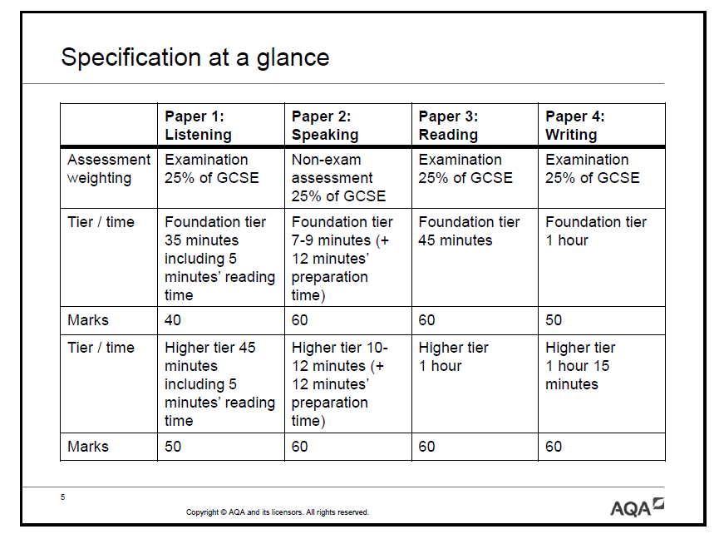
Achievement

Slide 18
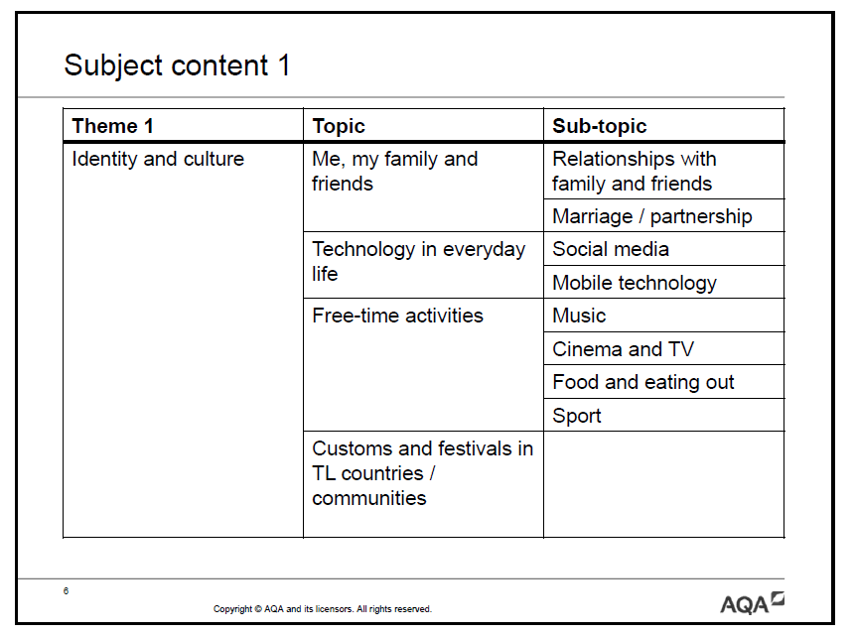

Slide 19
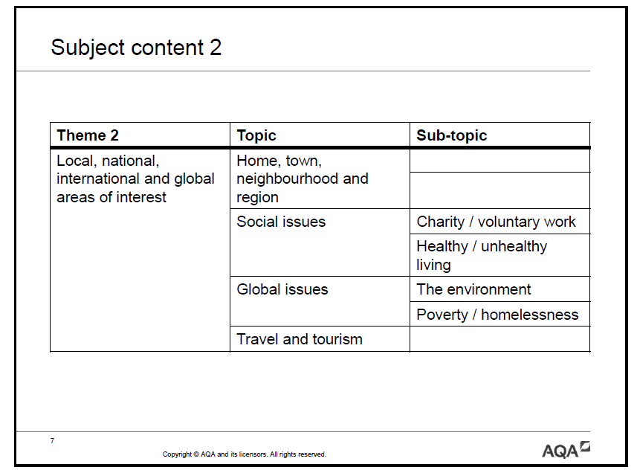

Slide 20
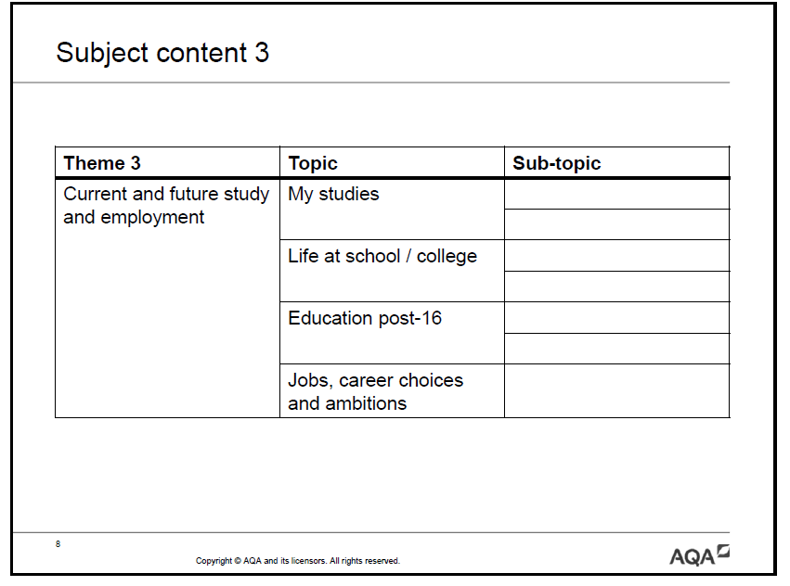

Slide 21
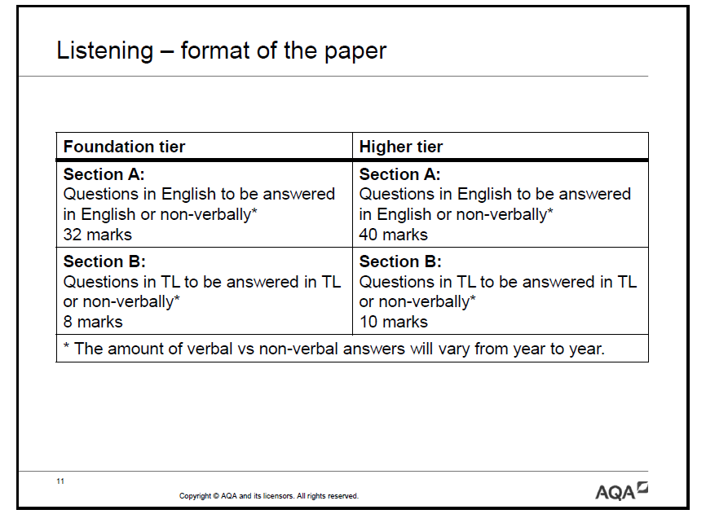

Slide 22
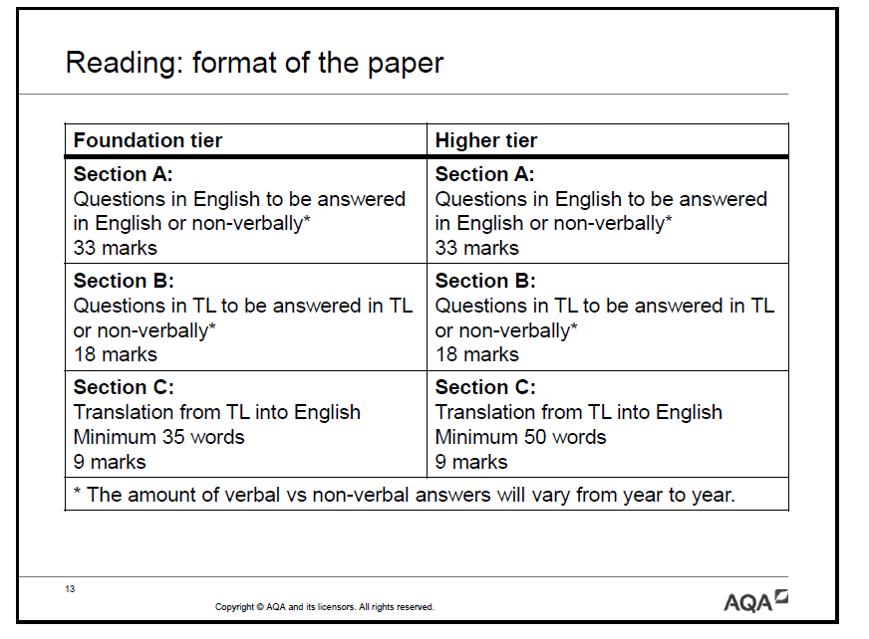

Slide 23
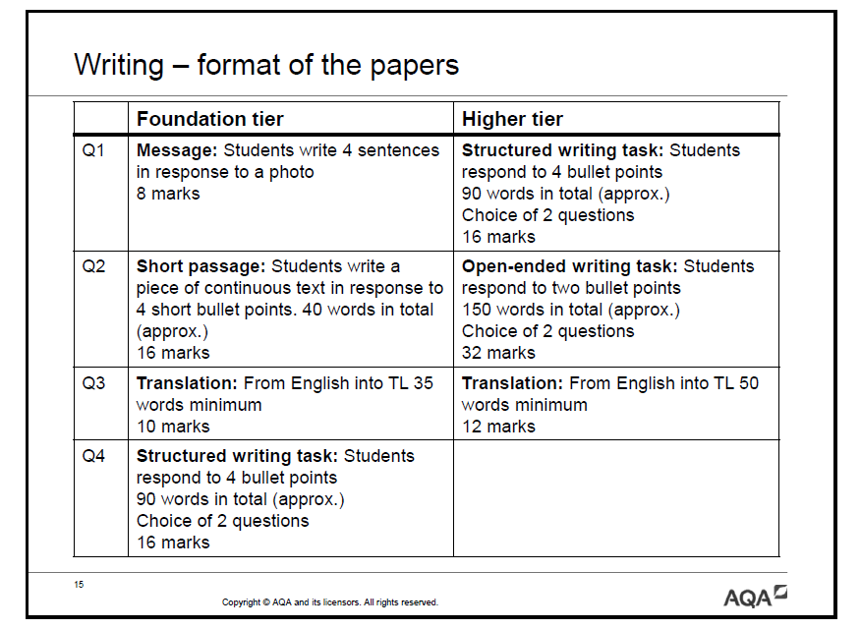

Slide 24
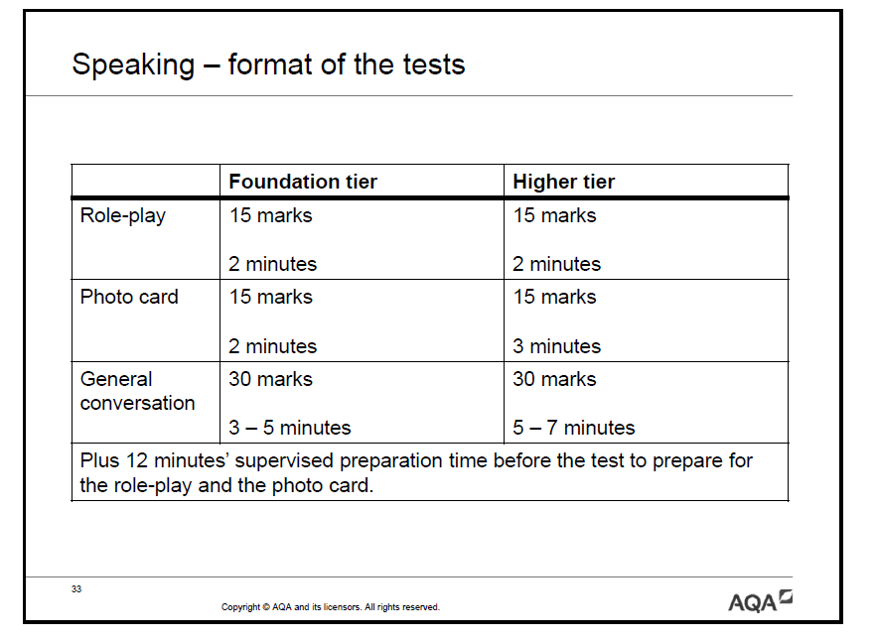

Slide 25
Examination Advice
Speaking
Remind your child that they can make notes during the preparation time.
When they speak are they finding ways to show off the full extent of their knowledge? i.e. using a range of tenses, talking about other people and giving opinions + reasons
If they make a mistake, remind them to not worry about it and to just correct themselves and move on.
Keep encouraging them to contribute fully in class when doing role play and photo card tasks and to use every opportunity to practise their French/Spanish.

Slide 26
Examination Advice
Writing + Translation
Do you see them working on written pieces for homework?
Ask them when these writing deadlines are!
Ask your child to translate what they have written, out loud into English.
Ask them if they have used complex sentences.
Ask them to highlight the different tenses they have used.
Encourage them NOT to use a translator but a dictionary instead.
Encourage your child to create mind map/revision notes of key vocab and phrases needed for the speaking and writing skills.
Your child has access to an online package – ‘Kerboodle’ - every student has a login which gives them textbook access and extra topic resources. www.kerboodle.com
Encourage them not to translate things literally and to tackle the exam passages one sentence at a time without missing anything.
Revisit old topics at home by testing them on old topic vocabulary/phrases.

Slide 27
Examination Advice
Reading + Listening
Ensure they know all the vocabulary from the AQA Specification – if you want another copy for home use, let me know.
Revise little and often and make flashcards.
Use vivid/powerful/silly ideas to make difficult vocabulary memorable.
Spend time each week revisiting an old topic – produce a mind map of key words/phrases + use colour/pictures to trigger memory!
Download past reading and listening papers from the AQA website or buy a GCSE AQA CGP 9-1 guide for French/Spanish

Slide 28
Mr Brettell
Head of Department: English

Slide 29
GCSE English Language
Paper One (50%)
Explorations in Creative Reading and Writing
Paper Two (50%)
Writers’ Viewpoints and Perspectives
Non- exam assessed
Spoken Language
Section A (25%): Reading based on a literature text
Section B (25%): Descriptive or Narrative task
Section A (25%): Reading based on a non-fiction text and a literary non-fiction text
Section B (25%): Writing to present a viewpoint e.g. argue, persuade
A spoken assessment: presenting and responding to questions using Standard English
One task
50 % of total GCSE
Exam: 1 hr 45 mins
80 marks
50 % of total GCSE
Exam: 1 hr 45 mins
80 marks
0 % of total GCSE

Slide 30
Details of 2 YEAR GCSE course: GCSE English Language
Assessment is by examination only
There are 2 exam papers
The exams are un-tiered
Grades will be assigned using the new numbered system (Grades 9 – 1, where Grade 9 represents the top 5% of students who would previously have been awarded A*)
Students will study:
Reading and comprehension skills using a range of fiction and non-fiction texts from the 19th, 20th and 21st century
Writing to describe and narrative writing skills
Discursive writing skills
Technical accuracy in spelling, punctuation and grammar (20% 0f GCSE grade)

Slide 31
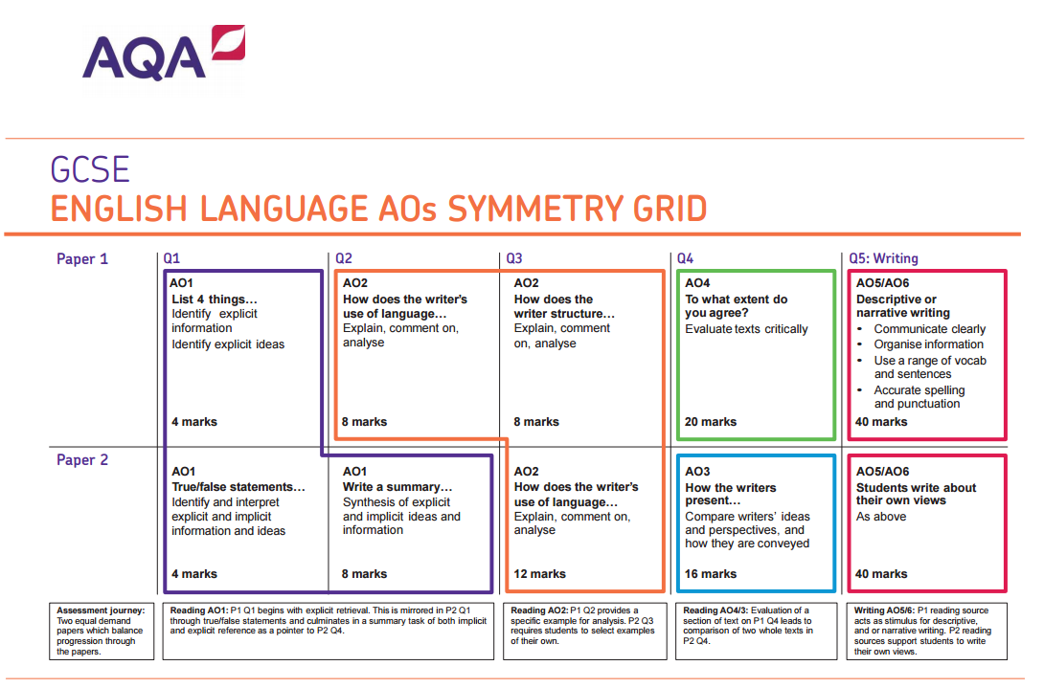
Essentially: identification and summary,
language analysis,
the ability to comment on a text’s structure,
the ability to compare texts,
being able to debate and evaluate a particular viewpoint,
creative writing element.

Slide 32
GCSE English Literature
Paper One (40%)
Shakespeare and the Nineteenth Century novel
Paper Two (60%)
Modern Texts
and Poetry
The core skills are the same in Literature as they are in Language and students will be prompted to recognise this
Section A:
Modern novel or play
An Inspector Calls
Section B:
Anthology Poetry
Power and Conflict
Section C:
Unseen Poetry
Section A:
Shakespeare play
Macbeth
Section B:
Nineteenth century novel
A Christmas Carol
40 % of total GCSE
Exam: 1 hr 45 mins
64 marks
60 % of total GCSE
Exam: 2 hrs 15 mins
96 marks

Slide 33
Details of 2 YEAR GCSE course:
GCSE English Literature
Assessment is by examination only
There are 2 exam papers
The exams are un-tiered
Grades will be assigned using the new numbered system (Grades 9 – 1, where Grade 9 represents the top 5% of students who would previously have been awarded A*)
Students will study:
Macbeth
A Christmas Carol
An Inspector Calls
Power and Conflict Poetry
Unseen Poetry
Paper 1
Paper 2

Slide 34







Poetry lectures and ‘Inside the Writer’s Studio’ events
Weekly morning sessions
Targeted small cohorts
Thursday skillset sessions
Aiming high sessions
Morning tutorial

Slide 35
Mr Medd
Head of Department: Mathematics

Slide 36
Details of 2 YEAR GCSE course
AQA GCSE Mathematics (8300)
Entirely linear
Exam board is AQA
Website www.aqa.org
Two tiers: Higher (grades 4-9), Foundation (grades 1-5)
Some change in content, some change in how questions are asked

Slide 37
Assessment
Homework: often past exam questions
In class assessment: internal regular examination-style tests. Used to inform progress.
Revision can be done using notes in exercise books, revision guides and revision websites:
KESH TAKEAWAY https://keshgcsemaths.wordpress.com/gcse-maths-takeaway/
CORBETT MATHS http://corbettmaths.com/
HEGARTY MATHS http://www.hegartymaths.com/
MATHS CASTS https://www.sites.google.com/site/mathscasts/
THE MATHS TEACHER http://www.themathsteacher.com/

Slide 38
Examinations
Three exams, all sat in Summer 2018
Paper 1 non-calculator, Paper 2 & 3 calculator
Each worth 80 marks
Total mark = grade

Slide 39
Mr Wylam
Head of Department: Science

Slide 40
Science
GCSE Combined Science: Trilogy
GCSE Biology/Chemistry/Physics

Slide 41
Details of the courses we offer
AQA GCSE Combined Science: Trilogy
4 hours of Science per week
6 exams in May/June 2018
2 exams per subject
Each paper lasts 1 hour 15 minutes and accounts for 16.7% of GCSE
Students will gain two GCSEs at the end of the course
AQA GCSE Biology/Chemistry/Physics
6 hours of Science per week
6 exams in May/June 2018
2 exams per subject
Each paper lasts 1 hour 45 minutes and accounts for 50% of each GCSE subject
Students will gain three GCSEs at the end of the course

Slide 42
Awarding Qualifications
The qualification will be graded on a 17-point scale: 1 – 1 to 9 – 9, where 9 – 9 is the best grade
A student taking Foundation Tier assessments will be awarded a grade within the range of 1 – 1 to 5 – 5
A student taking Higher Tier assessments will be awarded a grade within the range of 4 – 4 to 9 – 9

Slide 43
Developing Practical Skills
Students will be required to complete a series of practical experiments to develop their scientific thinking skills and understanding
Combined Science carry out eight per subject (a total of 24 over two years)
Separate Science students will carry out ten per subject (a total of 30)
Practical skills will be evaluated through the final examinations through questions designed to test students’ understanding

Slide 44
Assessment
Students are assessed twice per term (three times in the first term including the mock examinations)
Students are expected to prepare for these assessments just as they would for the summer
Used to track students and put intervention in place when necessary
Assessments and homework tasks are made up of past exam questions to help students understand the language used by AQA

Slide 45
Preparation for Examinations
Revision & Independent Study: We are developing students’ ability to self study. They should constantly be revising and trying new techniques to find the ones best suited for them.
Revision Guides: are very useful to support learning and may be purchased at a reduced cost from the Science department
Revision Classes: These will be focused at certain groups throughout the year. Encourage your child to come along and take part.

Slide 46
Year 11 Examination Dates
 | Biology | Chemistry | Physics
Paper 1 | Tue 15th May | Thu 17th May | Wed 23rd May
Paper 2 | Mon 11th June | Wed 13th June | Fri 15th June

Slide 47
Mr Clark
Assistant Headteacher
Revision Techniques

Slide 48

What are the top 6 effective revision strategies?

Slide 49
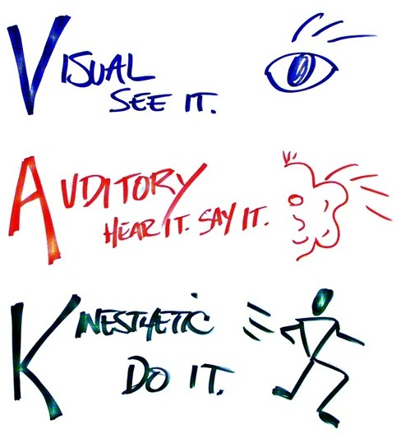
Some myths about your brain
Learning in a particular “learning style” has no evidence of success (e.g.. VAK)
*Reading something over and over again won’t help you learn it – highlighting and underlining included
“Cramming” has very short term benefits but is not a sustainable way to revise
You have very little ability to judge how well you know something without testing yourself
Notes:
FLASHCARDS
Flashcards are a great example
Don’t check answers until the end
Mix up your cards so you cover different topics & prioritise your cards
Keep repeating!!

Slide 50






Notes:
SELF Testing:
Use these tests to identify areas of weakness
Arrests forgetting
Avoids the “illusion of knowing”
End to cramming for the tests and revising huge chunks of content
Every time you work hard to recall a memory you strengthen it
FLASHCARDS
Flashcards are a great example of Self Testing
Mix up your cards so you cover different topics & prioritise your cards
Keep repeating!!
Buy in most shops
Use online generators/information on the school website
MNEMONICS/FLASHCARDS
Useful to have a strategy to remember in the exams and enables use to commit something to our working memory
Many Vile Earthlings Munch Jam Sandwiches Under Newspaper Piles
‘Mercury, Venus, Earth, Mars, Jupiter, Saturn, Uranus, Neptune, Pluto’
BRAT
DAMITT
PEEL
TAP
AFOREST
RE-Working Text
Defining key terms/events/people is a good way to learn- It makes your brain consider the meaning
Convert the points of something you read into questions to answer later.
Write things in your own words & make links to other things you know
Deliberate Practice
Multiple exam questions/papers
Revise different types of questions
With exam revision repetition is our friend
Practice skills, knowledge and timing
Crafting and drafting exam papers is vital
Mastery of content should bring happiness!
Feedback from Teachers
Use your books and files to revise
Act upon the feedback you get in class
Don’t repeat mistakes
Organisation

Slide 51
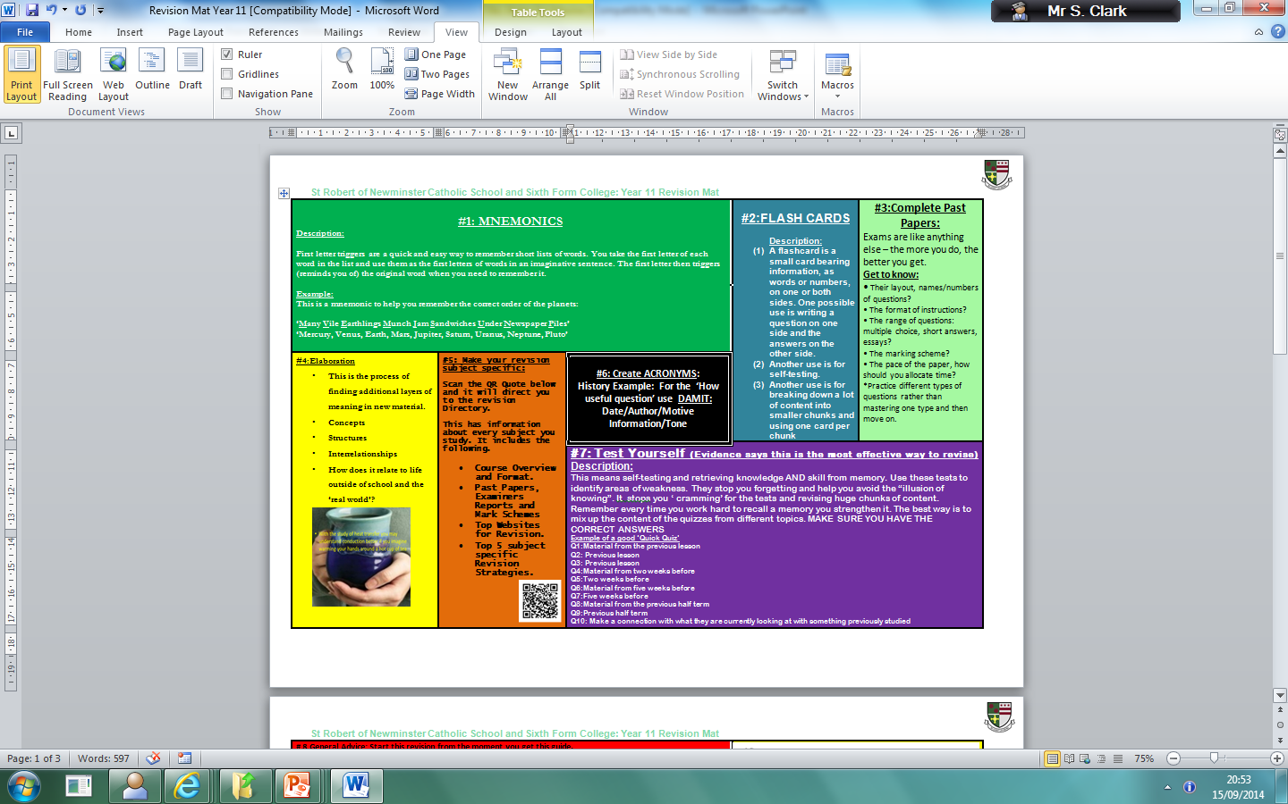
Page 24,25,26 of pupil planner

Slide 52
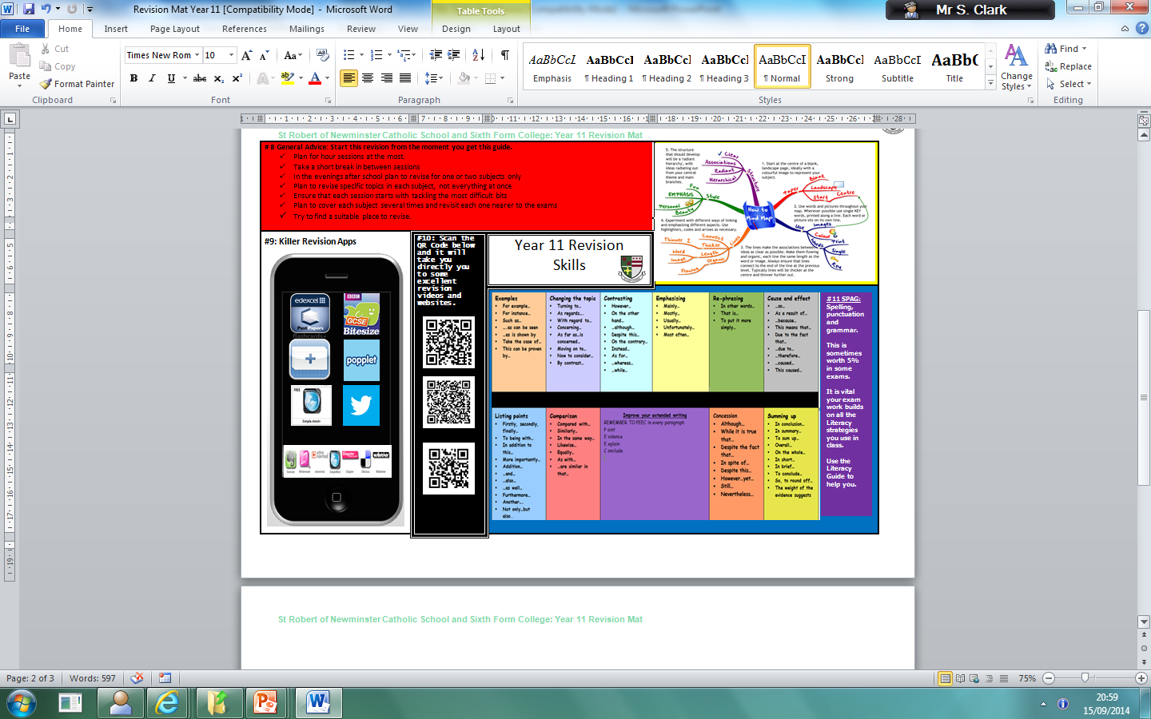

Slide 53
The Revision Planner p20-p23 in Pupil Planner
 | Mon 20th | Tues 21st | Wed 22nd | Thur 23d | Fri 24th | Sat 25th | Sun 26th
Homework
Coursework
Revision

Slide 54
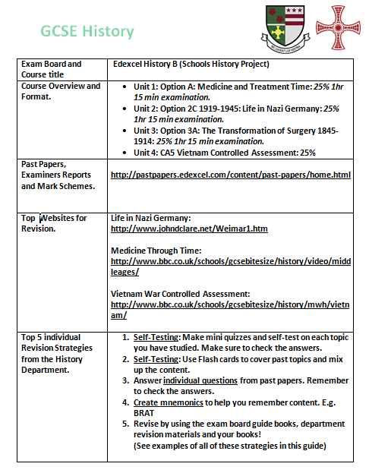
Departmental Revision Guides

Slide 55
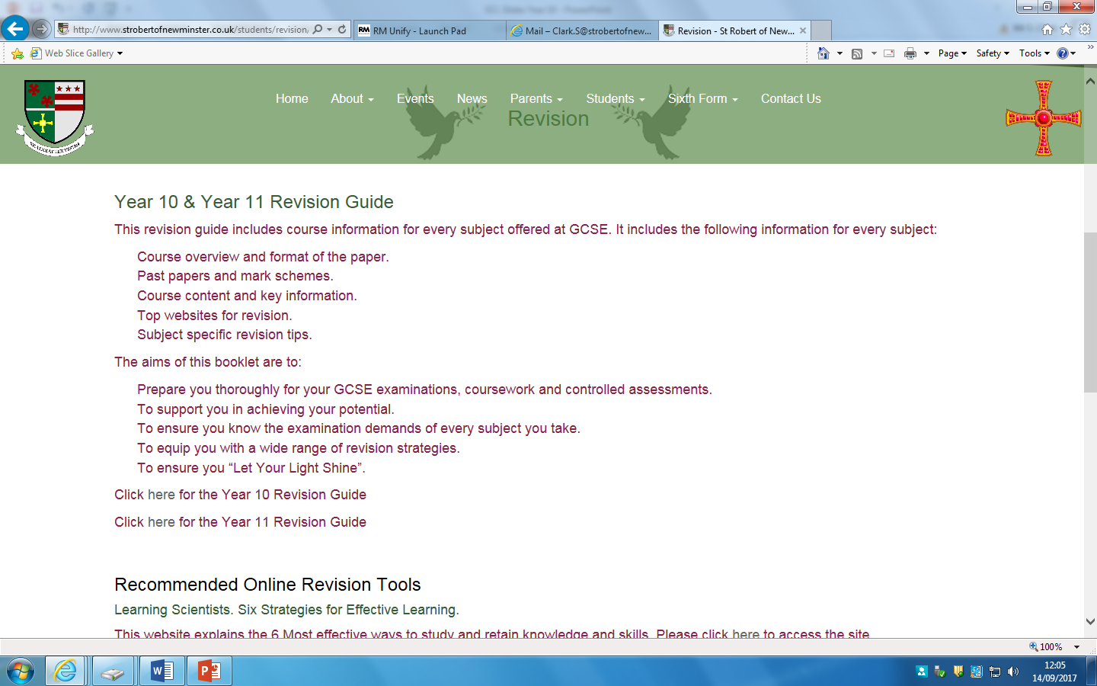

Slide 56
Mr McHale
Senior Assistant Head Teacher (Pastoral)

Slide 57
How do I seek advice from the school?
If you need any advice from the school contact your child's Head of House.
If there is a personal issue Mrs Hughes, school social worker, is available.
If there is an attendance issue Mrs Moran/Mrs Devlin are the attendance team.
You could communicate with subject staff or mentors (where applicable) via the planner.

Slide 58
Parents/Carers – How can I help?????

Slide 59
I don’t understand all these controlled assessments, levels and exams – its completely different from when I was at school.
I can’t stand the arguments when I try to help....
I’m surprised she’s not got any homework, I expected more in Year 11
Surely she shouldn’t be going out again when she’s studying for GCSE’s?
He’s always got an excuse, I don’t know what to believe!
I’ll just write her a note to excuse her late homework, just this once....
Notes:
Common frustrations/reactions from Parents.

Slide 60
The Biggest Challenge: Priorities
Friendships
Family life
Social life
Hobbies
Clubs
Fashion
Romantic Concerns
GCSEs?

Slide 61
A Partnership
You are the expert on your own child and always have been his or her most important teacher.
Your support, encouragement and interest can make a spectacular difference to your child’s motivation and ability to cope with demands of GCSE.

Slide 62
Attendance
A GCSE in under 5 days???
You may think you’ve got forever BUT look at how many hours of lessons you have in Year 10.
Eng/Maths/Sci 6.5 days (4 hrs per week)
Opted Subjects 3.25 days (2hrs per week)
You will cover most topics only once in these hours so learning first time round is the key to successful revision and exam results!
Every Lesson Counts!!!!!!!!!!!
Notes:
4hrs per week x 39 weeks = 156 / 24 hrs in a day = 6.5 days

Slide 63
What you can do right now:
Check your child’s planner weekly and sign it.
Use the planner to communicate with Head of House/Tutor/Subject teacher.
Ensure your child is equipped for each and every lesson.
Check your child is completing homework, encourage good presentation of work in books.
Show an interest – ask them to explain what they are enjoying at school
Ensure your child attends and is punctual every day.
Support the School.

Slide 64
Thank You

