Slide 1
18 February 2018
11:54 PM
Apprenticeship Update
Rolls Royce extend deadline till the end of Feb 2018
Although there has been a decline of British manufacturing industry, around one in ten people in work across Tyne and Wear still work in a manufacturing or engineering business.
Retail continues to be a major employer providing over 10% of all jobs across Tyne and Wear. Creative and media industries represent one of the fastest growing sectors in the area. Jobs include actors, musicians, journalists, graphic designers, photographers and computer game developers. In recent years the health and care sector has expanded and now provides jobs for almost 16% of all workers across Tyne and Wear. The NHS remains the country’s largest employer with around 1.7 million employees across the country and around 30,000 in Tyne and Wear.
Y10 Work Experience Deadline : Fri 23rd March
Nestle Recruiting for Level 3 Engineers
Y12 Work Experience Deadline : Fri 20th April
Lloyd’s (not the bank) looking for Level 3 apprentices in Insurance, HR and Digital Communications.
Complete the online questionnaire on the school website to register your future aspirations
Severn Trent advertising for Apprentices
National Apprenticeship Website:
www.gov.uk/apply-apprenticeship
National Apprenticeship Week: Monday 5th – Friday 9th March

Slide 2
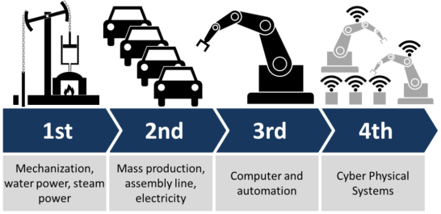
18 February 2018
11:54 PM
Careers in the manufacturing industry
The 4th Industrial Revolution is here!
Y10 Work Experience Deadline : Fri 23rd March
Y12 Work Experience Deadline : Fri 20th April
Year 9 Option Choices coming soon
Are you fully aware of the future opportunities on offer throughout the North East?
Register on Startprofile.com to build your profile
Many economists point out that we are moving towards a knowledge based, high-tech, low carbon economy. This new economy will require highly educated and trained people with specialist knowledge and skills to fill a growing number of professional and technical roles. Many of these people will be graduates and post-graduates or people who have undergone extensive training through technical apprenticeships and tertiary education.
Question of the Week
What is the difference between studying a course in Pharmacy and studying a course in Pharmacology?
Work Discovery Week 2018: Monday 25th – Friday 29th June

