Slide 1

Helping my child to succeed at GCSE
‘Let your Light Shine’
Welcome

Slide 2

Key Staff
Mrs Salmon: Senior Assistant Head Teacher (Achievement)
Mr McHale: Senior Assistant Head Teacher (Pastoral)
Mr Green: Assistant Head Teacher (Pastoral)
Mr Clark: Assistant Head Teacher (Teaching & Learning)
Mrs Dunn: Assistant Head Teacher (Intervention)
Head of House: Mr Thompson, Mrs Duncan, Mrs McHale, Mrs Hilburn-Mullhatton
Mr Brettell: Head of English
Mr Medd: Head of Maths
Mr Wylam: Head of Science & Physics
Mr Davis: Head of RE
Mrs Bruce: Head of MFL

Slide 3
GCSE Reform
Why?
In order to promote a more holistic learning experience and relieve demands of too much coursework, we have moved to linear assessment.
What?
Modular exams are exams that are taken at the end of each unit or part of the GCSE, while linear exams are exams taken at the end of the course.
(DfE 2014)

Slide 4
Assessment
Change in assessment at GCSE from grades to numbers.
Current Y11 (examined in 2019)
  All subjects will be assessed using numbers

Slide 5
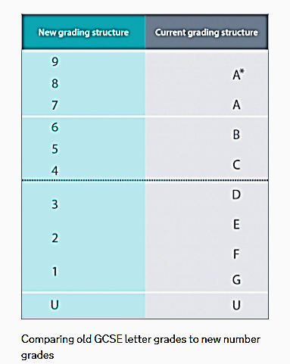
NEW
OLD
5 =
Strong Pass
4 = Standard Pass

Slide 6
Pupil Targets
KS2 | Autumn Y7 | Spring Y7 | Summer Y7 | Autumn Y8 | Spring Y8 | Summer Y8 | Autumn Y9 | Spring Y9 | Summer Y9 | Autumn Y10 | Spring Y10 | Summer Y10 | Autumn Y11 | Spring Y11 | Summer Y11 | New GCSE Grades | Old GCSE grades
 |  |  |  |  |  |  |  |  |  |  |  |  |  |  |  | 9 | ^
 |  |  |  |  |  |  |  |  |  |  |  |  |  |  |  | 8 | A*
 |  |  |  |  |  |  |  |  |  |  |  |  |  |  |  | 7 | A
8A
8B |  |  |  |  |  |  |  |  |  |  |  |  |  |  |  | 6 | B
8C
7A
7B |  |  |  |  |  |  |  |  |  |  |  |  |  |  |  | 5 | C
7C
6A
6B |  |  |  |  |  |  |  |  |  |  |  |  |  |  |  | 4 | D
6C
5A
5B |  |  |  |  |  |  |  |  |  |  |  |  |  |  |  | 3 | E
5C
4A
4B |  |  |  |  |  |  |  |  |  |  |  |  |  |  |  | 2 | F
4C
3A
3B |  |  |  |  |  |  |  |  |  |  |  |  |  |  |  | 1 | G
3C
2A
2B
2C
The ‘Aspirational target grade’ is the GCSE grade that your child should achieve based on their progress from KS2.
These grades were given to your child at the beginning of Year 10 for each subject studied.
They should be recorded in their planner.

Slide 7
Pupil Targets

Slide 8
Student Progress Against Targets
The progress of your child is tracked throughout their GCSE courses.
September 2018: (Year 11) - Teachers assess progress
October 2018 (Year 11) – Grade report to parents
November 2018: (Year 11) – Examinations & Mock results day in December
January 2019: (Year 11) – Full Report and Parents’/Carers’ Evening
February 2019: (Year 11) – Teacher assess progress & grade report to parents in March
May 2019: (Year 11) – Formal examinations begin
…………………………………………………………………………
N.B. As a result of monitoring progress, student class moves may occur at our discretion

Slide 9
Achieving Potential
Support from subject teachers for the highest achievement.
All pupils will experience study skills and preparation for exams with revision techniques (Mr Clark).
Planning and revision materials supplied to pupils throughout the course.
Tutorial time spent planning a revision programme.
Revision classes, Booster classes, GCSE Pod (Mrs Dunn).
  N.B. Revision attendance is not considered optional!

Slide 10
Mr Bayne
Head of Sixth Form

Slide 11
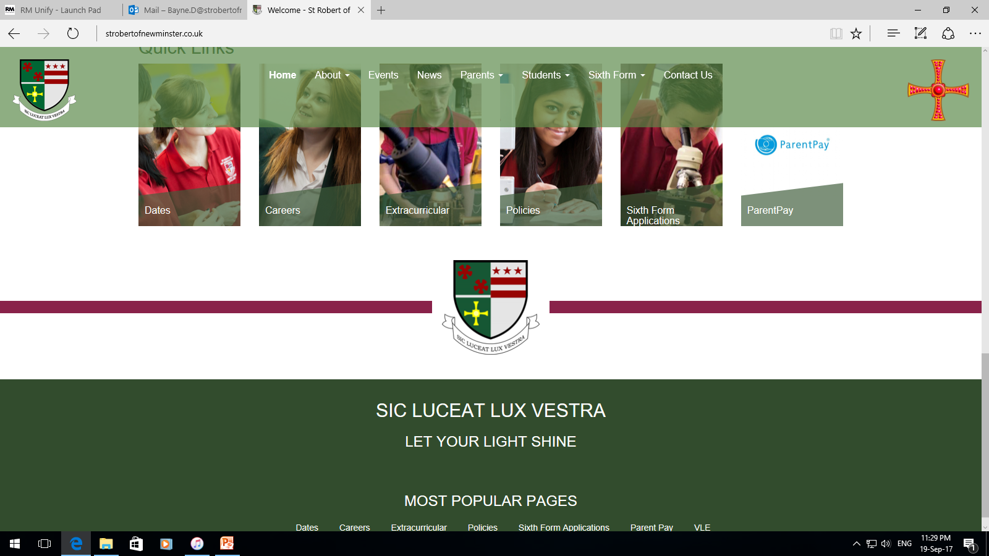
St Robert’s 6th Form
80% of students progress to university.
Successful record of students to Oxbridge, Medicine, Dentistry and Veterinary Science.
32% of students go to Russell Group universities.
Over 35 courses.
Wide range of enrichment activities.
Most successful 6th Form in Sunderland area.

Slide 12
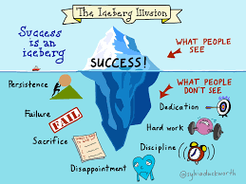
Expectations
Behaviour
Equipment
Personality
Revision
Effort
Persist
Aspire
Resilience
Engage
Dedication
Notes:
Behaviour: highest standard; mature approach to school within and outside of classrooms
Equipment: Pen, pencil, calculator, compass, protractor, ruler, green pen
Personality: Enquiring mind to learning to develop analysis and evaluation assessment objectives; treat internal assessments e.g. practical assessment in Science, just as seriously as external assessments
Revision: Ownership of your workload; use revision resources; create a revision timetable; start now not just before the exams
Effort: Give 100%; try your best
Persist: Try and try again
Aspire: to be the very best; look ahead to 6th form subjects; employment; apprenticeship requirements
Resilience: will find it hard; use the support around you at home and school; 2 years of learning and challenging concepts
Engage: in the learning in and out of the classroom; homework tasks complete to prepare, consolidate, extend learning do best standard first time on time e.g. RE takeaway homework
Dedication: to yourself and your aspirations through your work

Slide 13
Mr Davis
Head of Department: RE

Slide 14

Students will complete 3 exams in summer 2019
Exam 1: Catholic Theology
Monday 13th May p.m.
Exam 2: Applied Catholic Theology
Monday 20th May a.m.
Exam 3: Judaism
Thursday 23rd May p.m.

Slide 15
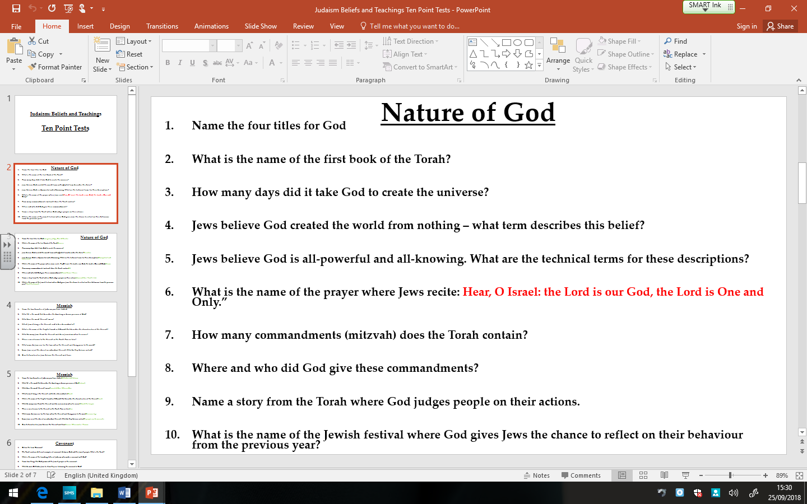
Study Support
All students in Year 11 will complete a weekly ten point test based on previous learning from Year 10.
These will be collated in a revision book.

Slide 16
Study Support
All students in Year 11 will complete a weekly ten point test based on previous learning from Year 10.
These will be collated in a revision book.

Slide 17
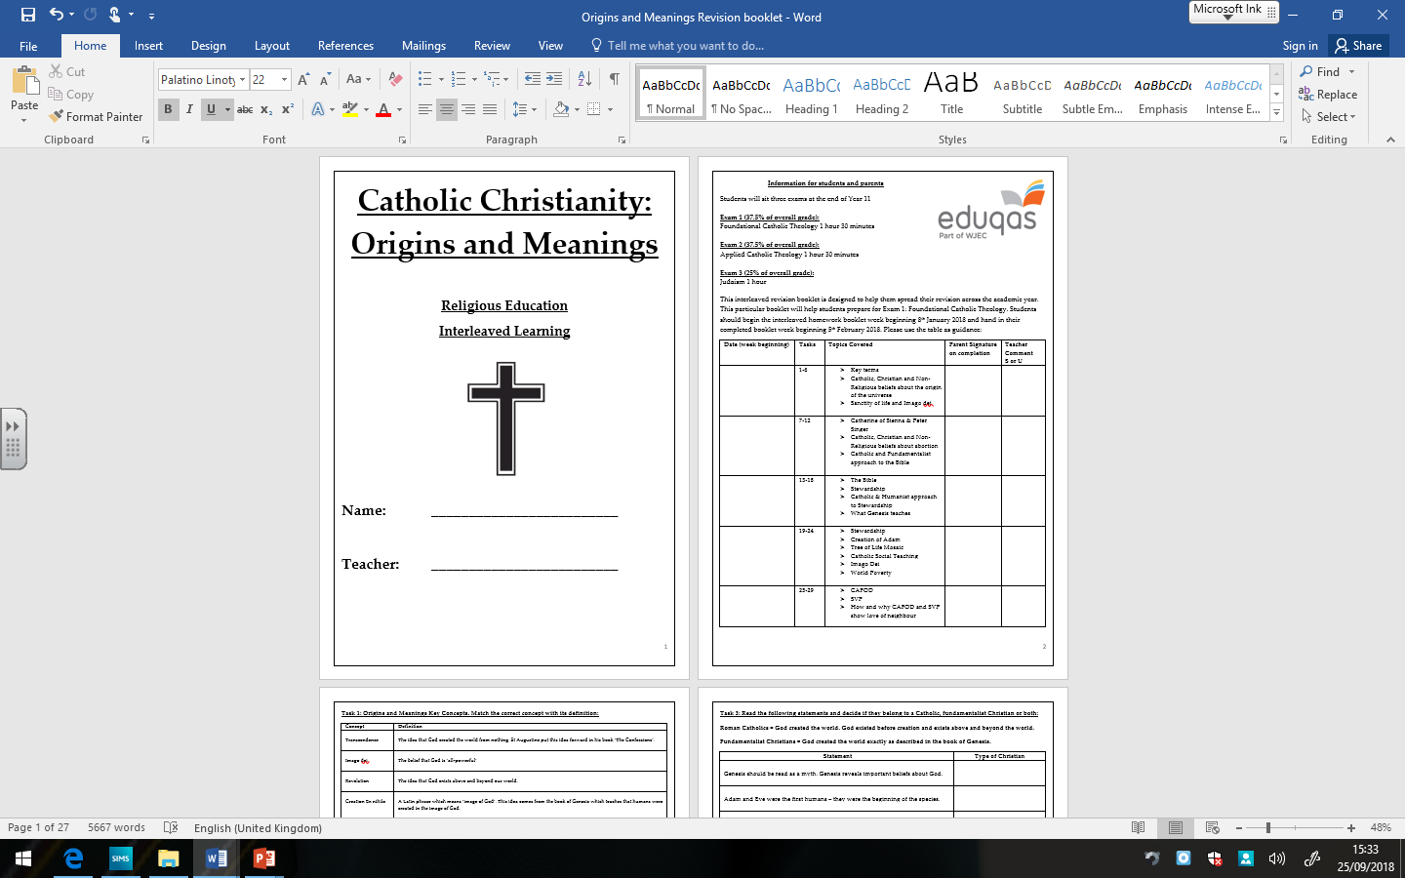
Study Support
Year 11 students will be provided with task booklets based on areas they have studied.
The booklets will ensure that weekly revision is complete.

Slide 18
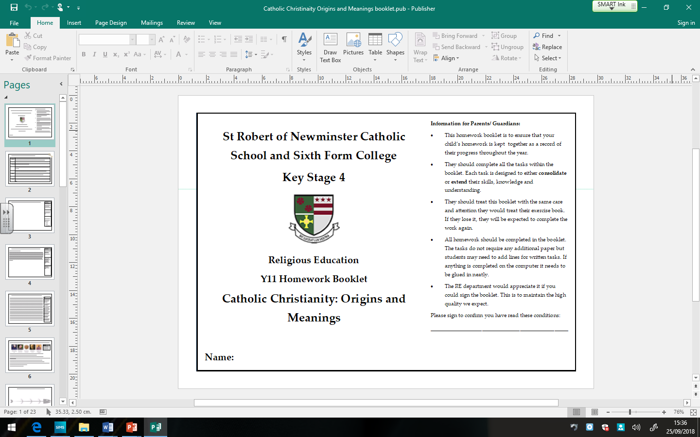
Study Support
All Year 11 pupils will be supplied with homework booklets.
These require pupils to complete weekly tasks to consolidate and extend learning.

Slide 19
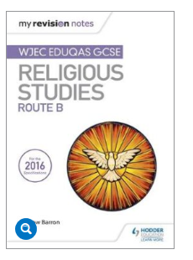
Study Support
Hodder publishing have recently produced a revision book to support the GCSE.
This retails at £9.99 on Amazon with free delivery.

Slide 20
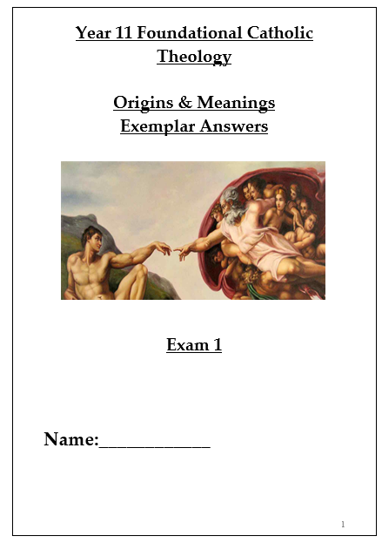
Study Support
The RE Department have also created their own revision resources.
Later in the year each pupil will be issued with an exemplar answers booklet for each of their exams.

Slide 21
Mrs Bruce
Head of Department: MFL

Slide 22
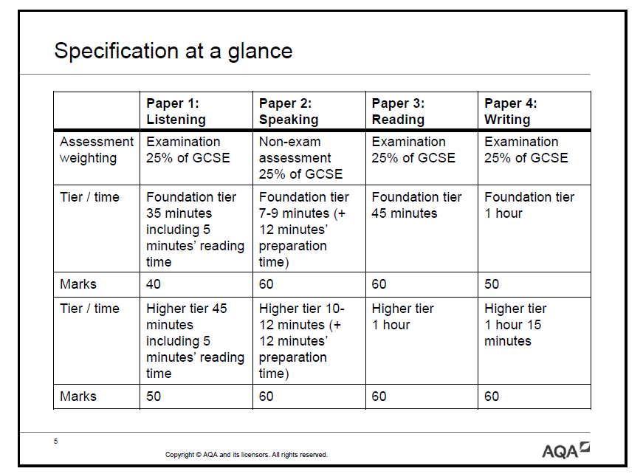
Achievement
Success is the sum of small efforts,
repeated day in and day out.
Robert Collier

Slide 23
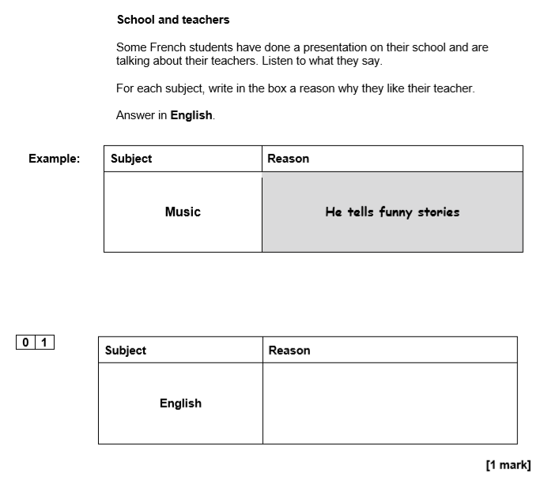
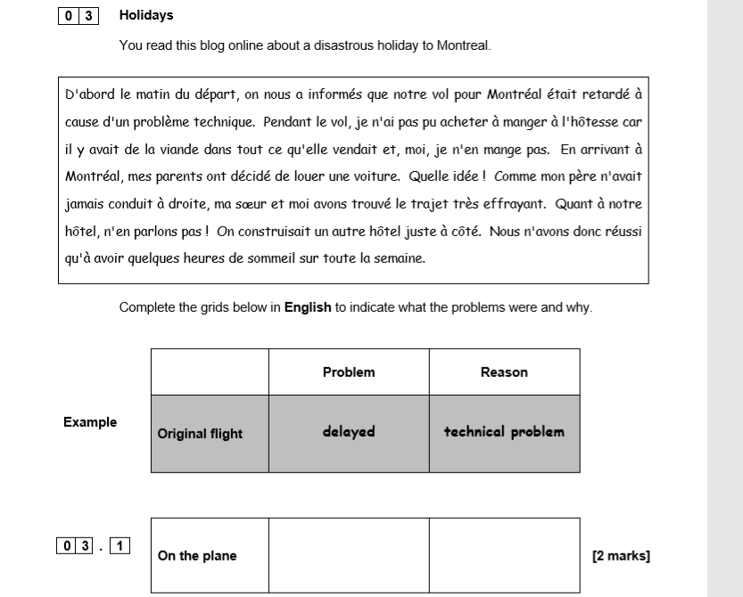
Listening Paper Q
Reading Paper Q

Slide 24
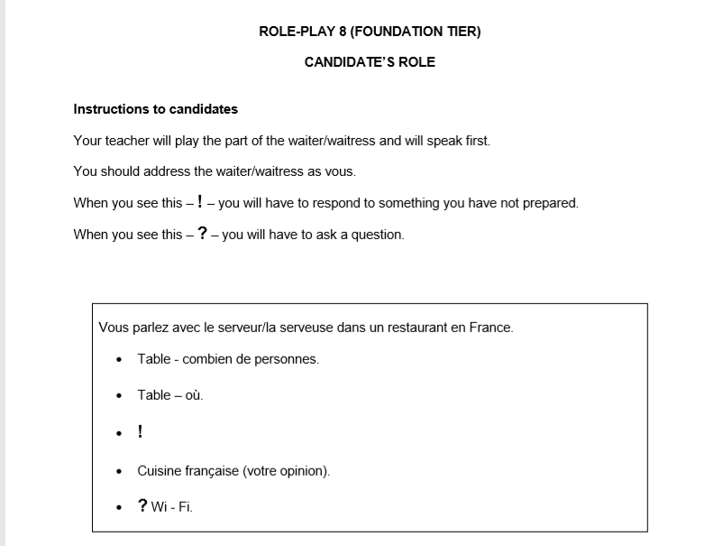
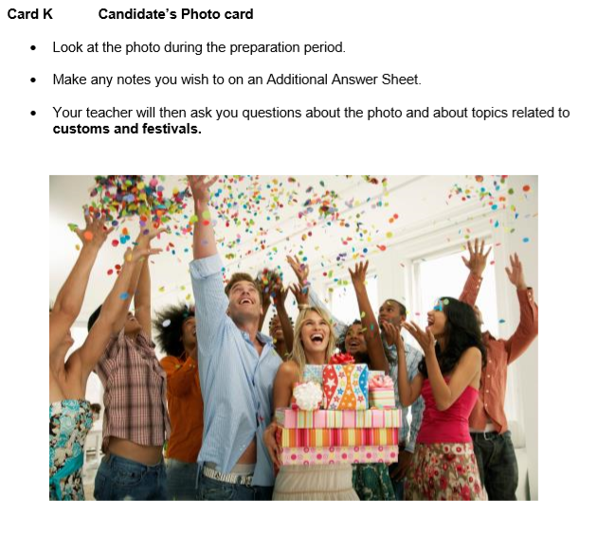
Role Play – Speaking Paper
Photo Card – Speaking Paper

Slide 25
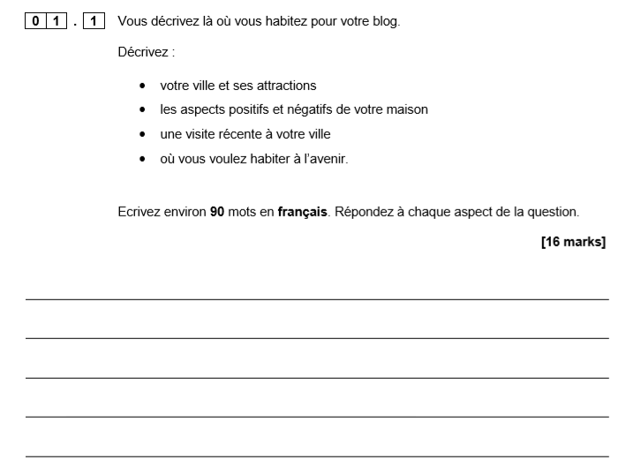
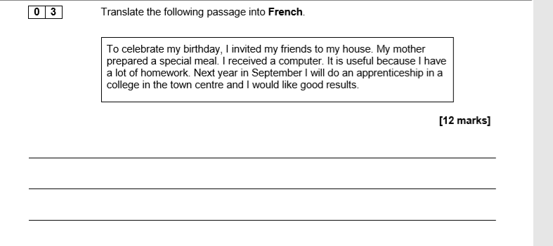
Writing Paper Q 90/150 words
Writing Paper Q Translation into French

Slide 26

MFL Intervention groups 2018-19
French
Aim High!
Aim Higher!
Aspiring for A Level
Drop ins and mentoring
Spanish
Sixth Form mentoring
Aspiring for A Level
German
Aspiring for A Level

Slide 27
MFL Exam Dates Summer 2019
French
Tuesday 14th May 2019 am Listening + Reading
Friday 17th May 2019 am Writing
Spanish
Wednesday 22nd May 2019 am Listening + Reading
Wednesday 5th June 2019 am Writing
German
Wednesday 12th June 2019 am Listening + Reading
Monday 17th June 2019 am Writing

Slide 28
Mr Brettell
Head of Department: English

Slide 29
15th May: English Literature (Shakespeare & 19th century novel)
23rd May: English Literature (Modern texts & poetry)
4th June: English Language (creative reading & writing)
7th June: English Language (writers’ viewpoints & perspectives)

Slide 30
GCSE English Language
Paper One (50%)
Explorations in Creative Reading and Writing
Paper Two (50%)
Writers’ Viewpoints and Perspectives
Non- exam assessed
Spoken Language
Section A (25%): Reading based on a literature text
Section B (25%): Descriptive or Narrative task
Section A (25%): Reading based on a non-fiction text and a literary non-fiction text
Section B (25%): Writing to present a viewpoint e.g. argue, persuade
A spoken assessment: presenting and responding to questions using Standard English.
50 % of total GCSE
Exam: 1 hr 45 mins
80 marks
50 % of total GCSE
Exam: 1 hr 45 mins
80 marks
0 % of total GCSE

Slide 31
Details of 2 YEAR GCSE course: GCSE English Language
Assessment is by examination only
There are 2 exam papers
The exams are un-tiered
Grades will be assigned using the new numbered system (Grades 9 – 1, where Grade 9 represents the top 5% of students who would previously have been awarded A*)
Students will study:
Reading and comprehension skills using a range of fiction and non-fiction texts from the 19th, 20th and 21st century
Writing to describe and narrative writing skills
Discursive writing skills
Technical accuracy in spelling, punctuation and grammar (20% 0f GCSE grade)

Slide 32
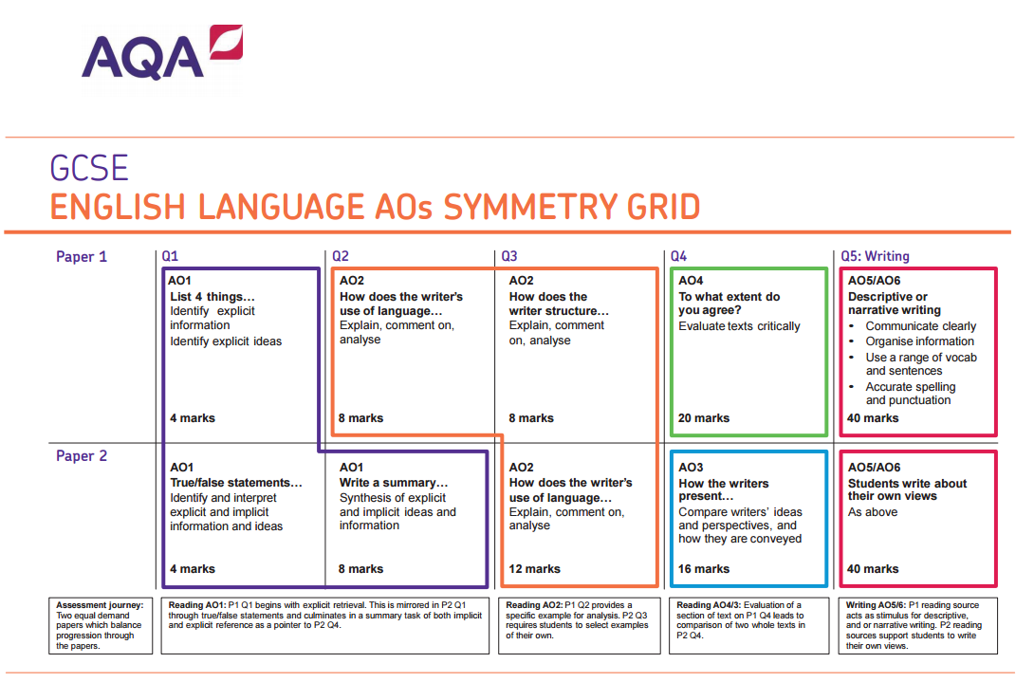
Essentially: identification and summary,
language analysis,
the ability to comment on a text’s structure,
the ability to compare texts,
being able to debate and evaluate a particular viewpoint,
creative writing element

Slide 33
GCSE English Literature
Paper One (40%)
Shakespeare and the Nineteenth Century novel
Paper Two (60%)
Modern Texts
and Poetry
The core skills are the same in Literature as they are in Language and students will be prompted to recognise this
Section A:
Modern novel or play
An Inspector Calls
Section B:
Anthology Poetry
Power and Conflict
Section C:
Unseen Poetry
Section A:
Shakespeare play
Macbeth
Section B:
Nineteenth century novel
A Christmas Carol
40 % of total GCSE
Exam: 1 hr 45 mins
64 marks
60 % of total GCSE
Exam: 2 hrs 15 mins
96 marks

Slide 34
Details of 2 YEAR GCSE course:
GCSE English Literature
Assessment is by examination only
There are 2 exam papers
The exams are un-tiered
Grades will be assigned using the new numbered system (Grades 9 – 1, where Grade 9 represents the top 5% of students who would previously have been awarded A*)
Students will study:
Macbeth
A Christmas Carol
An Inspector Calls
Power and Conflict Poetry
Unseen Poetry
Paper 1
Paper 2

Slide 35
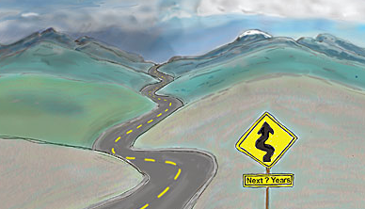







In-class intervention
Poetry lectures and ‘Inside the Writer’s Studio’ events
Weekly morning sessions
Targeted small cohorts
Thursday skillset sessions
Aiming high sessions
Tutorial time

Slide 36
Mr Medd
Head of Department: Mathematics

Slide 37
5th June: Paper 1 (non-calculator)
12th June: Paper 2 (calculator)
14th June: Paper 3 (calculator)

Slide 38
Details of 2 YEAR GCSE course
AQA GCSE Mathematics (8300)
Entirely linear
Exam board is AQA
Website www.aqa.org
Two tiers: Higher (grades 4-9), Foundation (grades 1-5)
Some change in content, some change in how questions are asked

Slide 39
Examinations
Three exams, all sat in Summer 2019
Paper 1 non-calculator, Paper 2 & 3 calculator
Each worth 80 marks
Total mark = grade

Slide 40


Level 2 Further Maths
Only students in 11N1 and 11R1
AQA
Linear Course
Can also achieve A^ (A* with distinction!)
Level 2 Further Mathematics (8360)
Website: www.aqa.org.uk

Slide 41
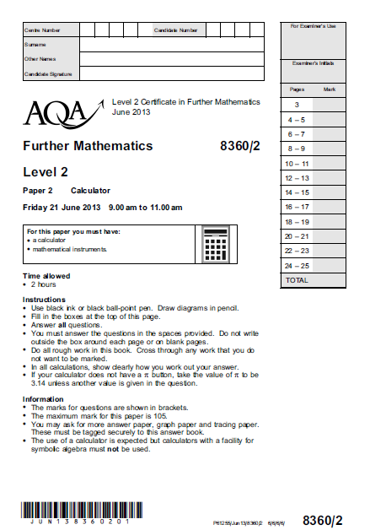
Exam Information
Two written papers: non-calc contributes 40% of the final grade, calc 60%.
Pupils will sit two exam papers: non-calc 1 hour 30 minutes, calc 2 hours.
Paper 1 – Non calculator
Paper 2 – Calculator

Slide 42
Assessment
Homework: often past exam questions and revision material as well as topics learnt in class.
Topic tests: will be used in class or as homework so as to identify areas of strength and weakness
In class assessment: internal regular examination-style tests. Used to inform progress. These are GCSE papers so grade will be entirely realistic.
Revision can be done using notes in exercise books, revision guides and revision websites, BUT KEY IS APPLICATION OF THE KNOWLEDGE:
CORBETT MATHS http://corbettmaths.com/
HEGARTY MATHS http://www.hegartymaths.com/
MATHS CASTS https://www.sites.google.com/site/mathscasts/
THE MATHS TEACHER http://www.themathsteacher.com/
ONMATHS https://www.onmaths.com/

Slide 43
Mr Wylam
Head of Department: Science

Slide 44
Science
GCSE Combined Science: Trilogy
GCSE Biology/Chemistry/Physics

Slide 45
14th May: Combined & Separate Biology Paper 1
16th May: Combined & Separate Chemistry Paper 1
22nd May: Combined & Separate Physics Paper 1
7th June: Combined & Separate Biology Paper 2
12th June: Combined and Separate Chemistry Paper 2
14th June: Combined & Separate Physics Paper 2

Slide 46
Details of the courses we offer
AQA GCSE Combined Science: Trilogy
4 hours of Science per week
6 exams in May/June 2018
2 exams per subject
Each paper lasts 1 hour 15 minutes and accounts for 16.7% of GCSE
Students will gain two GCSEs at the end of the course
AQA GCSE Biology/Chemistry/Physics
6 hours of Science per week
6 exams in May/June 2018
2 exams per subject
Each paper lasts 1 hour 45 minutes and accounts for 50% of each GCSE subject
Students will gain three GCSEs at the end of the course

Slide 47

Awarding Qualifications
The qualification will be graded on a 17-point scale
A student taking Foundation Tier assessments will be awarded a grade within the range of 1 – 1 to 5 – 5
A student taking Higher Tier assessments will be awarded a grade within the range of 4 – 4 to 9 – 9

Slide 48
Developing Mathematical Skills
Science and Maths go hand in hand
It is important our students can apply the skills they learn during maths lessons in science
The mathematical content has increased – between 10% (Biology) and 30% (Physics) of questions will include mathematical applications
A scientific calculator is essential for success in Science

Slide 49
Developing Extended Response
The amount of detail is key
Students need to be able to explain and describe how systems are related
Trying hard, being resilient, reading key content and asking for help are all needed
Improvement tasks are given for exactly this – to improve

Slide 50
Developing Practical Skills
Students will be required to complete a series of practical experiments to develop their scientific thinking skills and understanding
Combined Science carry out eight per subject (a total of 24 over two years)
Separate Science students will carry out ten per subject (a total of 30)
Practical skills will be evaluated through the final examinations through questions designed to test students’ understanding

Slide 51
Assessment
Students are assessed regularly in Science through end of topic assessments either set as homework or in class assessments.
We expect students to prepare for in class assessments just as they would for the summer
Used to track students and put intervention in place when necessary and also supports tier of entry.
Assessments and homework tasks are made up of past exam questions to help students understand the language used by AQA.

Slide 52
Preparation for Examinations
Homework: Homework is essential for consolidation of classwork.
Revision & Independent Study: We are developing students’ ability to self study. They should constantly be revising and trying new techniques to find the ones best suited for them.
Revision Guides: are very useful to support learning and may be purchased at a reduced cost from the Science department.
Revision Classes: These will be focused at certain groups throughout the year. Encourage your child to come along and take part.

Slide 53
Year 11 Examination Dates 2019
 | Biology | Chemistry | Physics
Paper 1 | Tue 14th May | Thu 16th May | Wed 22nd May
Paper 2 | Fri 7th June | Wed 12th June | Fri 14th June
26 weeks until the first exam (not including holidays)!
Approximately 52 lessons for Separate Science
Approximately 35 lessons for Combined Science

Slide 54
Mr Clark
Assistant Head Teacher
Revision Techniques

Slide 55
 | Mon 20th | Tues 21st | Wed 22nd | Thur 23d | Fri 24th | Sat 25th | Sun 26th
Homework
Coursework
Revision

Slide 56


Slide 57
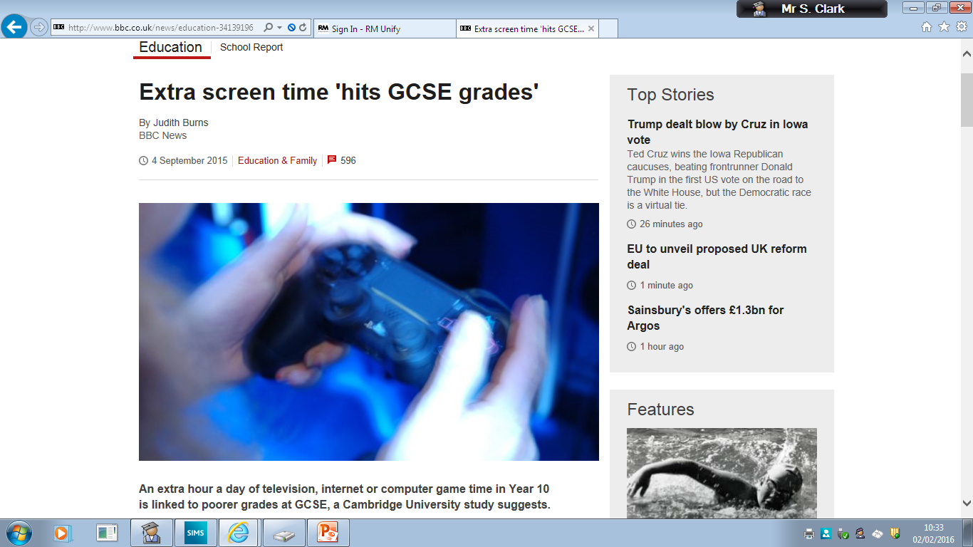

Slide 58


Slide 59


Slide 60
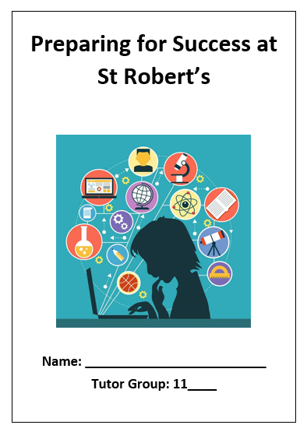
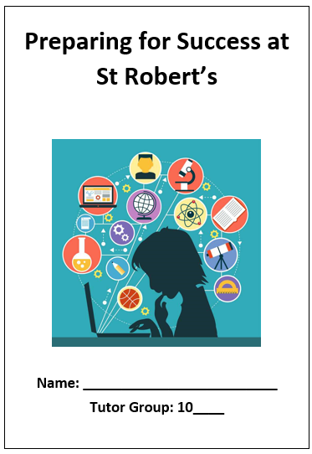
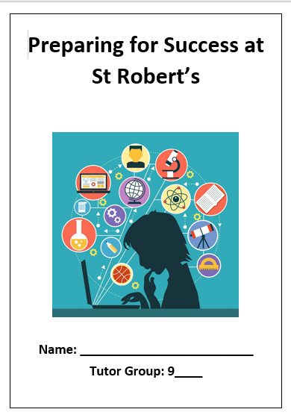
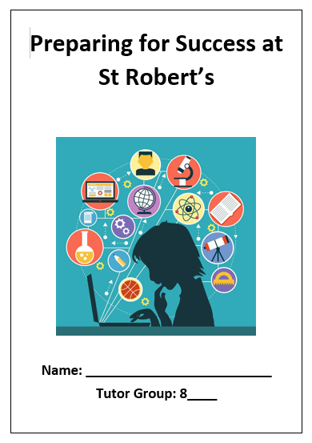
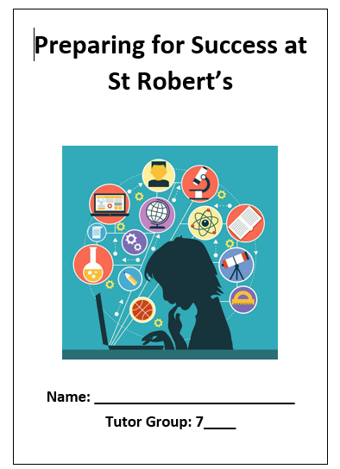
Notes:
We focus on…………….

Slide 61
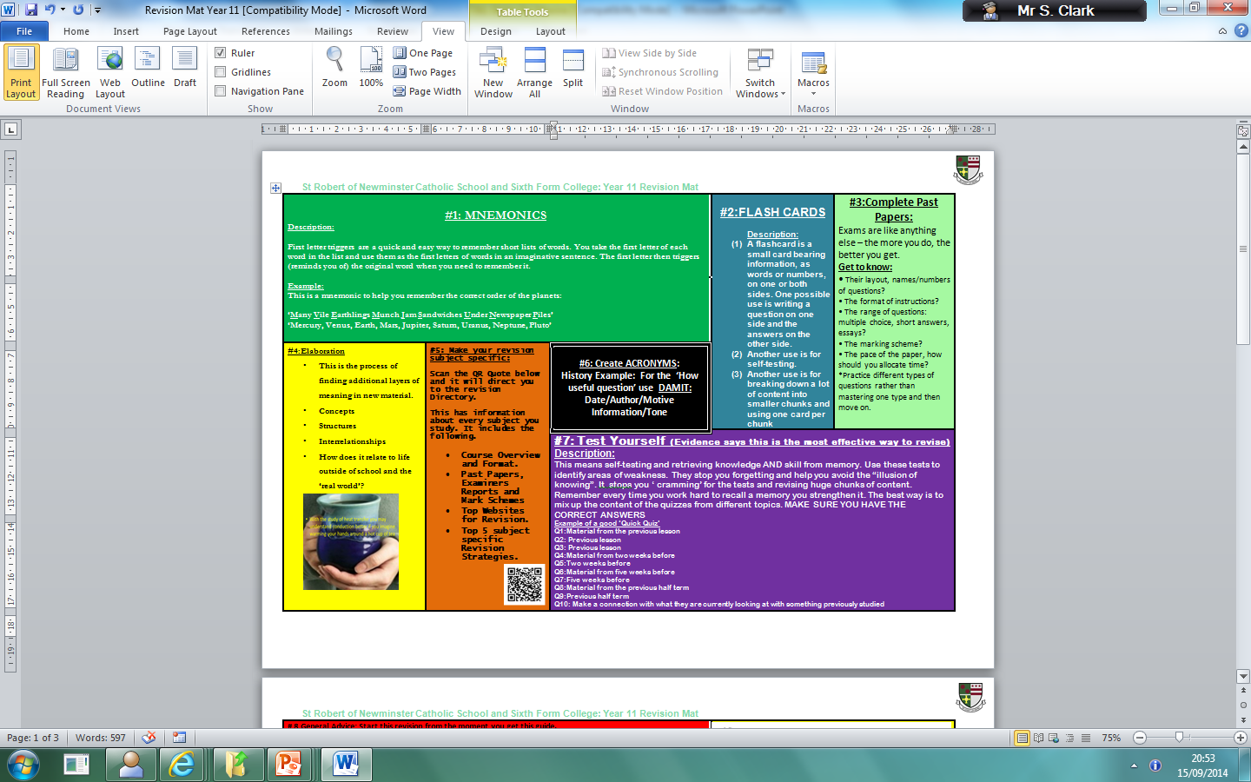

Slide 62
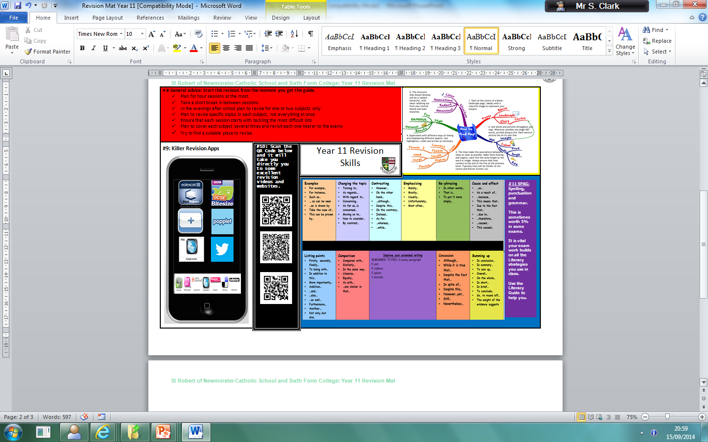

Slide 63
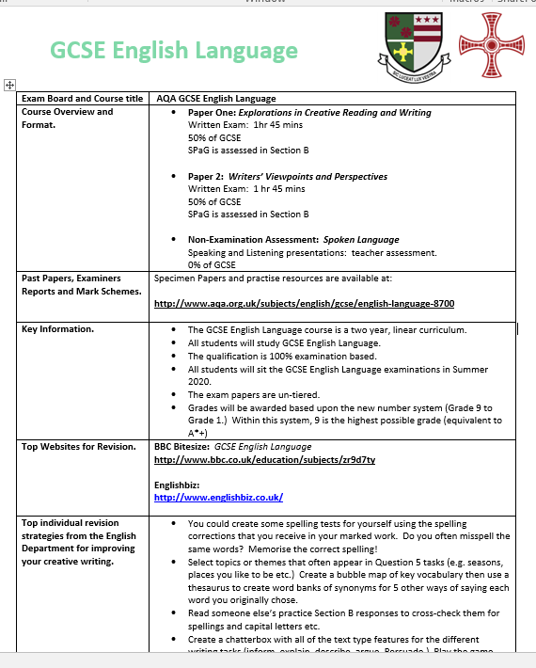
Departmental Revision Guides

Slide 64
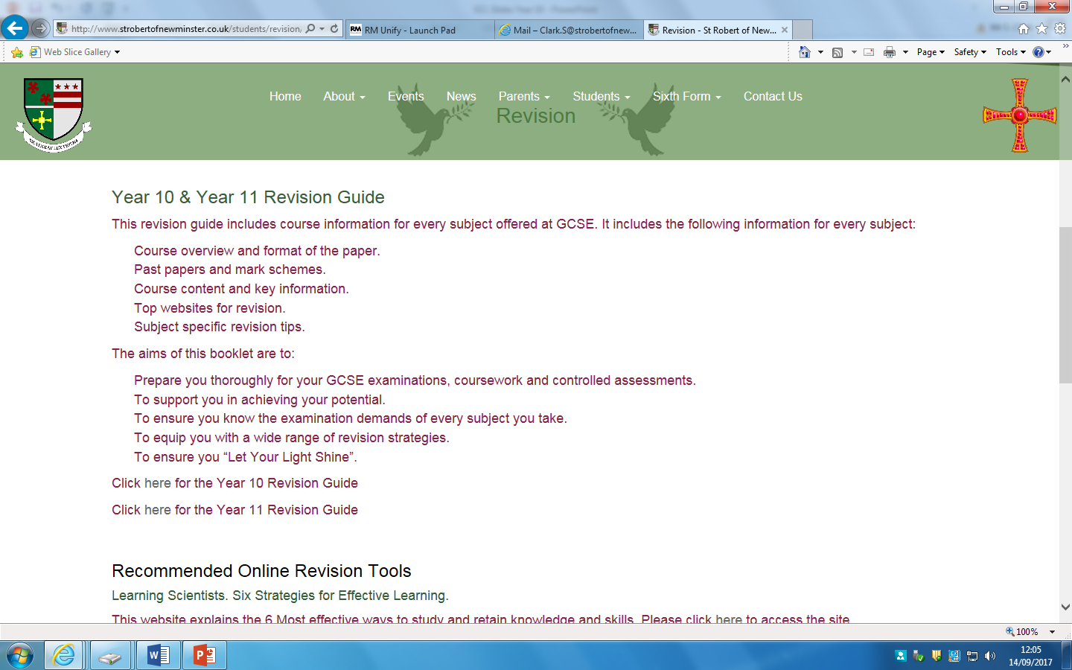

Slide 65
Mrs Dunn
Assistant Head Teacher
GCSE POD

Slide 66


Slide 67
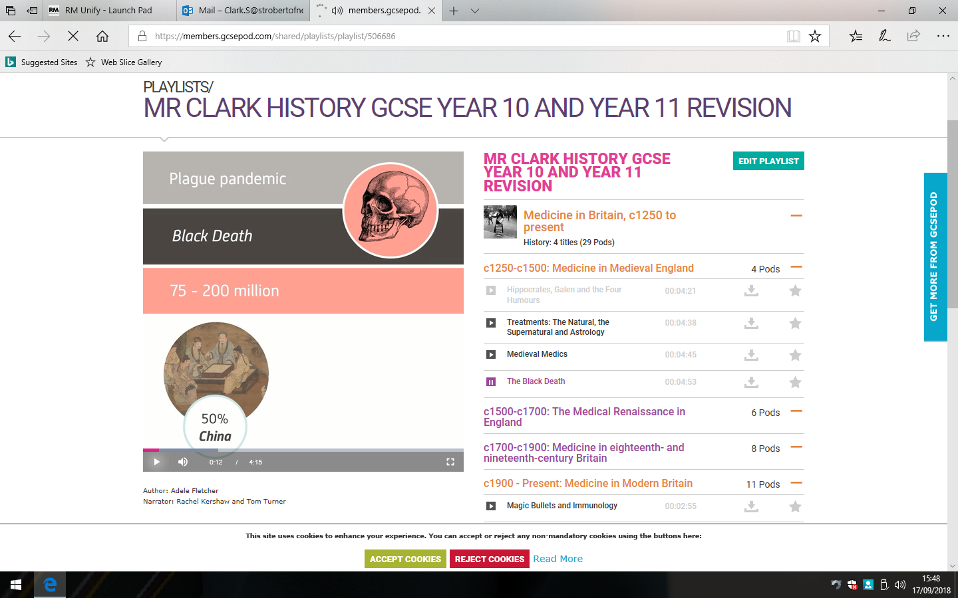

Slide 68
Mr McHale
Senior Assistant Head Teacher (Pastoral)

Slide 69
How do I seek advice from the school?
If you need any advice from the school contact your child's Head of House.
Mrs Duncan - St Aidan Lindisfarne
Mrs Hilburn-Mulhatton - St Cuthbert Durham
Mrs McHale - St Godric Finchale
Mr Thompson - St Hilda Whitby
If there is a personal issue Mrs Hughes- school social worker is available.
If there is an attendance issue Mrs Moran/Mrs Devlin are the attendance team.
You could communicate with subject staff or mentors (where applicable) via the planner.

Slide 70
Parents/Carers – How can I help?????

Slide 71
I don’t understand all these controlled assessments, levels and exams – its completely different from when I was at school.
I can’t stand the arguments when I try to help....
I’m surprised she’s not got any homework, I expected more in Year 11
Surely she shouldn’t be going out again when she’s studying for GCSE’s?
He’s always got an excuse, I don’t know what to believe!
I’ll just write her a note to excuse her late homework, just this once....
Notes:
Common frustrations/reactions from Parents.

Slide 72
The Biggest Challenge: Priorities
Friendships
Family life
Social life
Hobbies
Clubs
Fashion
Romantic Concerns
GCSE’s?

Slide 73
A Partnership
You are the expert on your own child and always have been his or her most important teacher.
Your support, encouragement and interest can make a spectacular difference to your child’s motivation and ability to cope with demands of GCSE.

Slide 74
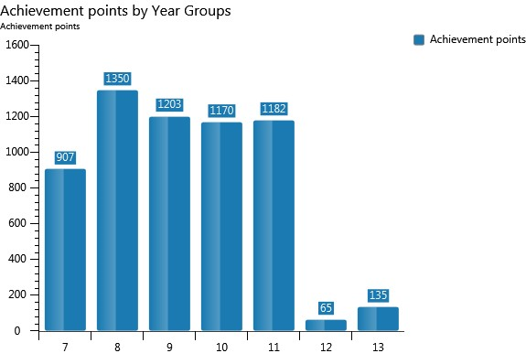

Slide 75
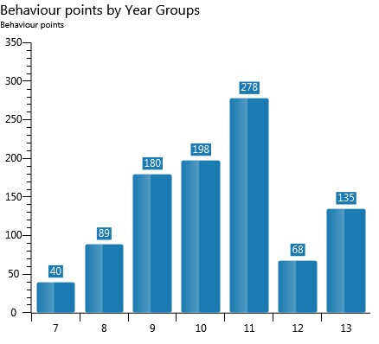

Slide 76
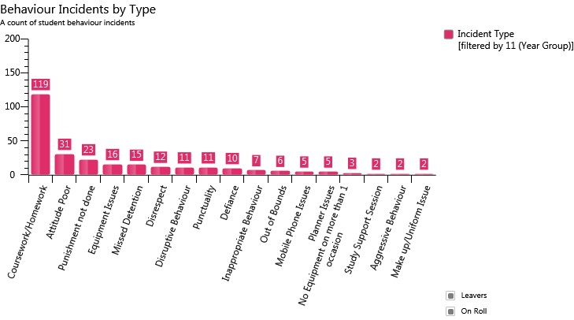

Slide 77
Attendance
A GCSE in under 5 days???
You may think you’ve got forever BUT look at how many hours of lessons you have in Year 10.
Eng/Maths/Sci 6.5 days (4 hrs per week)
Opted Subjects 3.25 days (2hrs per week)
You will cover most topics only once in these hours so learning first time round is the key to successful revision and exam results!
Every Lesson Counts!!!!!!!!!!!
Notes:
4hrs per week x 39 weeks = 156 / 24 hrs in a day = 6.5 days

Slide 78
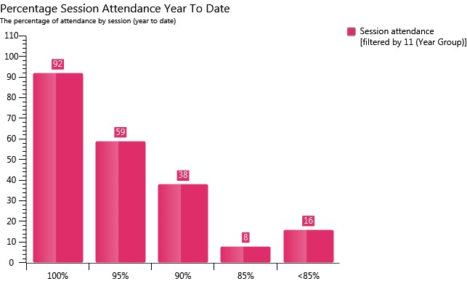

Slide 79
What you can do right now:
Check your child’s planner weekly and sign it.
Use the planner to communicate with Head of House/Tutor/Subject teacher.
Ensure your child is equipped for each and every lesson.
Check your child is completing homework, encourage good presentation of work in books.
Show an interest – ask them to explain what they are enjoying at school?
Ensure your child attends and is punctual every day.
Support the School.

Slide 80
Thank You

