Slide 1
6th Form Open Evening

Slide 2
Mr Juric Headteacher

Slide 3
Why choose St Robert’s?
Welcoming Sixth Form with many external students
Ethos – High standards within a caring Catholic setting
Experience and Track Record
Size and Range
Outcomes: Results and Progression

Slide 4
Mr Bayne Head of 6th Form

Slide 5
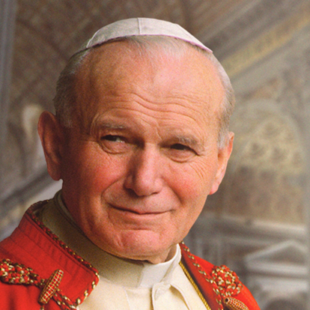
Pope John Paul II
“Catholic education aims not only to communicate facts but also to transmit a coherent, comprehensive vision of life, in the conviction that the truths contained in that vision liberate students in the most profound meaning of human freedom”

Slide 6
Mr D Bayne
Head of Post16
Mr D Dent
HoY12
Mrs H Macklon
AHoY12
Miss B Salmon
HoY13
Mr J Flavell
AHoY13
Ms R Convery
14-19 IAG, EPQ
Mrs T Green
Attendance
Ms A Lee
Admin
6th Form Team

Slide 7
Results
 | St Robert’s | Sunderland Average
A*-A | 23% | 20%
A*-C | 77% | 75%
Pass | 98% | 98%

Slide 8
Results
 | St Robert’s | Sunderland Average
AAB in Facilitating subjects | 14.1% | 10.8%
Technical Level PPE | 37.1 | 33.9

Slide 9
Results
Only Sixth Form or College in Sunderland area to have positive Value Added (VA) for the last two years.
+0.07 VA in 2017.
Positive VA in 2018.

Slide 10
Where do our students go to?
160 students to university.
Oxbridge, Medicine, Dentistry, Veterinary.
32% going to Russell Group universities.
Employment.
Apprenticeships.

Slide 11
What to study?
49 areas of study.
34 Institutions.
Law, Psychology, Chemical Engineering, Criminology, Environmental Science, Journalism, Primary Education, Architecture, Acting.

Slide 12
Ewan Lynn-Noble Head Boy
Isobel Marriner Deputy Head Girl

Slide 13
Skills for Success
Independent Working
Organisation
Research Skills
Community contribution
Progress

Slide 14
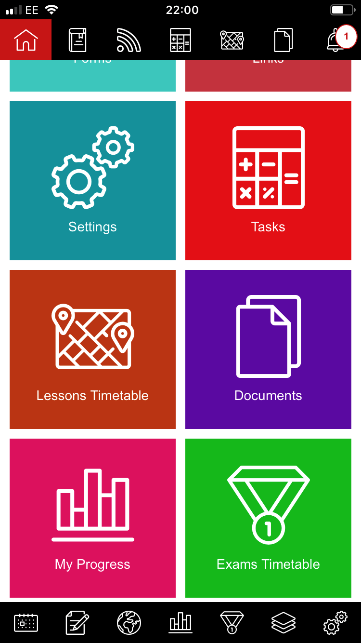
Student Planner App

Slide 15
Support
Pastoral system
Counsellor
Chaplain
Working with parents/carers

Slide 16
Facilities
Two Common Rooms.
6th Form café.
6th Form Library and study area.
Department study areas.

Slide 17
Opportunities
Prefects
Classroom support
Reading mentors
Duke of Edinburgh Award
6th Form Magazine
Sports Ambassadors
Work Experience
Extended Project Qualification (EPQ)

Slide 18
University Links
Northumbria - High Achievers
Newcastle University – Partners
Durham - Supported Progression
Sunderland – First Choice
Oxnet – Oxford and Cambridge

Slide 19
University Visits
Glasgow
Edinburgh
York & York St John
Leeds & Leeds Beckett
Sheffield
Manchester
Oxford/Cambridge

Slide 20
Next Steps
Apply online at our website.
Interview with 6th Form team.
Taster Day.
Register on GCSE Results Day.

Slide 21
Further Information
sixthform@strobertofnewminster.co.uk
@strobertsVIform
@StRobertofNewminster6thForm
stroberts6thform

