Slide 1
Year 12 Parents’ Information Evening
Email: sixthform@strobertofnewminster.co.uk
@StRobertsVIform

Slide 2
Outline
6th Form Team
Destinations
Student App
Key Dates
Key Issues
Opportunities
Mentoring
University Visits and UCAS

Slide 3
Mr D Bayne
Head of Post16
Mr D Dent
HoY13
Mrs H Macklon
AHoY13
Miss B Salmon
HoY12
Mrs A Christie
AHoY12
Ms R Convery
14-19 IAG, EPQ
Mrs T Green
Attendance
Ms A Lee
Admin

Slide 4
Destinations
145 students to university
Cambridge
Maryam Ahmed – History
Megan Robinson - Music
Oxford
Emmet O’Leary – History
Isabelle Saint - Chemistry
Medicine
Emily Ingham – Leeds
Lesedi Mphisa - Manchester
37% going to Russell Group universities

Slide 5
Areas of study
Business ​ | 13​
History​ | 12​
Law​ | 8​
Sport​ | 8​
Mathematics​ | 7​
Psychology​ | 7​
Sociology​ | 7​
Geography​ | 4​
Mechanical Engineering​ | 4​
Biomedical Science​ | 3​
Computer Science​ | 3​
Economics​ | 3​
Health and Social Care​ | 3​
Journalism​ | 3​
Nursing (Mental Health)​ | 3​
Pharmacy​ | 3​
Physics​ | 3​
58 areas of study

Slide 6
Places
Northumbria​ | 32​
Newcastle​ | 22​
Sunderland​ | 19​
Durham​ | 9​
Leeds Met​ | 6​
Teesside​ | 6​
York​ | 5​
De Montfort​ | 4​
Manchester​ | 4​
Manchester Met​ | 4​
Leeds ​ | 3​
York St John​ | 3​
32 Institutions

Slide 7
Autumn Term
Baseline Test: 23rd September
Grade Collection: 11th October
Baseline to Parents: 16th October
Half Term: 28th Oct – 1st Nov
End of Term: 20th December

Slide 8
Spring Term
Year 12 Assessment Week: 13th January
Grade Collection: 6th February
Half Term: 17th – 21st February
Year 12 Parent Evening: 26th February
INSET Day: 18th March

Slide 9
Summer Term
Easter Holidays: 6th – 17th April
Grade Collection: 24th April
Full Report to Parents: 1st May
Half Term: 25th May – 29th May
Year 12 Exams: 8th June
Exam Resits: 22nd June
Year 12 Exam Resit Week: 24th June

Slide 10
Summer Term
INSET Day: 26th June
University Visits: June and July
Grade Report to Parents: 10th July
Work Experience: 13th July
Term ends: 17th July

Slide 11
Key Issues
Attendance –
Leave of absence forms
Unexplained absence
Punctuality
Truancy (Internal)
Uniform

Slide 12
Behaviour
Attitude
Coursework/Homework
Suspicious Absence
Uniform

Slide 13
Achievements
Independent Working
Research Skills
Contribution
Progress

Slide 14
Uniform
Red Sixth Form polo shirt or rugby shirt with badge
Plain black Sixth Form cardigan, jumper or hoody.
Black shoes.
Plain black smart trousers.
Plain black skirt.

Slide 15
Support
Subject staff
Form Tutor
Mrs Green
6th Form Team
College counsellor

Slide 16
Opportunities
Independent Study Log
Prefects
Classroom support
Reading mentors
Sports Ambassadors
Work Experience
World Challenge
Extended Project Qualification (EPQ)

Slide 17
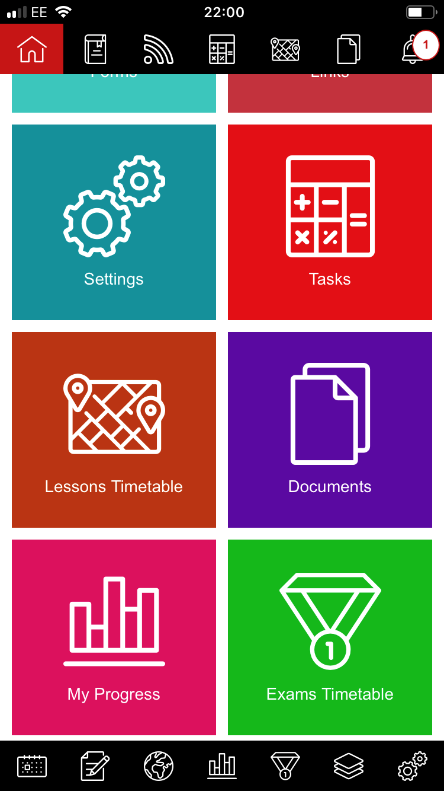

Slide 18
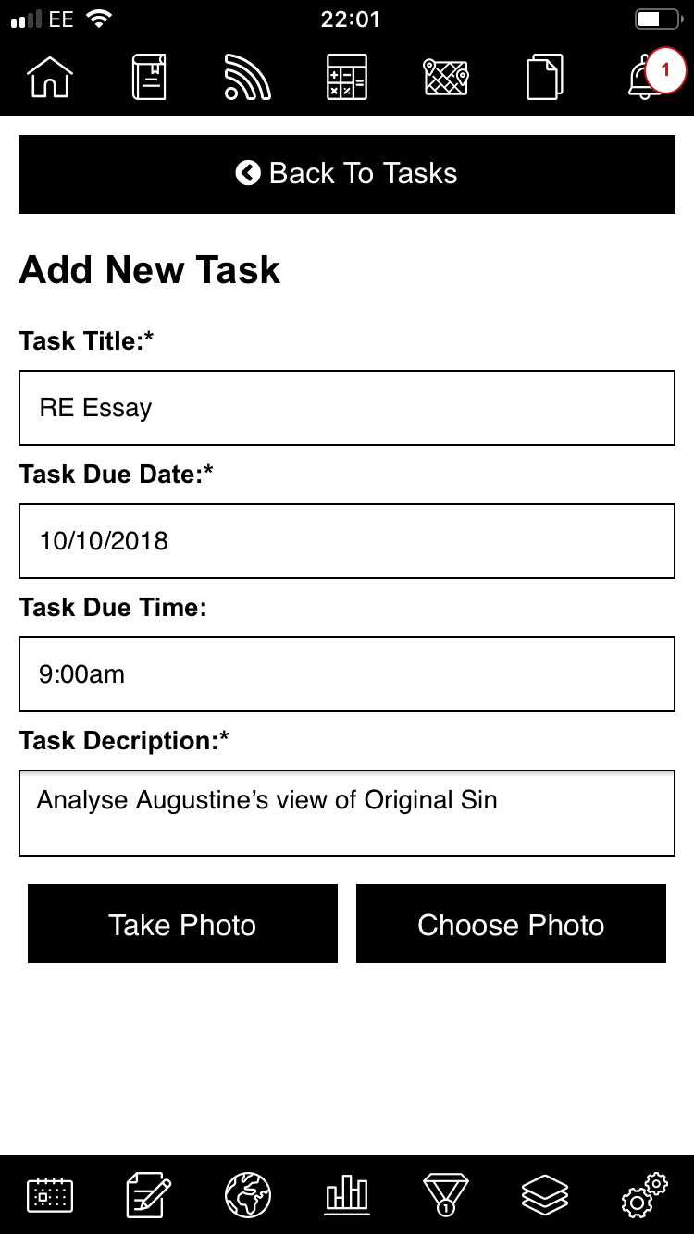

Slide 19
Work Experience
Mon 13th – Fri 17th July
Pupils/parents expected to find themselves a high quality Placement.
Company/Organisation completes the placement form.
All placements approved by Futureworks.
Deadlines for Forms: Friday 17th April

Slide 20
Placement Confirmation
Futureworks carry out a risk assessment of the placement to ensure it is safe and meets all safeguarding standards.
Once the placement has been vetted, the students will be notified if their Work Experience has been granted.
Careers interview.

Slide 21
Mentoring
In House Mentoring
Durham Mentoring – Hatfield College
University Mentoring Programmes - Oxbridge

Slide 22
University Support
Northumbria - High Achievers
Newcastle University – Partners
Durham - Supported Progression
Sunderland – First Choice
Oxnet – Oxford and Cambridge

Slide 23
UCAS
Application process late in Summer Term
Assigned an academic referee
Guidance on personal statements

Slide 25
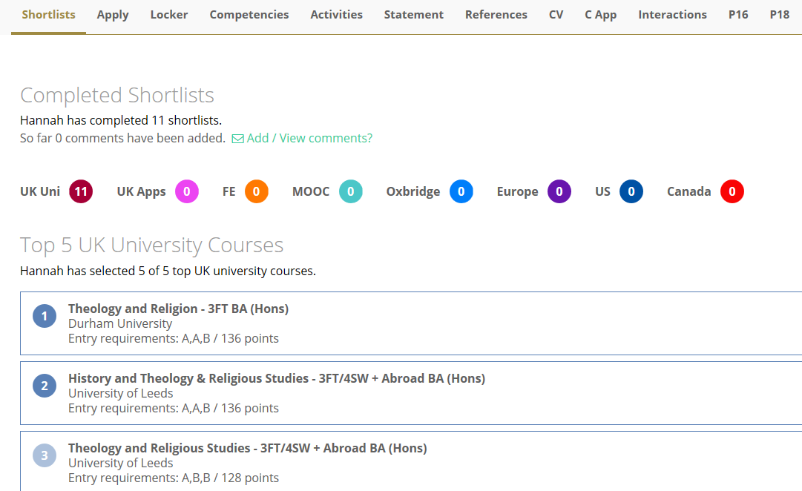

Slide 26
University Visits
Glasgow
Edinburgh
York & York St John
Leeds & Leeds Beckett
Sheffield
Manchester
Oxford/Cambridge

Slide 27
Email: sixthform@strobertofnewminster.co.uk
@strobertsVIform

