Slide 1

Helping my child to succeed at KS3
‘Let your Light Shine’
Welcome

Slide 2

Key Staff
Mrs Salmon: Senior Assistant Head Teacher (Achievement)
Mr McHale: Senior Assistant Head Teacher (Pastoral)
Mr Clark: Assistant Head Teacher (Teaching & Learning)
Mrs Dunn: Assistant Head Teacher (Achievement/Intervention)

Slide 3
Mr McHale
Senior Assistant Head Teacher

Slide 4
Welcome to Year 7
Pastoral Staff:
Mr McHale (Senior Assistant Headteacher)
Mr Green (Assistant Headteacher)
Mr Davis (Assistant Headteacher)
St Cuthbert, Durham | St Godric, Finchale | At Aidan, Lindisfarne | St Hilda, Whitby
Mrs Mullhatton | Mrs McHale | Mrs Duncan | Mr Thompson
Miss Martin | Miss Boxer | Miss Bone | Mr Hurst
Miss Fowler
2 tutor groups in St Godric, St Cuthbert and St Hilda.
3 tutor groups in St Aidan.

Slide 5
How do you communicate with us?
If you need any advice from the school contact your child's Head of House or Assistant Head of House.
You could communicate with tutors, subject staff or mentors via your child’s planner.
If your child needs extra support your child can be referred to Mrs Hughes our school Counsellor.
If there is an attendance issue Mrs Moran/Mrs Devlin are the attendance team. Please remember to telephone the school if your child is absent – a text message is not sufficient.

Slide 6
How do we communicate with you?
We may contact you about events and issues by letter.
Heads of House and Head’s of Department may telephone you to discuss an issue.
Staff will write notes for you in your child’s planner.
We send text messages to keep you up to date.
We send notifications via the MY ED App.
The school website is regularly updated.

Slide 7
A Partnership
You are the expert on your own child and always have been his or her most important teacher.
Your support, encouragement and interest can make a spectacular difference to your child’s motivation and ability to cope with demands of Secondary school.

Slide 8
Year 7 currently have 1808 achievement points.

Slide 9
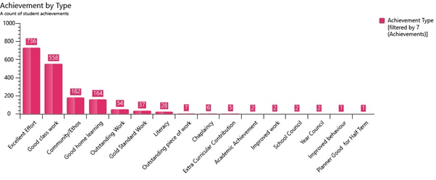

Slide 10
Year 7 currently have 129 behaviour points.

Slide 11
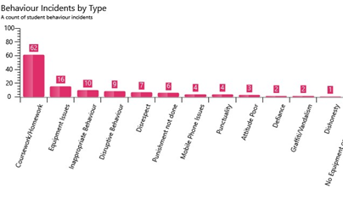

Slide 12
Attendance
As of Monday 7th October 2019 we have been back at school for 25 days.
If your child has been absent it has affected their attendance in the following ways:
1 day off school – Attendance = 96%
2 days off school – Attendance = 92%
3 days off school – Attendance = 88%

Slide 13
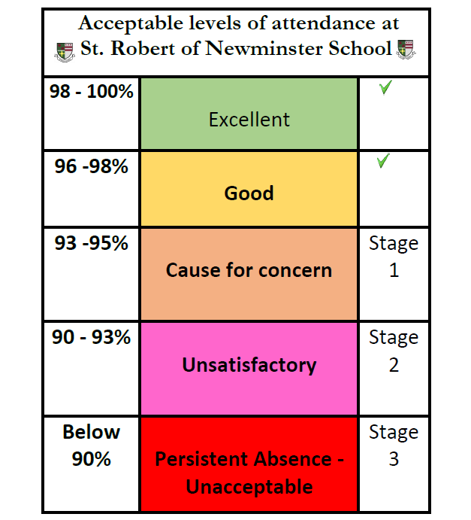

Slide 14
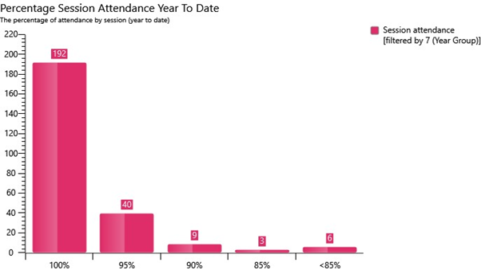
Attendance

Slide 15
What you can do right now:
Check your child’s planner weekly and sign it.
Ensure your child is equipped for each and every lesson.
Check your child is completing homework, encourage good presentation of work in books.
Ensure your child attends school every day and that they are always on time.
Ensure your child’s uniform is correct.
Show an interest – ask them to explain what they are enjoying at school?

Slide 16
Mrs Salmon
Senior Assistant Head Teacher

Slide 17
Curriculum
English (4hrs)
Maths (4hrs)
Science (3hrs)
RE (2hrs)
Spanish (2hrs)
PE (2hrs)
History (1hr)
Geography (1hr)
Art (1hr)
DT (2hr)
IT (1hr)
Music (1hr)
Tutorial (1hr)
Reading (30mins)
Assessment of Progress:
3 assessment points
2 Grade reports/1 Full report
Website:
Parent → Curriculum → KS3 Curriculum & Assessment

Slide 18
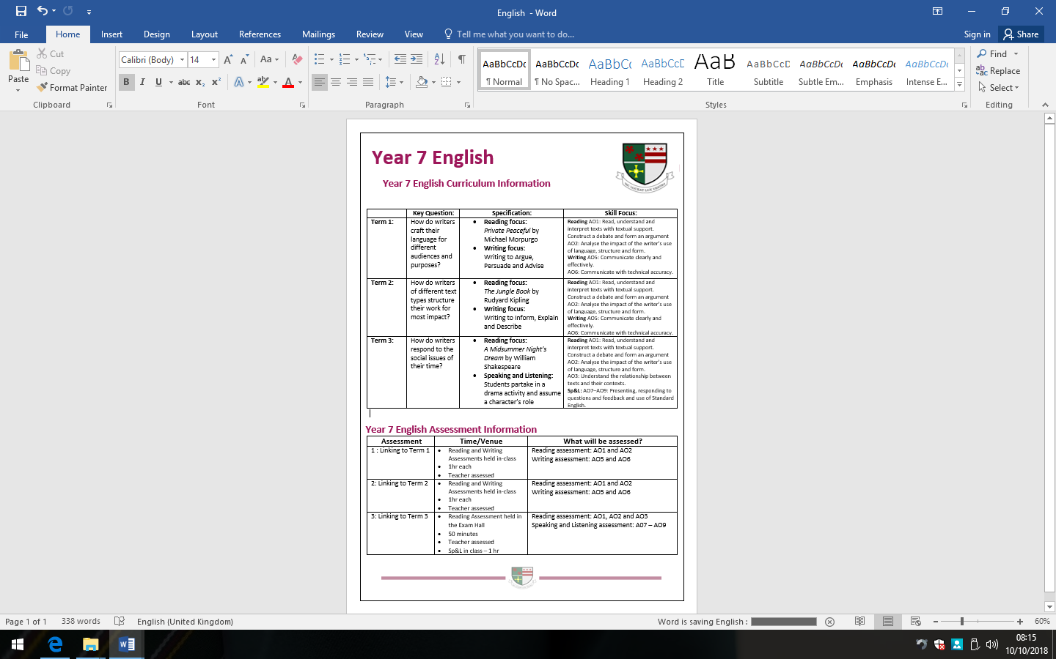

Slide 20
Student Progress Against Targets
Term 1
- October 2019: Teachers assess progress
- November 2019: Tutor Evening with Grade Report to Parents/Carers
Term 2
- February 2020: Teachers assess progress
- March 2020: Parents'/Carers' evening with subject teachers and Grade Report
Term 3
- June 2020: Teachers assess progress: Formal examination hall
- July 2020: Full Report and grades to Parents/Carers

Slide 21
GCSE Reform
Why?
In order to promote a more holistic learning experience and relieve demands of too much coursework, we have moved to linear assessment.
What?
Modular exams are exams that are taken at the end of each unit or part of the GCSE, while linear exams are exams taken at the end of the course.
(DfE 2014)

Slide 22
Assessment
Change in assessment at GCSE from grades to numbers.
Current Y7 (examined in 2024)
  All subjects will be assessed using numbers

Slide 23
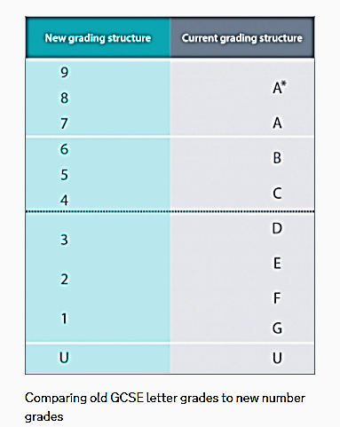
NEW
OLD
5 =
Strong Pass
4 = Standard Pass

Slide 24
Pupil Targets
KS2 | Autumn Y7 | Spring Y7 | Summer Y7 | Autumn Y8 | Spring Y8 | Summer Y8 | Autumn Y9 | Spring Y9 | Summer Y9 | Autumn Y10 | Spring Y10 | Summer Y10 | Autumn Y11 | Spring Y11 | Summer Y11 | New GCSE Grades | Old GCSE grades
 |  |  |  |  |  |  |  |  |  |  |  |  |  |  |  | 9 | ^
 |  |  |  |  |  |  |  |  |  |  |  |  |  |  |  | 8 | A*
 |  |  |  |  |  |  |  |  |  |  |  |  |  |  |  | 7 | A
 |  |  |  |  |  |  |  |  |  |  |  |  |  |  |  | 6 | B
 |  |  |  |  |  |  |  |  |  |  |  |  |  |  |  | 5 | C
 |  |  |  |  |  |  |  |  |  |  |  |  |  |  |  | 4 | D
 |  |  |  |  |  |  |  |  |  |  |  |  |  |  |  | 3 | E
100 |  |  |  |  |  |  |  |  |  |  |  |  |  |  |  | 2 | F
 |  |  |  |  |  |  |  |  |  |  |  |  |  |  |  | 1 | G
Y7: Pupils receive an end of Y7 target
Y8: Pupils receive an end of Y11 target
This ‘Aspirational target grade’ is the GCSE grade that your child should achieve based on their progress from KS2.

Slide 25
KS2 | Autumn Y7 | Spring Y7 | Summer Y7 | Autumn Y8 | Spring Y8 | Summer Y8 | Autumn Y9 | Spring Y9 | Summer Y9 | Autumn Y10 | Spring Y10 | Summer Y10 | Autumn Y11 | Spring Y11 | Summer Y11 | New GCSE Grades | Old GCSE grades
 |  |  |  |  |  |  |  |  |  |  |  |  |  |  |  | 9 | ^
 |  |  |  |  |  |  |  |  |  |  |  |  |  |  |  | 8 | A*
7+
7 |  |  |  |  |  |  |  |  |  |  |  |  |  |  |  | 7 | A
7-
6+
6 |  |  |  |  |  |  |  |  |  |  |  |  |  |  |  | 6 | B
6-
5+
5 |  |  |  |  |  |  |  |  |  |  |  |  |  |  |  | 5 | C
5-
4+
4 |  |  |  |  |  |  |  |  |  |  |  |  |  |  |  | 4 | D
4-
3+
3 |  |  |  |  |  |  |  |  |  |  |  |  |  |  |  | 3 | E
3-
2+
2 (100) |  |  |  |  |  |  |  |  |  |  |  |  |  |  |  | 2 | F
2-
1+
1 |  |  |  |  |  |  |  |  |  |  |  |  |  |  |  | 1 | G
1-
1W
1W
1W

Slide 26
Mrs Dunn
Assistant Head Teacher

Slide 27
Y7 class groupings
KS2 information on progress and transition information from Primary schools used to group students
Progress evaluated throughout the year
In year progress against targets and end of year progress in Y7 exams as well as KS2 results are used to set year 8 groups
Class groupings reviewed regularly in year 8 and reset again going into Y9 based on in year progress and end of year progress in Y8 exams

Slide 28
Class group structure for Year 7
Curriculum groups
Class groupings
English, Maths, MFL, Geography, History, Art, IT, Music, RE and Science
Design and Tech groups
Smaller groups taught on rotation of Food, textiles and product design
PE
PE groups slightly different to class groups

Slide 29
Mr Clark
Assistant Head Teacher

Slide 30
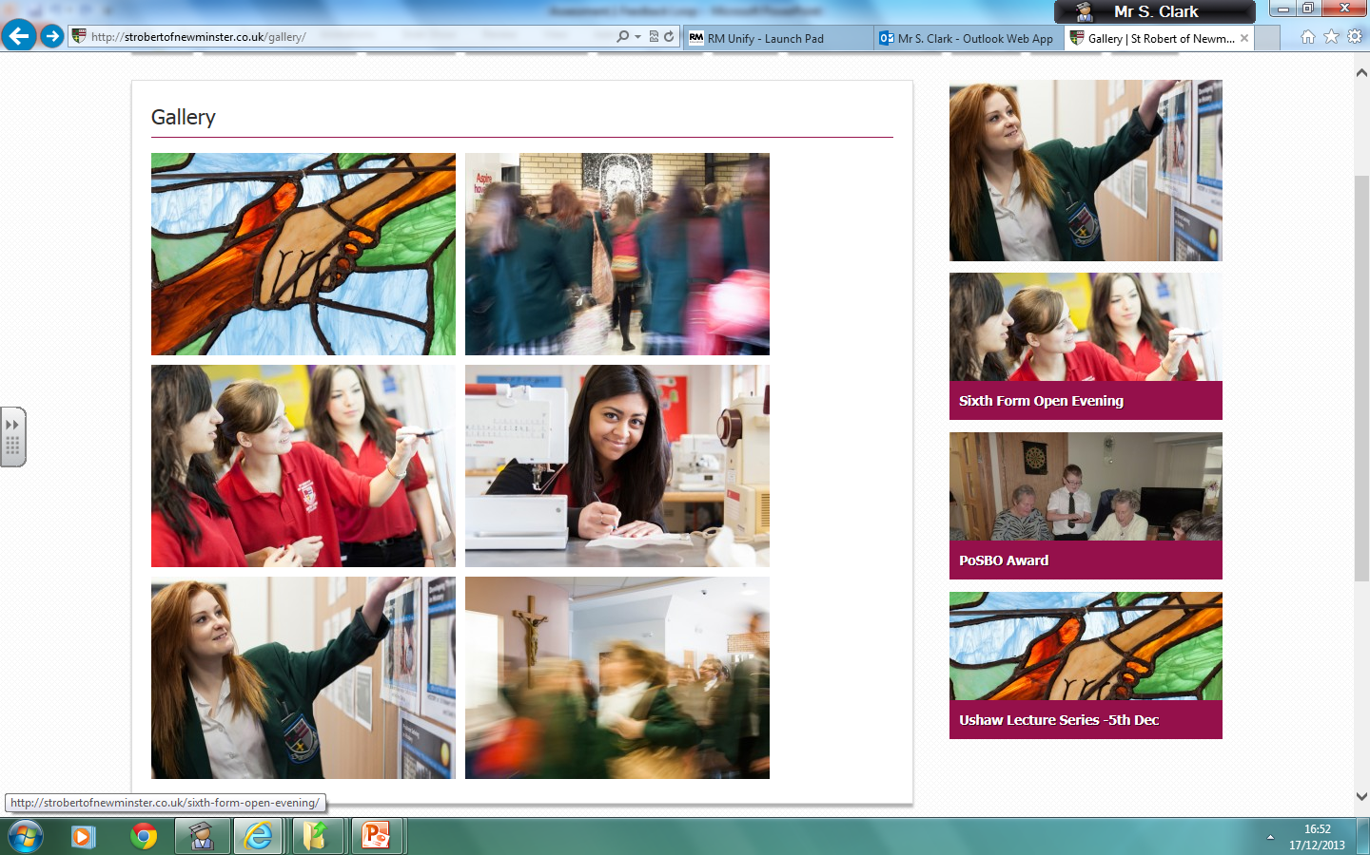

Homework

Slide 31
What does the evidence tell us about homework ?
Most promising for raising attainment
8
Feedback
May be worth it
Meta-cognitive
Peer tutoring
Homework (Secondary)
1-1 tuition
Early Years
Effect Size (months gain)
Collaborative
Behaviour
Phonics
Small gp tuition
Parental involvement
Smaller classes
Social
ICT
Individualised learning
Summer schools
After school
Small effects / high cost
Homework (Primary)
Mentoring
0
Performance pay
Aspirations
£0
Ability grouping
£1000
Cost per pupil
www.educationendowmentfoundation.org.uk/toolkit
Notes:
Higgins, S., Katsipataki, M., Kokotsaki, D., Coleman, R., Major, L.E., & Coe, R. (2013). The Sutton Trust-Education Endowment Foundation Teaching and Learning Toolkit. London: Education Endowment Foundation. [Available at http://www.educationendowmentfoundation.org.uk/toolkit]

Slide 32
What type of homework will be set?
Prepare - tasks required to prepare, successfully, for the next lesson or beyond.
Consolidate - tasks which helps to reinforce the challenging nature of the work done in class.
Extend - tasks designed to challenge pupils to find out more and gather new information to deepen their knowledge, understanding and skills.

Slide 33
How much homework is set?
Key Stage 3:
Homework is set once a week if the pupil is taught two or more lessons a week in that subject.
Homework is set fortnightly if the pupil is taught one lesson a week in that subject.
Key Stage 3:
Year 7: 30 minutes per subject.
Year 8: 30 to 45 minutes per subject.
Year 9: 45 minutes per subject.

Slide 34
Our expectations of pupils
Clearly write the homework in their planners.
Include when the homework is to be handed in.
Pupils must complete their homework on time and to a high standard.
Pupils must re-draft homework if it is not to a high standard.

Slide 35
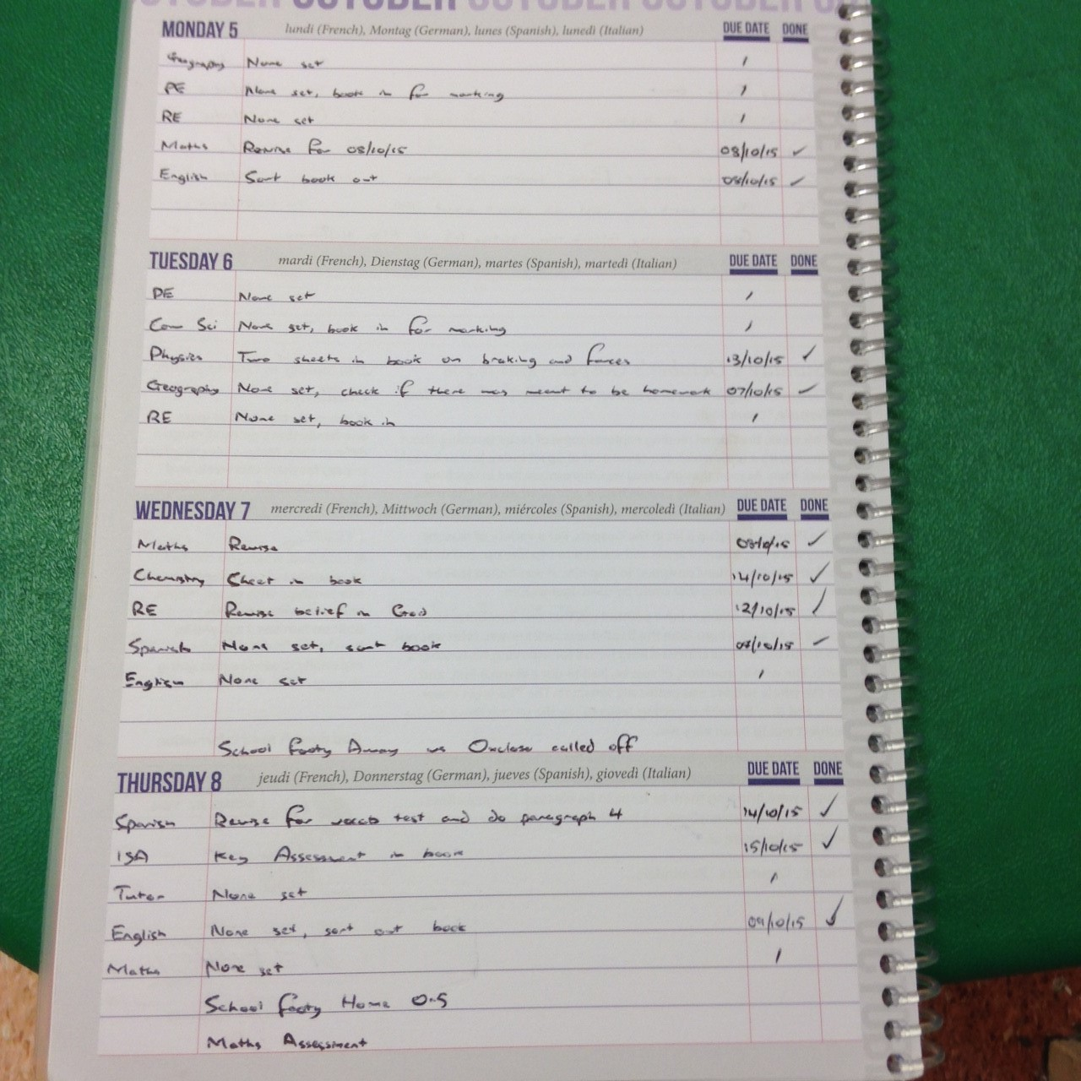
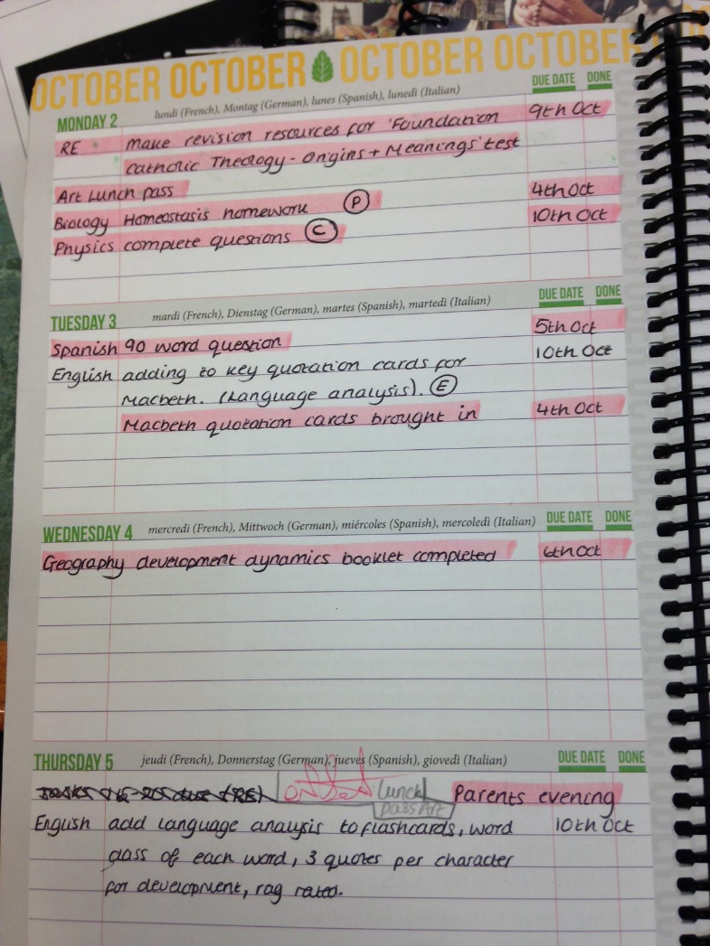
Planners and Organisation
All subjects to be written in the planner
P-Prepare
C-Consolidate
E-Extend
Due date to be included
None set to be written in if no homework is set
Add a ‘Tick’ when done
Neat and tidy

Slide 36
How can you support us?
You can support your child by:
• Ensuring they have a quiet space to work
• Encouraging them to commit specific time to homework
• Helping them to get organised, discuss their work and their deadlines

Slide 37


Slide 38
Thank You

