Slide 1
Y11 17th October Parent Information Evening Helping my child to succeed at GCSE
‘Let your Light Shine’
Welcome

Slide 2
Key Staff
Mrs Salmon: Senior Assistant Head Teacher (Achievement)
Mr McHale: Senior Assistant Head Teacher (Pastoral)
Mr Green: Assistant Head Teacher (Pastoral)
Mr Clark: Assistant Head Teacher (Teaching & Learning)
Mrs Dunn: Assistant Head Teacher (Intervention)
Mr Bayne: Head of 6th Form
Mr Brettell: Head of English
Mr Medd: Head of Maths
Mr Wylam: Head of Science & Physics
Mr Davis: Head of RE
Mrs Bruce: Head of MFL
Mrs Horrocks: Acting Head of Geography
Mrs Bellwood: Acting Head of History
School Nurse Team & Emotional Resilience Nurse:
M McHugh
H Lilley
K Lax

Slide 3
Pupil Targets
KS2 | Autumn Y7 | Spring Y7 | Summer Y7 | Autumn Y8 | Spring Y8 | Summer Y8 | Autumn Y9 | Spring Y9 | Summer Y9 | Autumn Y10 | Spring Y10 | Summer Y10 | Autumn Y11 | Spring Y11 | Summer Y11 | New GCSE Grades
 |  |  |  |  |  |  |  |  |  |  |  |  |  |  |  | 9
 |  |  |  |  |  |  |  |  |  |  |  |  |  |  |  | 8
 |  |  |  |  |  |  |  |  |  |  |  |  |  |  |  | 7
 |  |  |  |  |  |  |  |  |  |  |  |  |  |  |  | 6
 |  |  |  |  |  |  |  |  |  |  |  |  |  |  |  | 5
 |  |  |  |  |  |  |  |  |  |  |  |  |  |  |  | 4
 |  |  |  |  |  |  |  |  |  |  |  |  |  |  |  | 3
100 |  |  |  |  |  |  |  |  |  |  |  |  |  |  |  | 2
 |  |  |  |  |  |  |  |  |  |  |  |  |  |  |  | 1
The ‘Aspirational target grade’ is the GCSE grade that your child should achieve based on their progress from KS2.
They should be recorded in their planner.

Slide 4
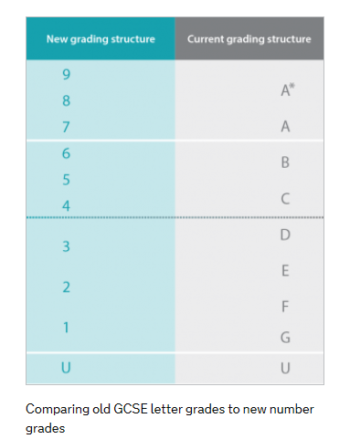
NEW
OLD
5 =
Strong Pass
4 = Standard Pass

Slide 5
Student Progress Against Targets
The progress of your child is tracked throughout their GCSE courses.
Term 1
- October 2019: Teachers assess progress; Parent/Carer Information Evening; Grade Report to Parents/Carers
November/December 2019: Mock examinations
December 2019: Mock exam results day
Term 2
- January 2020: Full report to Parents/Carers & Parent/Carer Evening
February/March 2020: Teachers assess progress including Mock speaking tests (Languages)
March 2020: Grade report to Parents/Carers
Term 3
- May 2020: External Exams begin
N.B. As a result of monitoring progress, student class moves may result at our discretion

Slide 6
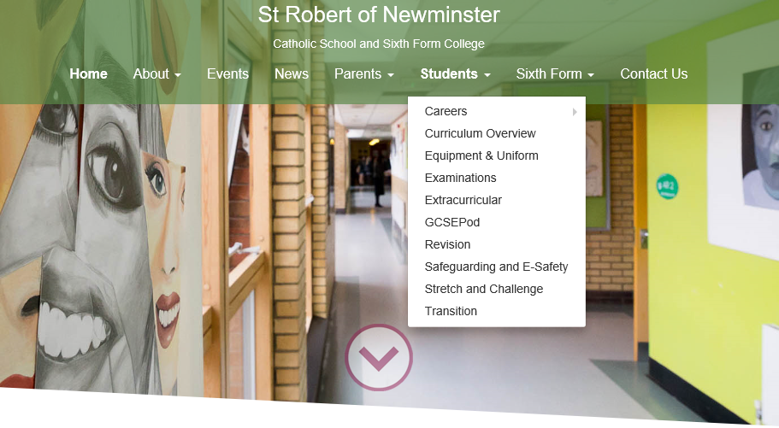
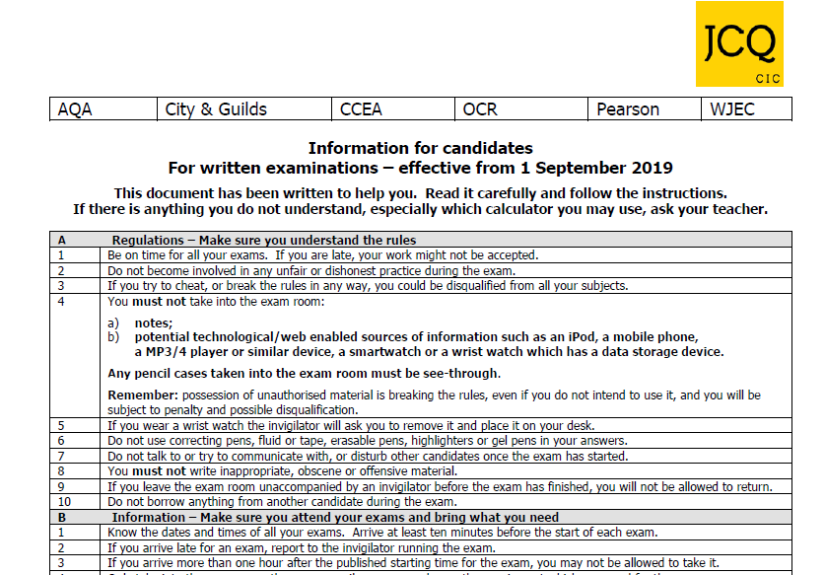
Examinations

Slide 7
Examinations
No mobile phones
No SMART watches
Black ballpoint pen
Scientific calculator, ruler, eraser (rubber), protractor
Highlight the question only
Clear pencil cases
Bottle of water with no labels

Slide 8
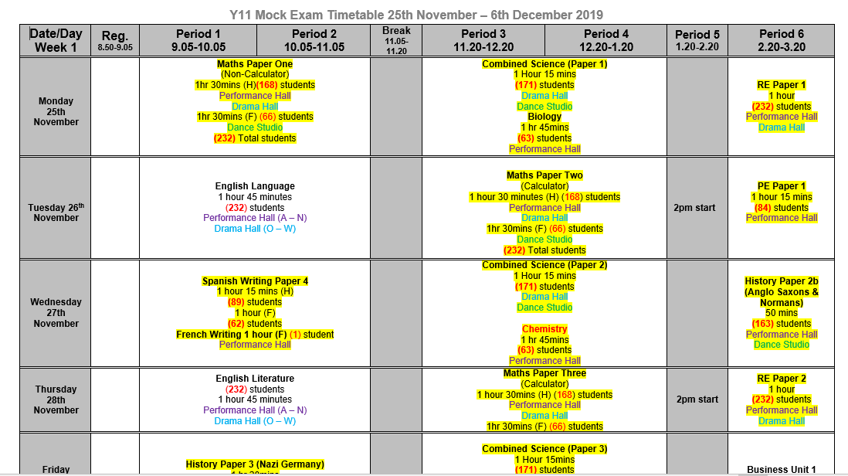
Examinations – Assessment 2

Slide 9
Examinations
September | October -Assessment 1 -Parent/Carer Info Evening -Grade Report | November -Assessment 2 (Mock examinations) | December -Mock examinations -Mock exam results day
January -Full Report & Parent/Carer evening | February -Assessment 3 (Second Mock English/Maths/ Science) | March -Grade Report | April
May -External Examinations begin 11th May | June -External examination end -24th June Contingency day | July | August
Notes:
Timeline for Y11:
October – now assessment report before half term
Exams begin 11th May (tbc)
MUST be available on 24th June for a contingency day – e.g. In the rare event that disruption to the exam period means exams must be rearranged, they will be held on the contingency day. If disrupted exams cannot all be held on one day, they will be held in the days leading up to the contingency day

Slide 10
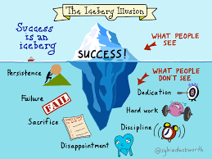
Expectations
Behaviour
Equipment
Personality
Revision
Effort
Persist
Aspire
Resilience
Engage
Dedication

Slide 11
Mr Bayne
Head of 6th Form

Slide 12
St Robert’s 6th Form
80% of students progress to university.
Successful record of students to Oxbridge, Medicine, Dentistry and Veterinary Science.
37% of students go to Russell Group universities.
Over 35 courses.
Wide range of enrichment activities.
Most successful 6th Form in Sunderland area.

Slide 13
Mr McHale
Senior Assistant Head Teacher (Pastoral)

Slide 14
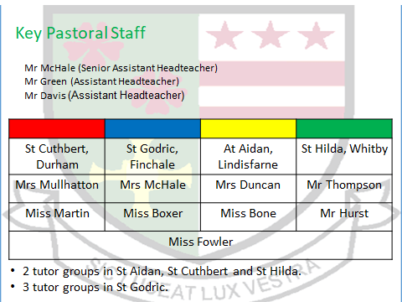

Slide 15
How do I seek advice from the school?
If you need any advice from the school contact your child's Head of House.
If there is a personal issue Mrs Hughes- school social worker is available.
If there is an attendance issue Mrs Moran/Mrs Devlin are the attendance team.
You could communicate with subject staff or mentors (where applicable) via the planner.
Mrs Gittins leads the Mentoring Programme

Slide 16
Parents/Carers – How can I help?????

Slide 17
I don’t understand all these controlled assessments, levels and exams – its completely different from when I was at school.
I can’t stand the arguments when I try to help....
I’m surprised she’s not got any homework, I expected more in Year 11
Surely she shouldn’t be going out again when she’s studying for GCSE’s?
He’s always got an excuse, I don’t know what to believe!
I’ll just write her a note to excuse her late homework, just this once....

Slide 18
The Biggest Challenge: Priorities
Friendships
Family life
Social life
Hobbies
Clubs
Fashion
Romantic Concerns
GCSE’s?

Slide 22
Attendance A GCSE in under 5 days???
You may think you’ve got forever BUT look at how many hours of lessons you have in Year 10.
Eng/Maths/Sci 6.5 days (4 hrs per week)
Opted Subjects 3.25 days (2hrs per week)
You will cover most topics only once in these hours so learning first time round is the key to successful revision and exam results!
Every Lesson Counts!!!!!!!!!!!

Slide 24
Mr Clark
Assistant Head Teacher
Homework /Revision Techniques

Slide 25
Preparing for Success Programme

Slide 26
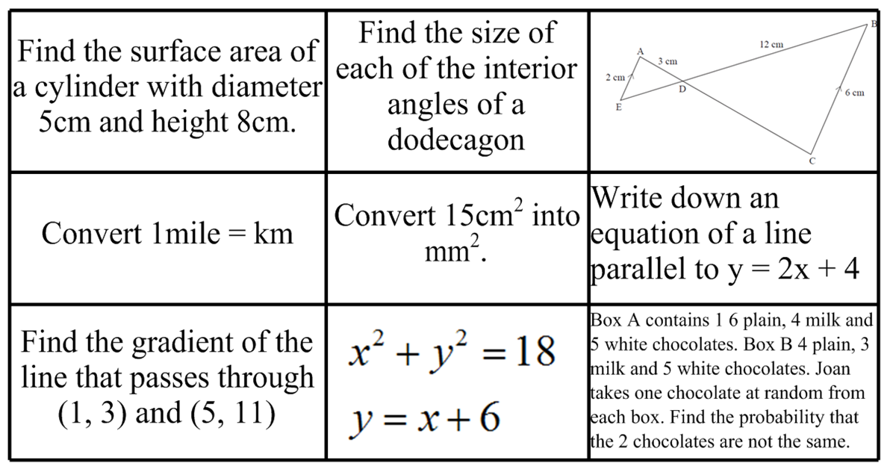
In-class revision

Slide 27
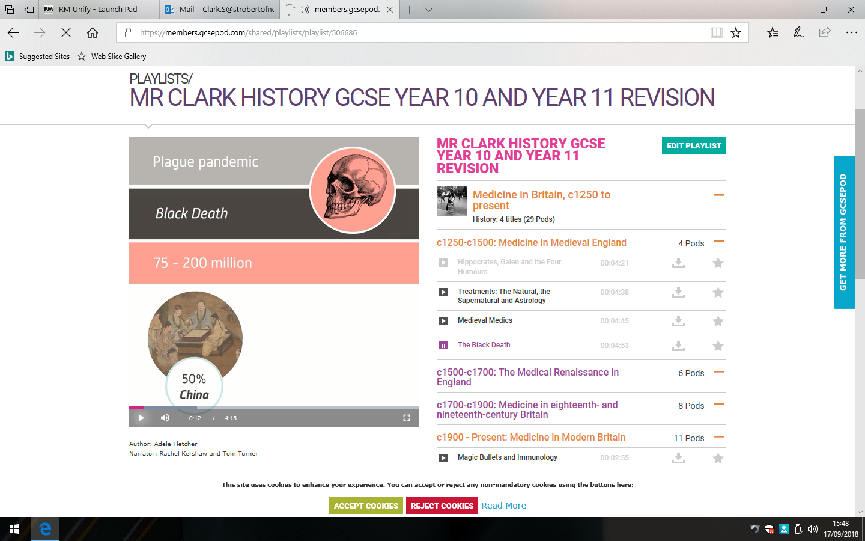
Out of class revision

Slide 28
Homework/Revision
Clearly write the homework in their planners.
Include when the homework is to be handed in.
Pupils must complete their homework on time and to a high standard.
Pupils must re-draft homework if it is not to a high standard

Slide 29
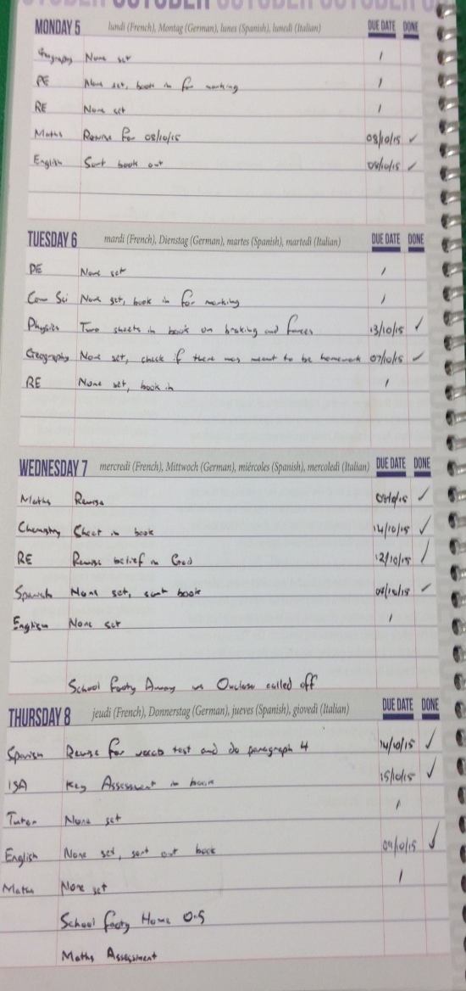
Planners and Organisation
All subjects to be written in the planner
P-Prepare
C-Consolidate
E-Extend
Due date to be included
None set to be written in if no homework is set
Add a ‘Tick’ when done
Neat and tidy

Slide 30
The Pupil Planner

Slide 31
The Pupil Planner
 | Mon 20th | Tues 21st | Wed 22nd | Thur 23d | Fri 24th | Sat 25th | Sun 26th
Homework
Revision

Slide 32
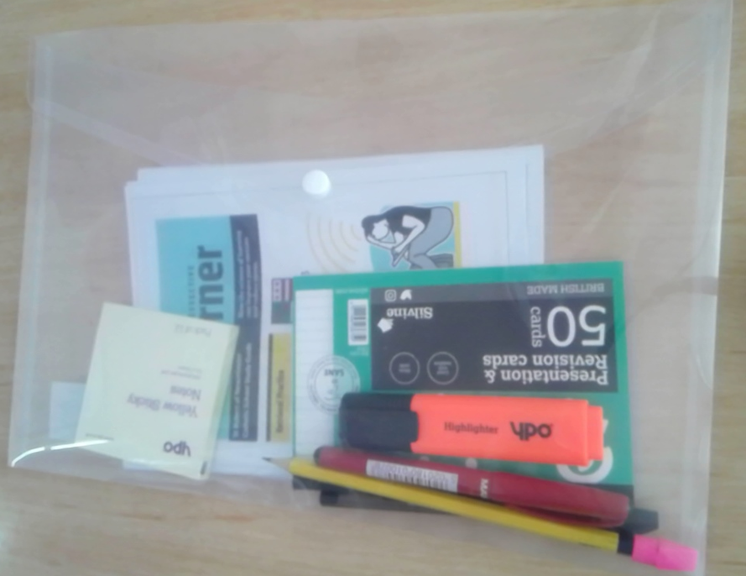
Revision Starter Packs

Slide 33
GCSE Subject Information-Parent guide

Slide 34
1: Spaced Practice

Slide 35
1: Spaced Practice

Slide 36
2: Interleaving-Blocking

Slide 37
2: Interleaving

Slide 38
3: Retrieval Practice-Self Testing

Slide 39
How can you support us?
You can support your child by:
Checking the pupil planner daily.
Helping them to get organised, discuss their work and their deadlines.
Ensuring they have a quiet space to work. Vary the locations.
Encouraging them to commit specific time to homework/revision.
Ensuring that they are removed from distractions.

Slide 40
Manage distractions

Slide 41
Help us create the right conditions to revise

Slide 42
Carousel
English –Mr Brettell
Maths-Mr Medd
Science-Mr Wylam
RE-Mr Davis
History-Mrs Bellwood
Geography-Mrs Horrocks
MFL –Mrs Bruce/Mrs Donkin
GCSE Pod –Mrs Dunn
Revision Tips and Tricks –Mr Clark
Wellbeing-NHS Nurses
Sixth Form –Mr Bayne

Slide 43
Thank You

