Slide 1
Year 9 Options & Curriculum Information Session
Mr Mitchell
Mrs Salmon

Slide 2
Aims of this information session
Information on our ‘Core’ curriculum
Students pathways & Ebacc
Possible option subjects
Advice for choosing option subjects
Timeline of the option process

Slide 3
The ‘core’
curriculum

Slide 4
Year 10 ‘core’ curriculum
In Year 10 all students will study the following:
English Language and English Literature (4)
Mathematics (4)
Religious Education (2)
Combined Science (4) / Separate Sciences (6)
Core PE (1)
PSHE Tutorial (1)
Plus additional subjects…
Notes:
S

Slide 5
Year 10 ‘core’ curriculum
Vast majority of students will study at least one of History or Geography and a Language (Spanish).
Plus, an additional two or three subjects of their choosing.

Slide 6
Option Pathways
Pathway S = EBacc (with MFL & Separate Sciences)
Pathway T = EBacc (with MFL & Combined Science)
Pathway R = EBacc (without MFL)
Personalised pathway
These pathways are based upon a number of factors (KS2 data and Year 9 current progress in all subjects)

Slide 7
Possible option subjects
Art Geography
Business Studies Health & Social Care
Computer Science^{ⱡ} History
Digital IT Music
Drama Physical Education
Engineering^{ⱡ} Product Design/
Food Prep. & Nutrition Construction*
French Textiles

Slide 9
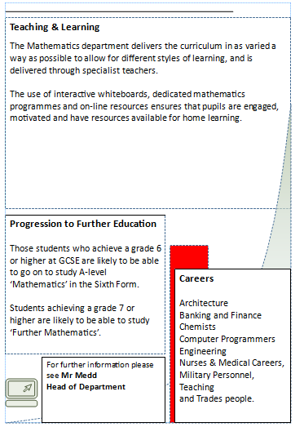

Slide 10
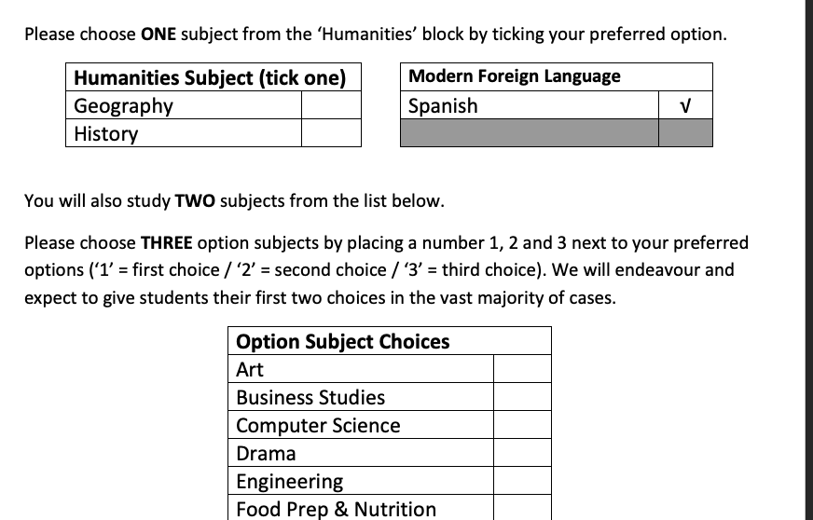

Slide 11
Helping your child pick options!
When selecting their subjects students should:
Pick subjects they enjoy
Ask subject teachers for further guidance
Pick subjects that they can achieve their very best in
There will be new and current subjects to choose from – read subject information
Different subjects will have different exams / coursework (remember to ask the teachers)
Don’t pick subjects just because they like the teacher/because their friend is choosing it

Slide 12
Useful websites
Careers Advice & Guidance
www.u-explore.com
University & College Admissions Service (UCAS)
www.ucas.co.uk

Slide 13
Option Process Timeline
Feb 13th Parent/Carer option information
Feb 27th Year 9 option information assembly
Early March Issue option booklet & pathway forms
Mar 11th Year 9 Parent/Carer evening
Mar 20th Final choices submitted
After Easter Confirmation of option choices

Slide 14
Aims of this information session
Information on our ‘Core’ curriculum
Students pathways & Ebacc
Possible option subjects
Advice for choosing option subjects
Timeline of the option process

Slide 15
Key staff to discuss option choices:
Mr Mitchell (Senior Teacher: Options advice)
Mrs Salmon (Senior Assistant Headteacher: Options advice)
Mr Green (Assistant Headteacher: Vocational & Work Related Learning Co-ordinator)
Mrs Hurst (SENDCO)

