Slide 1
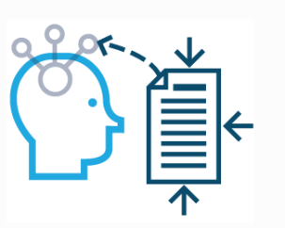
Ready to Revise: How do I plan a revision schedule and make sure I use my time well?
So far we have looked at why revision is important and how to revise. Now it is time to think about:
What to revise?
When to revise?
Where to revise?

Slide 2
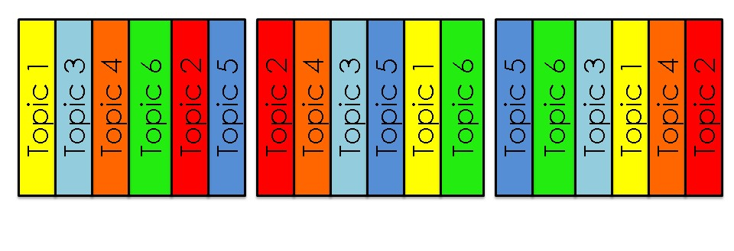
Ready to Revise: How do I plan a revision schedule and make sure I use my time well?
When planning what to revise, its best to switch between topics often. Interleaving will help you make connections between topics and transfer information to your long-term memory.
DON’T
DO
Notes:
Not just about switching between subjects but also switching between topics in one subject. Changing the order of topics can help pupils find new connections each time.

Slide 3
Ready to Revise: How do I plan a revision schedule and make sure I use my time well?
When should you revise and for how long?
Research by cognitive scientists suggests that revision works best when it is ‘little and often’.
Aim to revise every day but for short periods with set breaks. This will ensure that your brain does not get too tired and help transfer information to your long-term memory.
Some people can concentrate for much longer than others so try this:
Start a revision session with a timer.
Stop the timer when your brain starts to wander – this is likely to be somewhere between 15 and 30 minutes.
Record the length of your study session.
Test yourself at different times of the day – you might be a morning person or early evening might suit you better!

Slide 4
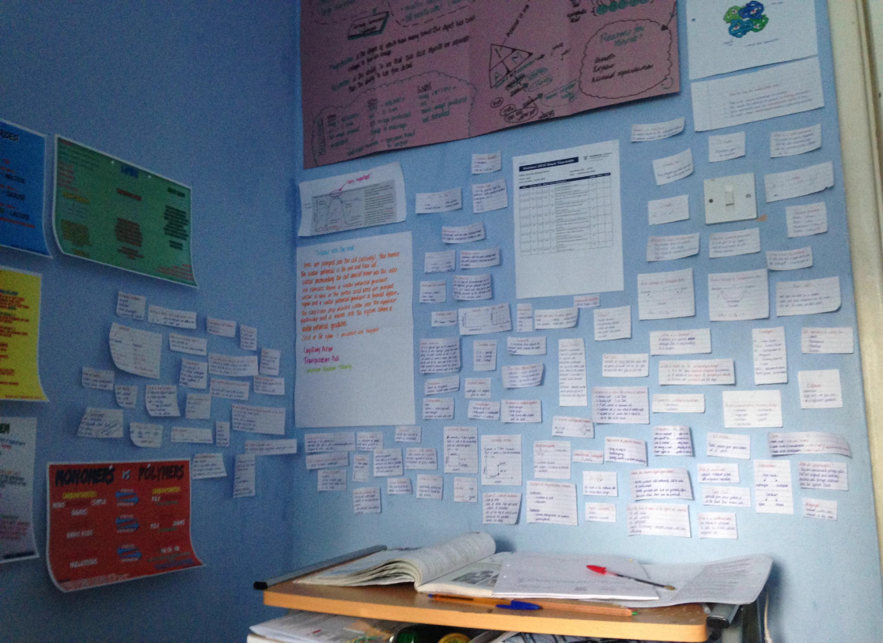
Ready to Revise: How do I plan a revision schedule and make sure I use my time well?
Choosing where to revise is also important. Your surroundings can both help and hinder your learning.
Turn and talk: where do you revise and why?
Tip: Put information you are struggling to remember somewhere you will see it every day. This could be your bedroom wall, on your mirror, or even the back of the toilet door!
Notes:
Collect feedback from students. Discussion here is important:
Do they revise alone or with friends? Why? Friends can be a distraction but if focussed can help with clarification and testing
Do they have somewhere to revise at home e.g. their own bedroom, dining table?
Where do they revise in school? Library, tutor room, canteen?

Slide 5
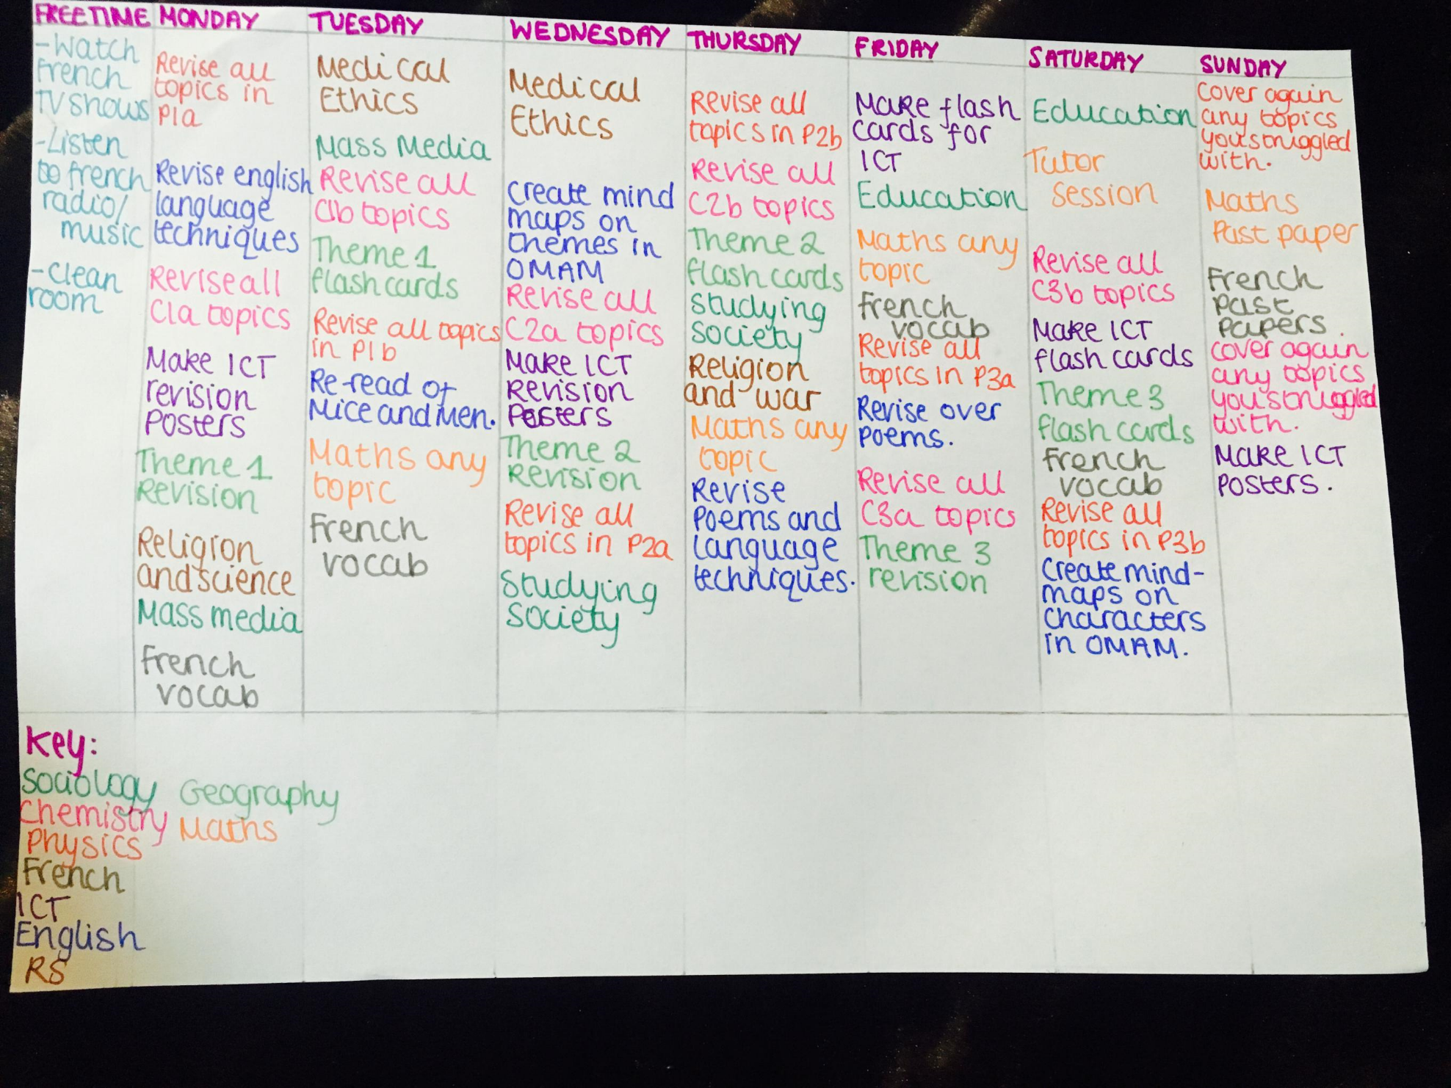

Slide 6
Ready to Revise: How do I plan a revision schedule and make sure I use my time well?
Copy this into the notes page (28) of your planner:
Write the title: Revision Planning.
Plan to revise every day for 15-30 minutes at a time. Plan your breaks too.
Schedule specific topics e.g. ‘vectors’ rather than ‘Maths’ and interleave topics (mix them up).
Plan where to revise; organise your space and resources to maximise your time and minimise distractions.
X Is not about drawing pretty pictures or being good at Art
X Is not about using different coloured pen

