Slide 1
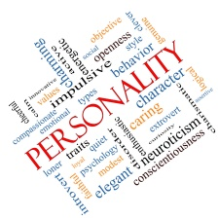
Year 11 Extension Module – June 2021
Using Unifrog
Whether you are staying on at our Sixth Form, attending another college or starting an apprenticeship later this year, it is never too late to research your future career choices and opportunities.
A new tool available for you is called UNIFROG.
Login at www.unifrog.org select LOGIN, enter your school email, then request a password reset to get started. (Your new password will be emailed to your school email address.)
VIDEO LINKS VIDEO LINKS VIDEO LINKS VIDEO LINKS VIDEO LINKS VIDEO LINKS VIDEO LINKS VIDEO LINKS
Getting Started
with Unifrog
Using the Personality
Profiling Tool
Unifrog’s Careers Library
Adding Competencies
To UNIFROG
NEXT
PAGE
VIDEO LINKS VIDEO LINKS VIDEO LINKS VIDEO LINKS VIDEO LINKS VIDEO LINKS VIDEO LINKS VIDEO LINKS

Slide 2
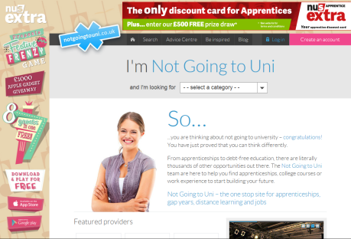
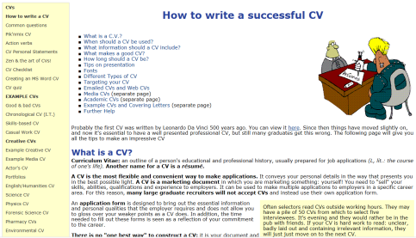
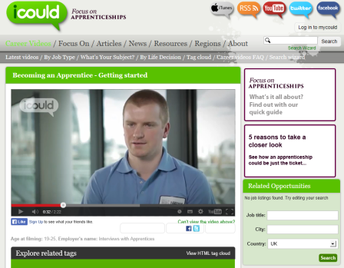
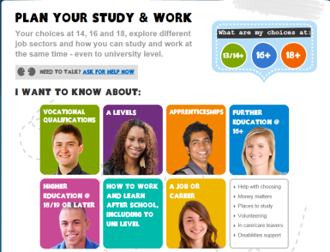
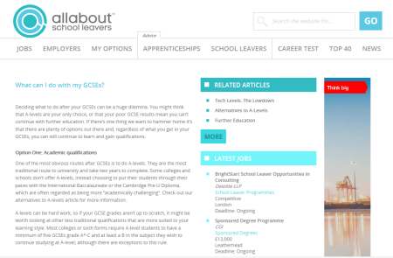
Personalised Learning Gateway – 2020/21
Some useful websites for you and your child
Making the correct choice at 16 and 18 is not an easy one, research is essential , as well as obtaining the correct information advice and guidance from our careers advisor. However a good starting point is to look through these websites with your child.
Learning Intentions
To understand my options after year 11 and 13
To know where to go for help
To develop my understanding of the world of work
Apprenticeships
The Complete
University Guide
Task 1
Writing a CV
Explore some of the ‘screen shots’ links shown opposite.
Taking a Gap Year
- What is it?
Task 2
Watch the video clips showing career opportunities available in different sectors.
Employment Officer
Construction Manager
Construction Careers
Caterer
Choices at 16 and 18
Sports Manager
Chiropractor
NEXT
PAGE
Impress at Interview
Task 3
Watch the video clip for a medic, then look at the profile for a career in this field.
What are my options?
Graduate Medic
NEXT
PAGE
Task 4
Discuss the local market / skills shortages within the north east. Labour Market Information
St Robert of Newminster Catholic School and Sixth Form College

Slide 3
Personalised Learning Gateway – 2020/21
Some useful websites for you and your child
At this stage of your education it is really important to make good choices on your future and consider all options available. It is important not to become stressed and to know where to go for help if you are unsure about your future. Some of the links below may help.
UNIFROG HELP
Launch Video
Getting Started with Unifrog
Topics covered in this video:
Exploring Pathways:
Brief explanation of Interests/Personality quizzes
You’ll Do, Skills Required, Entry Requirements, and LMI
Brief explanation of Know How library and MOOCs
Recording what you’ve done:
Brief explanation of Activities and Competencies with examples of activities
Searching for opps:
Drafting application materials:
Making applications:
Anxiety and Stress
Apprenticeships
ALEVELS – Making the right choice
Coping with Change
Mental Health
BTEC Myths
Employee Rights
Careers Library Treasure Hunt
NEXT
PAGE
NEXT
PAGE
St Robert of Newminster Catholic School and Sixth Form College

Slide 4
Personalised Learning Gateway – 2020/21
Some useful websites for you and your child
You will need access to Unifrog to access these resources – see the first slide for information on how to obtain your password.
UNIFROG HELP
Launch Video
Which Qualification?
Apprenticeships
Getting Started with Unifrog
Topics covered in this video:
Exploring Pathways:
Brief explanation of Interests/Personality quizzes
You’ll Do, Skills Required, Entry Requirements, and LMI
Brief explanation of Know How library and MOOCs
Recording what you’ve done:
Brief explanation of Activities and Competencies with examples of activities
Searching for opps:
Drafting application materials:
Making applications:
Which Pathway
should I choose?
Help with Stress
College, University
or Apprenticeship?
Help with Anxiety
Mindfulness
What are employer
competences?
Dealing with
Depression
UK Rights at Work
HOME
PAGE
St Robert of Newminster Catholic School and Sixth Form College

