Slide 1
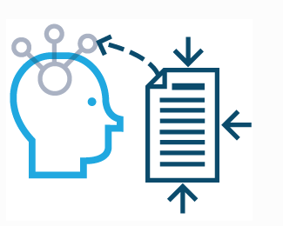
Ready to Study: Top Tips
Subjects require very different types of recall and application. One size doesn’t always fit all your subjects. You need to mix it up. Determination and perseverance are crucial.
Look at the next slide and aim to use the variety of methods during your preparation work for your new courses.

Slide 2
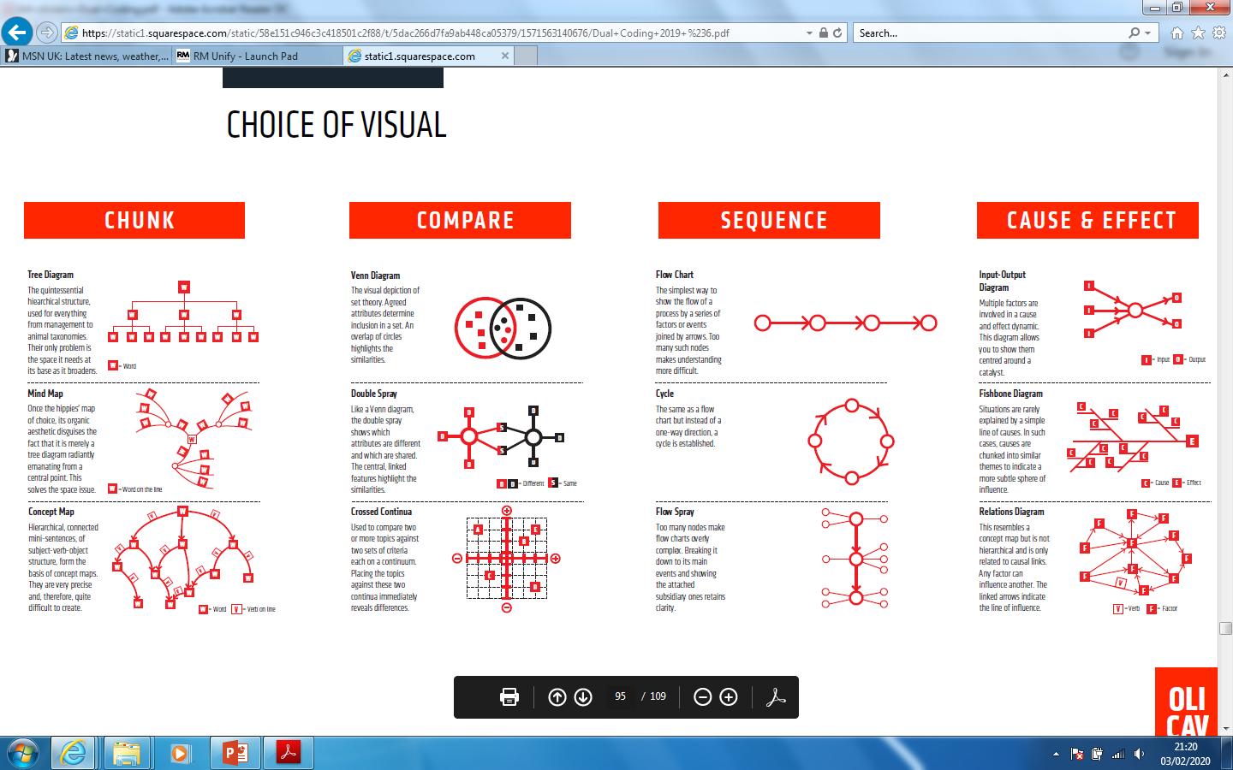
Ready to Study

