Slide 1
Y11 Parent Information Evening Helping my child to succeed at GCSE
Let your light shine

Slide 2
Key Staff
Curriculum
Mrs Salmon
(Senior Assistant
Headteacher Curriculum)
Mrs Dunn
(Assistant Headteacher Intervention)
Mr Clark
(Assistant Headteacher Teaching, Learning & Assessment)
Pastoral
Mr McHale
(Senior Assistant Headteacher Pastoral)
Mr Green
(Assistant Headteacher Pastoral)
Mr Davis
(Assistant Headteacher Pastoral)
Heads of House/SENDCo
Mr Bayne
(Head of 6th Form)
Notes:
We aim to provide you with all relevant information to help you understand how school will prepare Y11 children for their key assessments this year and ultimately their formal examinations and indeed how you can help support them at home.​

Slide 3
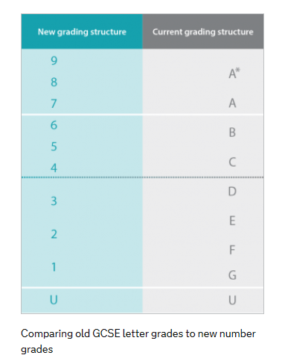
Let your light shine
Through Christ, in partnership and with service and witness at the core of all we do, our school will be a centre of excellence. We will educate the whole person so that everyone fulfils their academic potential, aspires highly and is optimistically ambitious.
Aspirational Target Grades
Based on KS2 end point i.e. end of Y6
‘Optimistically ambitious’ top 25% nationally
Grade potential to aim towards
Outcomes
9-1 grades: 5 strong pass; 4 standard pass
D*-P
Notes:
Target grades are based on national transition matrices which give information on KS2 end points and potential KS4 end points.​
Set targets for those achieving in the top 25% of all pupils nationally to reinforce aspirational nature of targets. Therefore 75% nationally will not achieve that grade. In our experience, many students surpass their aspirational targets thereby placing them in top 20, 15, 10% of pupils nationally.​
It is something to aim towards, it is not a prediction.​
​

Slide 4
Communication
The progress of your child is tracked throughout their GCSE courses.
Term 1
October 2021: Teachers assess progress; Grade Report to Parents/Carers sent home before half term
November/December 2021: Practice examinations (2 weeks)
16th December 2021: Practice examination results day
Term 2
January 2022: Full report to Parents/Carers & Parent/Carer Evening via Teams
February/March 2022: Teachers assess progress including Practice examination speaking tests (Languages) and an opportunity for a 2nd practice examination in English, Maths and Science
March 2022: Grade report to Parents/Carers
Term 3
May 2022: External Examinations begin
Notes:
Home school communication in Y11​
Term 1: Assess progress and grade report to parents before half term. Inform you of snapshot of achievement at this moment in time to help target their preparations for their practice exams in Nov/Dec. Timetable for these exams is included in your pack. Inform you of tips and techniques used in school to help students know more and remember more which can be reinforced by yourselves at home.​
Practice examination results day in Dec before break up for Christmas.​
​
Term 2: Following practice exams, teachers write a full written report give advice for how to improve over the year. Follow up mock speaking tests and other class based assessments and Grade report in March.​ Parent/Carer evening via Teams.
​
Term 3: External exams begin May​
​
Should there be any class moves or invites to revision classes – attendance is not optional​

Slide 5
Assessments
September | October Assessment 1, Parent/Carer Info Evening & Grade Report | November Assessment 2 (Practice examinations) | December Practice examinations & Practice exam results day
January Full Report & Parent/Carer evening | February Assessment 3 (Second Practice Examinations English/Maths/ Science) | March Grade Report | April
May External Examinations begin | June External examination end | July | August
Notes:
Practice exam TT is in your packs​
Idea begin planning time up to exams to create a revision TT – blank one in packs​
​
Exams update JCQ​
End Sept Ofqual announced proposal for exams in 2022; JCQ document released in October it states that formulae sheets will be provided in Maths and GCSE combined science and Physics; advanced information on the focus of exams will be available in Feb 2022 for the majority of subjects except Ee Lit, History, Geography, Art & Design. For English Lit, History and Geography there will be a choice of topics on their exams. Art will be assessed on portfolio coursework only. This means that up until that time students will continue to study the full depth and breadth of each subject. Once schools receive further information, we will be able to strengthen and deepen understanding of the topics selected for assessment and ensure exam skills are developed.​
Contingency planning should exams not go ahead we would revert to a teacher assessed grade system.​
Preparing for exams in Summer, practice exams run through exactly same expectations.​
​
Must adhere to exam hall rules and be fully prepared with equipment​
​
No SMART watches – risk of accessing internet​
Ask for watches to be removed and placed on table.​
If SMART watch or we suspect it is a SMART watch, will be removed for the duration of the exam.​
​
Ballpoint only – no other such as gel pens.
Scientific calculator – should know when can use i.e. calc maths paper, science exams, geography exams. ​
Highlighters only on question not on answer as papers scanned electronically and it risks blurring of answer​
Clear pencil cases only​
No labels on water bottles ​
​
Timeline for Y11:​
October – now assessment report before half term​
Exams begin May (tbc) usually around second week of May​
MUST be available end June for a contingency day – e.g. In the rare event that disruption to the exam period means exams must be rearranged, they will be held on the contingency day. If disrupted exams cannot all be held on one day, they will be held in the days leading up to the contingency day.

Slide 6
Be Prepared
Behaviour
Equipment
Personality
Revision
Effort
Persist
Aspire
Resilience
Engage
Dedication
Notes:
Y11 Focus on:​
Persist: Try and try again​
Aspire: To be the very best; look ahead to 6th form subjects; employment; apprenticeship requirements. ​
Resilience: will find it hard; use the support around you at home and school; 2 years of learning and challenging concepts​
​

Slide 7
Support
Curriculum
Quality first teaching
Literacy Support
Raising Achievement Tutor Groups
Intervention
Pastoral
Daily Tutor Check in
Counselling
Celebration of success
Careers information & guidance
Notes:
​

Slide 8
Supporting your child's progress post pandemic
In school intervention
National Tuition Partners
Tutoring opportunity across the MAT
Mixture of in person and online tuition
Please support the attendance and engagement with these sessions
Notes:
The last couple of years have been unprecedented in education and please be assured that we have a central plan to support your child's progress in each subject area and how we will address any "curriculum gaps" that may have occurred due to the pandemic. Over the course of the year there will be 3-4 cycles of intervention that we will run with Yr 11, in addition to the focused work that takes place within subject curriculum time. Year 11 have already been invited to attend in school intervention this cycle and this will support their progress in the upcoming practice exams and this has been running for a couple of weeks now. Please talk to your child about how this is going and encourage them to ask their teachers to go over specific things they are unsure of. We really need your support in encouraging students to attend and engage with this and if there are specific barriers to them attending please discuss this with us so we can try to work round that. We will also be offering further small group tuition in specific subjects through our pool of tutors in the MAT and through the National Tuition Partners. These sessions will be online and again your support in encouraging your child to engage in this opportunity is a crucial part in determining the impact it has on their progress. Please contact either Mrs Dunn or Mrs Harrison if you have any queries about the additional support your child has been offered. ​

Slide 9
Pastoral Team
Let your light shine

Slide 10
Mr McHale (SAHT)
Mr Green (AHT)
Mr Davis (AHT)
Heads of House
Head of St Cuthbert/Durham
Mrs Mulhatton (Miss Martin)
Head of St Godric/Finchale
Mrs McHale (Mr Hurst)
Head of St Hilda/Whitby
Mr Thompson (Miss Bone)
Head of St Aidan/Lindisfarne
Mrs Duncan (Miss Fowler)
Pastoral Support – Mrs G Mason

Slide 11
Seeking advice and communication
Your child's Head of House.
School counsellors are available via a referral from the Pastoral Team.
Mrs Moran & Mrs Devlin are the attendance team.
Communicate with subject staff / tutors (where applicable) via the student planner.

Slide 12
Supporting our Pastoral Priorities
Excellent attendance
Punctuality – arrive on time for school (8:45am)
Correct uniform
Respect for staff and the school environment
Maximising lesson time
Gold standard class and homework

Slide 13
Common Concerns
Surely she shouldn’t be going out again when she’s studying for GCSE’s?
I don’t understand all these assessments, levels and exams – its completely different from when I was at school.
He’s always got an excuse…I don’t know what to believe!
I’m surprised he has no homework…I expected more in Year 11!
I can’t stand the arguments when I try to help…
I’ll just write her a note to excuse her homework this once…

Slide 14
Balancing Priorities
Friendships
Family Life
Social Life
Hobbies / Clubs
Romantic concerns
GCSE’s

Slide 15
Attendance
Look at how many hours of lessons you have in Year 11
Eng/Maths/Sci 6.5 days (4 hrs per week)
Opted Subjects 3.25 days (2hrs per week)
You will cover most topics only once in these hours so learning first time round is the key to successful revision and exam results.
Every Lesson Counts!

Slide 16
In School Preparation
Let your light shine

Slide 17
Homework & Revision
Clearly write the homework in their planners.
Include when the homework is to be handed in.
Pupils must complete their homework on time and to a high standard.
Pupils must re-draft homework if it is not to a high standard

Slide 18
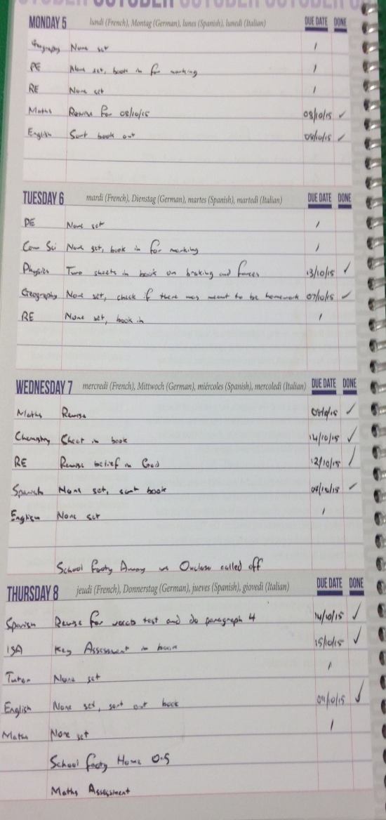
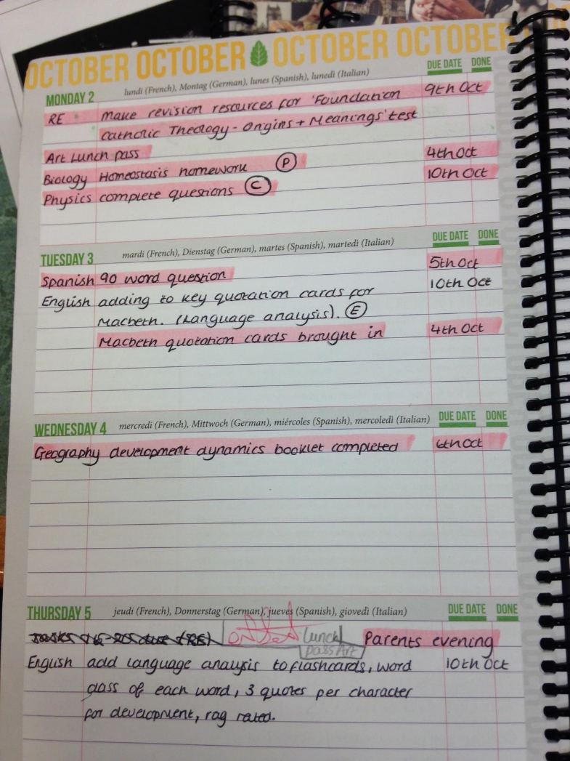
Planner & Organisation
All subjects to be written in the planner:
P-Prepare
C-Consolidate
E-Extend
Due date to be included
None set to be written in if no homework is set
Add a ‘Tick’ when done
Neat and tidy

Slide 19
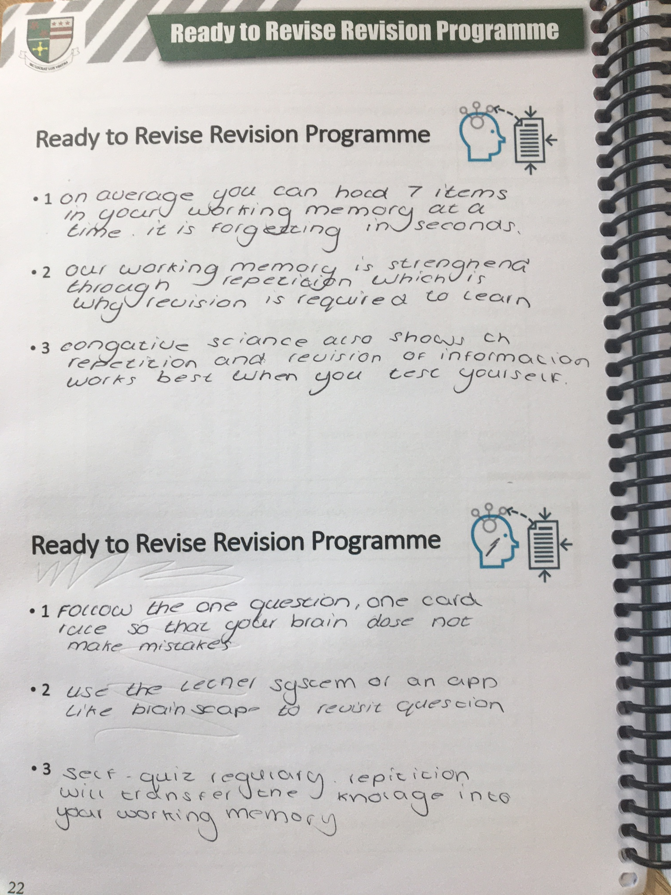
Ready to Revise Programme
There will be two revision programmes throughout Year 11:
The lead up to practice exams in November / December 2021
The lead up to summer examinations in May 2022

Slide 20
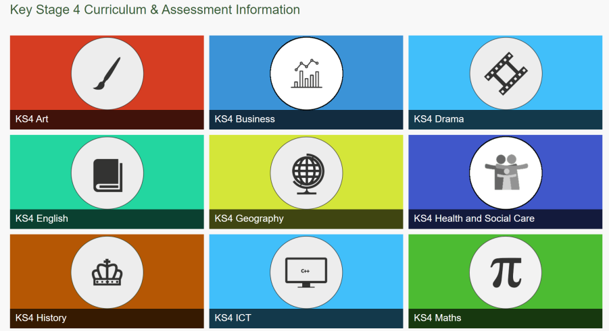
GCSE Subject Information – Student / Parent Guide
GCSE Subject information is available to access through the school website:

Slide 21
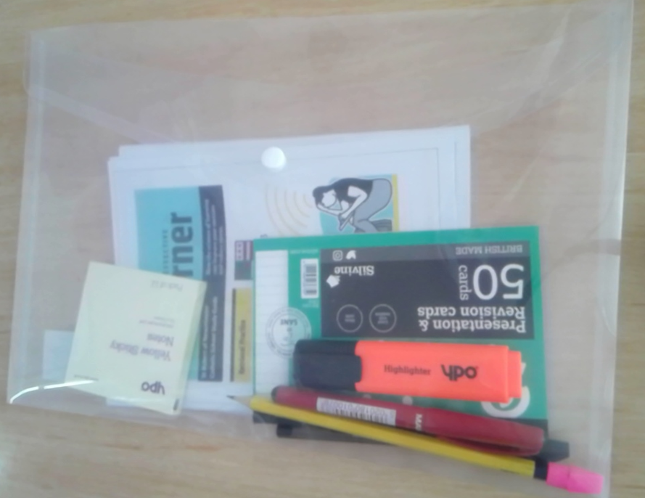
Revision Starter Pack
Each Year 11 pupil will be given a revision starter pack to help them prepare for their practice examinations in November and December.

Slide 22
Out of School Preparation
Let your light shine

Slide 23
Developing effective revision habits
Make it
Obvious
Make it
Attractive
Make it
Easy
Make it
Rewarding

Slide 24
Developing effective revision techniques
1. Spacing and Interleaving
2. Deliberate Practice
4.Retrieval Practice
3. Flash Cards
5. Dual Coding

Slide 25
GCSE Pod

Slide 26
Create the right conditions to revise
Set up a study space
Eat healthy food
Take regular breaks
Sleep well. Don’t revise before bed
Take regular exercise

Slide 27
How can parents help?
Checking the pupil planner daily
Helping organisation by discussing their work and their deadlines
Ensure they have a quiet space to work
Encourage them to commit specific time to homework/revision
Ensure that they are removed from distractions

Slide 28
Progression to 6th Form
Let your light shine

Slide 29
St Robert’s 6th Form
80% of students progress to university
Successful record of students to Oxbridge, Medicine, Dentistry and Veterinary Science
Over 40% of students go to Russell Group universities
All students achieve a destination after Year 13
Offer over 35 courses
Wide range of enrichment activities
Unrivalled post-16 pastoral support
Most successful 6th Form in Sunderland area

