Slide 1
Work Experience Opportunities 2021-22
St Robert of Newminster Catholic School and Sixth Form College
Mr J Green
Mrs G Mason
Year 12

Slide 2
A single Opportunity for Work Experience
During the allocated Work Experience week: Monday 18th – Friday 22nd July 2022

Slide 3
The Process - Preparation
Career Choice: Think carefully about the sector you are thinking about working in.
Discuss this opportunity with your parents/carer / tutor, then collect an application form from your tutor or Mrs Mason.
Find a provider and contact them requesting a Work Experience placement.

Slide 4
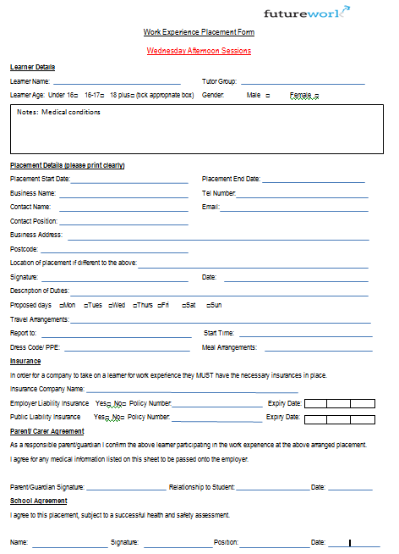
Y12 -Work Experience 2021-22
Work Experience week will take part : Mon 18th – Fri 22nd July 22
(Last week of this academic year)
Pupils/parents/carers expected to find a high quality Placement.
PROCESS
Find/contact a provider and ask them to complete the placement form (spare copies downloadable from school website)
Check all information is completed
Check the form is signed and dated and return to Mrs Mason in school.
This information will then be checked, before it is sent to Futureworks.
Deadlines for Forms to be returned: : Friday 25th February 2022
NO FORMS WILL BE ACCEPTED
AFTER THESE DATES

Slide 5
The Process - Processing
Futureworks will then carry out a risk assessment of your placement to ensure it is safe and meets all safeguarding standards.
Once your placement has been vetted, you will be notified if your Work Experience has been granted.
Please note: The school reserves the right to remove any pupil from the activity at any time if the attitude and behaviour of that pupil does not come up to the high expectations of this school. We monitor student behaviour and achievement very closely using a points system and this will be used to decide if a pupil can attend a trip, visit or work placement.
A final decision will be made by your Head of Year, Pastoral Managers.

Slide 6
The Process - Implementation
You will be expected to attend all organised days at your placement and must inform the school if you are ill or cannot attend for any reason.
You must act in a mature and sensible manner at all times and inform Mr Green of any issues/concerns as they arise.

Slide 7
Placement Confirmation
Futureworks will then carry out a risk assessment of the placement to ensure it is safe and meets all safeguarding standards.
Once the placement has been vetted, the students will be notified if their Work Experience has been granted.
Please note: The school reserves the right to remove any pupil from the activity at any time if the attitude and behaviour of that pupil does not come up to the high expectations of this school. We monitor student behaviour and achievement very closely using a points system and this will be used to decide if a pupil can attend a trip, visit or work placement.
A final decision will be made by the Head of Year or the Head of College.
Students can request an impartial careers interview with Tracey Green our Careers Advisor later in the year.

Slide 8
Finally
You should organise yourself a high quality work placement, that confirms your career aspirations and pathway.
You should discuss pathway opportunities with the provider whilst on placement.
IT IS YOUR RESPONSIBILITY TO FIND AND ORGANISE YOUR OWN PLACEMENT, THEN THE SCHOOL AND FUTUREWORKS WILL WORK TOGETHER TO ENSURE THAT YOUR PLACEMENT IS SUITABLE FOR YOU TO ATTEND.

Slide 9
Health Care Placements
You can organise a placement at a local care home, doctor’s surgery or Physiotherapists.
however
Please be aware due to confidentiality, you might not be allowed to meet patients inside consultation rooms.
At this current time, no hospital WE placements will be allowed for Sunderland Royal Hospital, however they are organising a ‘Taster Week’ in the summer term to look at the different roles within the hospital.
(No patient contact will be allowed during this week.)

Slide 10
Questions?
If you have any questions regarding your work experience, please speak to Mrs Mason, Your Tutor / Head of House or Mr Green for advice / support.
DO NOT CONTACT FUTUREWORKS –
ALL CORROSPONDANCE MUST GO THROUGH
MRS MASON .

