Slide 1
Y8 Parent Information Evening Helping my child to succeed at KS3
Let your light shine

Slide 2
Key Staff
Curriculum
Mrs Salmon
(Senior Assistant
Headteacher Curriculum)
Mrs Dunn
(Assistant Headteacher Intervention)
Mr Clark
(Assistant Headteacher Teaching, Learning & Assessment)
Pastoral
Mr McHale
(Senior Assistant Headteacher Pastoral)
Mr Green
(Assistant Headteacher Pastoral)
Mr Davis
(Assistant Headteacher Pastoral)
Heads of House/SENDCo

Slide 3
Pastoral Team
Let your light shine

Slide 4
Mr McHale (SAHT)
Mr Green (AHT)
Mr Davis (AHT)
Heads of House
Head of St Cuthbert/Durham
Mrs Mulhatton (Miss Martin)
Head of St Godric/Finchale
Mrs McHale (Mr Hurst)
Head of St Hilda/Whitby
Mr Thompson (Miss Bone)
Head of St Aidan/Lindisfarne
Mrs Duncan (Miss Fowler)
Year 7 Pastoral Lead – Mrs Gittins

Slide 5
Seeking advice and communication
Your child's Head of House.
School counsellors are available via a referral from the Pastoral Team.
Mrs Moran & Mrs Devlin are the attendance team. Please remember to telephone the school if your child is absent.
Communicate with subject staff / tutors (where applicable) via the student planner.

Slide 6
How we will communicate with you…
We may contact you about events and issues by letter.
Heads of House and Heads of Department may telephone you to discuss an issue.
Staff may communicate through your child’s planner.
We send text messages to keep you up to date.
We send notifications via the MY ED App.
The school website is regularly updated.

Slide 7
Supporting our Pastoral Priorities
Excellent attendance
Punctuality – arrive on time for school (8:45am)
Correct uniform
Respect for staff and the school environment
Maximising lesson time
Gold standard class and homework

Slide 8
Partnership
You are the expert on your own child and always will be their most important teacher.
Your support, encouragement and interest can make a spectacular difference to your child’s motivation and ability to cope with demands of Secondary School.
Your child
School
You

Slide 9
Achievement Points
Year 8 currently have 4809 achievement points.​

Slide 10
Achievement Points
​ | Year 8​
Extra Curricular Contribution​ | 54​
Academic Achievement​ | 1837​
Home learning​ | 342​
Gold Standard Work​ | 781​
Environmental Stewardship​ | 21​
Community/Ethos​ | 283​
Positive Behaviour​ | 1491​
Total Achievements​ | 4809​

Slide 11
Behaviour Points
Year 8 currently have 690 behaviour points

Slide 12
Behaviour Points
​ | Year 8​
Mobile Phone​ | 4​
Punctuality​ | 11​
Homework/Coursework​ | 175​
Disruption to Learning​ | 317​
Equipment​ | 35​
Disrespect​ | 135​
Uniform​ | 11​
Total Behaviour Incidents​ | 690​

Slide 14
Current Attendance
Current Year 8 attendance is 94.01%

Slide 15
Ready to Learn
Let your light shine

Slide 16
What can I do to ensure my child is ready to learn?
Check your child’s planner weekly and sign it.
Ensure your child is equipped for each and every lesson.
Check your child is completing homework, encourage good presentation of work in books.
Ensure your child attends school every day and that they are always on time.
Ensure your child’s uniform is correct.
Show an interest – ask them to explain what they are enjoying at school

Slide 17
Curriculum & Assessment
Let your light shine

Slide 18
Curriculum Structure
English (4hrs)
Maths (3hrs)
Science (3hrs)
RE (2hrs)
French (2hrs)
PE (2hrs)
History (2hr)
Geography (2hr)
Art (1hr)
DT (2hr)
IT (1hr)
Music (1hr)
PSHE / RSE (1hr)
Assessment of Progress:
3 assessment points
2 Grade reports/1 Full report
School Website:
Parent → Curriculum → KS3 Curriculum & Assessment

Slide 20
How we will monitor your child's progress…
CAT4
NGRT
Progress tests
Internal assessments

Slide 21
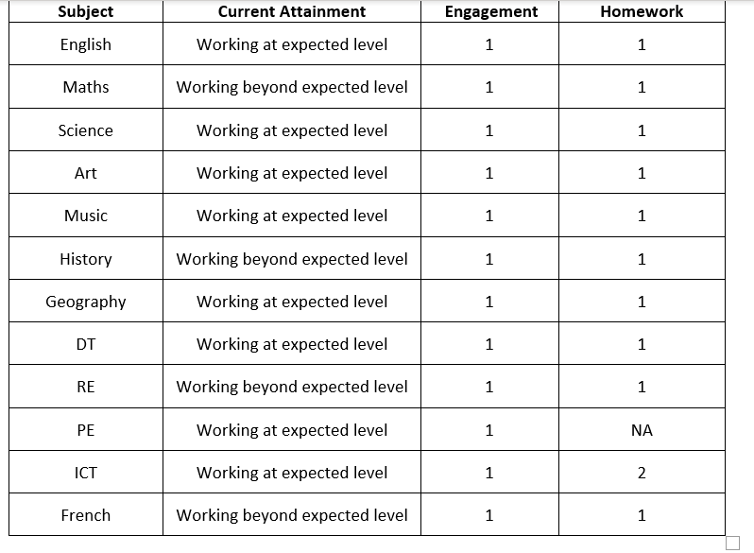
Internal Assessments
Each assessment will evaluate whether your child is making expected progress within our curriculum.

Slide 22
Communication
Term 1
November 2021: Teachers assess progress
December 2021: Grade Report to Parents/Carers
Term 2
January 2022: Teachers assess progress
March 2022: Full written report to parents/carers
Term 3
June 2022: Teachers assess progress: Formal examination hall
July 2022: Grade report to parents/carers and parents evening.

Slide 23
Assessment
Change in assessment at GCSE from grades to numbers.
Current Y8 (examined in 2025)
All subjects will be assessed using numbers

Slide 24
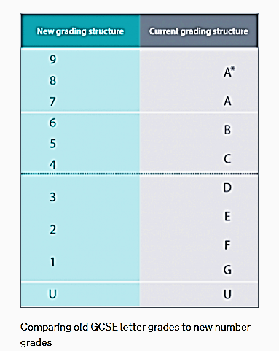
5 =
Strong Pass
4 =
Standard Pass

Slide 25
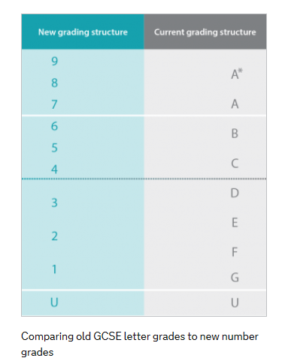
Let your light shine
Through Christ, in partnership and with service and witness at the core of all we do, our school will be a centre of excellence. We will educate the whole person so that everyone fulfils their academic potential, aspires highly and is optimistically ambitious.
Aspirational Target Grades
Based on KS2 end point i.e. end of Y6
‘Optimistically ambitious’ top 25% nationally
Grade potential to aim towards
Outcomes
9-1 grades: 5 strong pass; 4 standard pass
D*-P

Slide 26
Class Groupings
Let your light shine

Slide 27
Year 8 Class Groupings
KS2 information on progress and transition information from Primary schools used to group students.
Progress evaluated throughout the year.
In year progress and end of year progress in Y8 exams as well as KS2 results are used to set year 9 groups.
Class groupings reviewed regularly in year 8 and reset again going into Y9 based on in year progress and end of year progress in Y8 exams

Slide 28
Class Group Structure
Class groupings
English, MFL, Geography, History, Art, IT, Music, RE and Science
Design and Tech groups
Smaller groups taught on rotation of Food, textiles and product design
PE
PE groups slightly different to class groups
Maths
Groups set based on progress in Y7

Slide 29
Literacy
Let your light shine

Slide 30
Importance of literacy…
Young people who leave school without good literacy skills are held back at every stage of life. It is therefore a whole-school priority to ensure that all pupils at St Robert’s learn to read, write and communicate effectively.
To monitor pupil progress in literacy, termly reading assessments are completed throughout Year 7 and 8 and reported to parents in the form of a Standardised Age Score.
A ‘SAS’ of 100 is average.
A ‘SAS’ of <89 suggests reading intervention is needed.

Slide 31
Reading for pleasure has a variety of benefits; research shows that frequent reading improves:
Reading attainment;
Writing ability;
Text comprehension and grammar;
Breadth of vocabulary;
Self-confidence as a reader;
General knowledge; and
Understanding of other cultures
At St Robert’s, we nurture pupils’ motivation to read through:
Half-termly library visits
Library lunch passes

Slide 32
Homework
Let your light shine

Slide 33
What does the evidence tell us about homework ?
Most promising for raising attainment
8
Feedback
May be worth it
Meta-cognitive
Peer tutoring
Homework (Secondary)
1-1 tuition
Early Years
Effect Size (months gain)
Collaborative
Behaviour
Phonics
Small gp tuition
Parental involvement
Smaller classes
Social
ICT
Individualised learning
Summer schools
After school
Small effects / high cost
Homework (Primary)
Mentoring
0
Performance pay
Aspirations
£0
Ability grouping
£1000
Cost per pupil
www.educationendowmentfoundation.org.uk/toolkit

Slide 34
What does homework look like?
Prepare - tasks required to prepare, successfully, for the next lesson or beyond.
Consolidate - tasks which helps to reinforce the challenging nature of the work done in class.
Extend - tasks designed to challenge pupils to find out more and gather new information to deepen their knowledge, understanding and skills.

Slide 35
How much homework is set?
Key Stage 3:
Homework is set once a week if the pupil is taught two or more lessons a week in that subject.
Homework is set fortnightly if the pupil is taught one lesson a week in that subject.
Key Stage 3:
Year 7: 30 minutes per subject.
Year 8: 30 to 45 minutes per subject.
Year 9: 45 minutes per subject.

Slide 36
Our homework expectations…
Clearly write the homework in their planners.
Include when the homework is to be handed in.
Pupils must complete their homework on time and to a high standard.
Pupils must re-draft homework if it is not to a high standard.

Slide 37
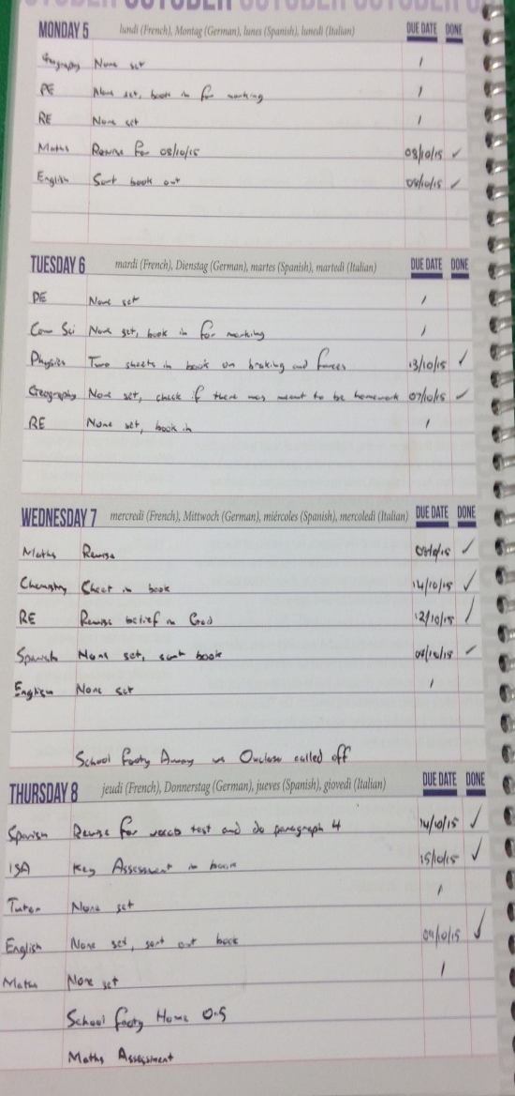
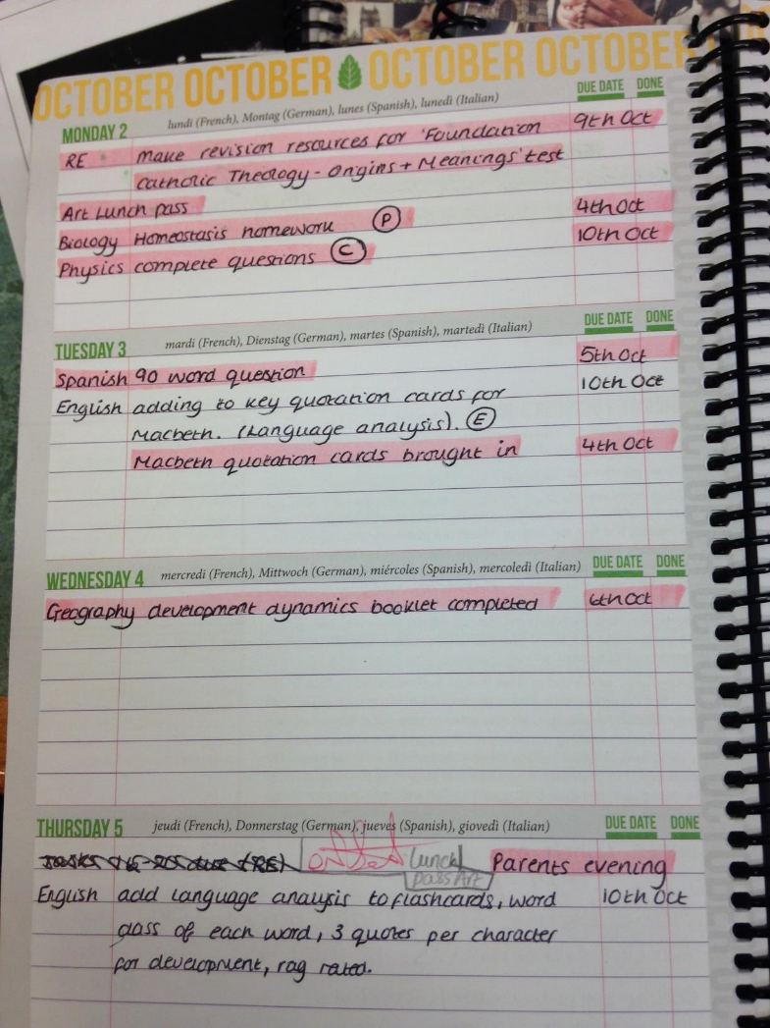
Planner & Organisation
All subjects to be written in the planner:
P-Prepare
C-Consolidate
E-Extend
Due date to be included
None set to be written in if no homework is set
Add a ‘Tick’ when done
Neat and tidy

Slide 38
Create the right conditions to work
Set up a study space
Eat healthy food
Take regular breaks
Sleep well.
Take regular exercise

Slide 39
How can parents help?
Checking the pupil planner daily
Helping organisation by discussing their work and their deadlines
Ensure they have a quiet space to work
Encourage them to commit specific time to homework/revision
Ensure that they are removed from distractions

Slide 41
Thank You
Let your light shine

