Slide 1
Whitby House
St Hilda

Slide 2
We gather together:
‘In the name of the Father, and of the Son and of the Holy Spirit’
Amen

Slide 3
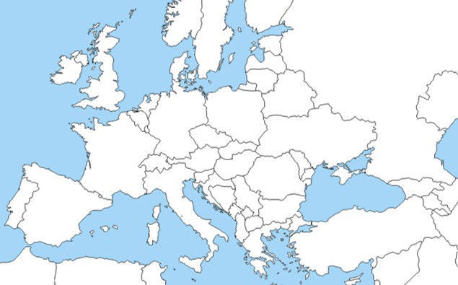
What has happened?
On 24 February, President Putin sent Russian troops to invade Ukraine.
There has been heavy fighting and bombing.
Many people have fled their homes. Many have fled to nearby countries.
Russia
Ukraine

Slide 4
Our assembly today will focus on ways in which our school community can support those impacted by the conflict in Ukraine:
Integrity is about doing what is right and acting with honesty and kindness.
Our faith is about being a community inspired by the teachings and actions of Jesus.
Respect is about ensuring all people are treated with dignity.
Our Values
Faith
Respect
Vocation
Excellence
Aspiration
Integrity

Slide 5
What can we do?
Each tutor group could set themselves a target of collecting £10, £20 or £50 over the next 5 weeks:
£10 could provide one person with essential hygiene supplies for a month.
£20 could provide emergency food for one person for a month.
£50 could provide blankets for ten people to keep them warm.

Slide 6
What can we do?
Mrs. Ross and the RE Department are collecting the following products which we hope to be delivered to those in need early next week:
Toiletries such as toothpaste, toothbrushes, soap, deodorant etc
First aid such as paracetamol, ibuprofen, bandages, plasters, sterile wipes etc.
Socks, sleeping bags, warm blankets, towels etc

Slide 7
Loving God, We pray for the people of Ukraine, for all those suffering or afraid, that you will be close to them and protect them.
We pray for the world that in this moment of crisis, we may reach out in solidarity to our brothers and sisters in need.
May we walk in your ways so that peace and justice become a reality for the people of Ukraine and for all the world.
Amen.

Slide 8
We end our assembly:
‘In the name of the Father, and of the Son and of the Holy Spirit’
Amen

