Slide 1

Focus ON Careers
St Robert of Newminster Catholic School and Sixth Form College
Salary:
£60-100K
Routes:
Degree minimum
LMI:
Shortage
Subject Links:
Sciences, HSC
Sector:
Healthcare
Skills Required:
Communication, Practical, Thinking
Ever thought about becoming a Dentist
To qualify as a dentist you need to complete a dental course, which usually lasts five years and leads to a bachelor's degree (either BDS or BChD).
There are four year courses available at Aberdeen, Kings, Liverpool and UCL dental schools for students with prior qualifications, for example a degree in Biomedical Sciences.
Dentistry is one of the most popular degrees in the UK and there is lots of competition for places. The Dental Schools Council offers some useful information about different courses and entry requirements.

Slide 2

Focus ON Careers
St Robert of Newminster Catholic School and Sixth Form College
Salary:
£30-40K
Routes:
NVQ, Degree minimum
LMI:
Medium Shortage
Subject Links:
English, History, Geography
Sector:
Media
Skills Required:
Communication, Thinking, Listening, ICT
Ever thought about becoming a Journalist
Common routes into journalism are to take an undergraduate degree in journalism, or to take an undergraduate degree in a different subject followed by a postgraduate journalism qualification. Either way, make sure that the course you choose is accredited by the National Council for the Training of Journalists (NCTJ) if you want to work for a UK-based news organisation. At both levels, there are degrees available in different areas, e.g. newspaper journalism, broadcast journalism and magazine journalism. Alternatively, it is sometimes possible to get in with a non-journalism degree and no journalism postgraduate qualifications, or with an apprenticeship or similar programme instead of a degree.

Slide 3

Focus ON Careers
St Robert of Newminster Catholic School and Sixth Form College
Salary:
£25-50K
Routes:
NVQ / BTEC
LMI:
Shortage in NE
Subject Links:
Maths, Construction , DT
Sector:
Construction
Skills Required:
Practical, Thinking
Ever thought about becoming a Plumber
University, sponsored degrees, higher and degree apprenticeships, vocational qualifications: there are all sorts of ways into the construction profession.

Slide 4

Focus ON Careers
St Robert of Newminster Catholic School and Sixth Form College
Salary:
£40-120K
Routes:
Degree minimum
LMI:
No shortage
Subject Links:
English, History, Sciences,
Sector:
Law
Skills Required:
Communication, Listening, Thinking
Ever thought about becoming a LAWYER
There are multiple routes into the legal profession for school leavers and university graduates. You can qualify as a solicitor, a barrister or a chartered legal executive, and can enter the legal profession through an apprenticeship. However, some roles may only be accessible from certain paths (for instance, you can’t currently qualify as a barrister through an apprenticeship), so it’s important to plan out your route for getting into law in advance.

Slide 5

Focus ON Careers
St Robert of Newminster Catholic School and Sixth Form College
Salary:
£60-80K
Routes:
NVQ, Degree minimum
LMI:
No shortage
Subject Links:
Maths, English
Sector:
Finance
Skills Required:
Communication, Mathematical, Logical
Ever thought about becoming an Accountant
The majority of large accountancy firms offer graduate and school leaver programmes to candidates – in general, smaller firms recruit graduates only. Whichever route you choose, once you start your accountancy career you’ll work towards getting qualified. This means that once your training is finished you’ll hold a nationally (often globally) recognised accountancy qualification that shows employers, clients and the general public that you have the relevant practical skills and theoretical knowledge to do your job well.

Slide 6
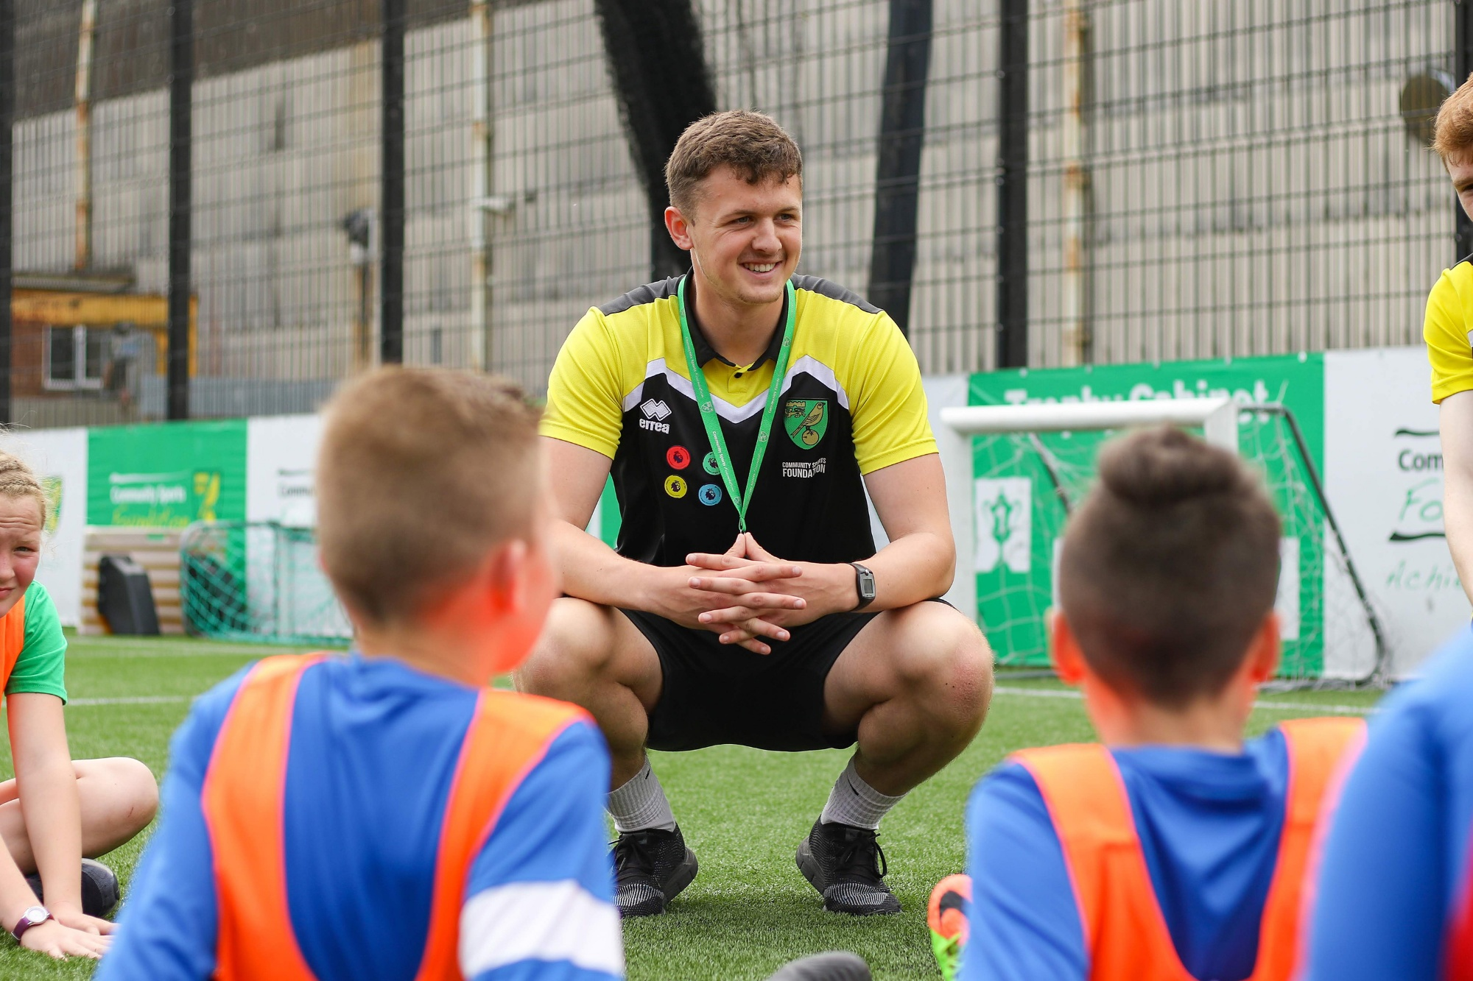
Focus ON Careers
St Robert of Newminster Catholic School and Sixth Form College
Salary:
£30-40K
Routes:
Degree minimum
LMI:
Shortage in NE
Subject Links:
Sciences, HSC, PE, Maths
Sector:
Education
Skills Required:
Communication, Practical, Thinking
Ever thought about becoming a pe teacher
You need to have a degree and complete a period of training to qualify as a teacher. The most popular way of doing this is to study for a degree and then take a one-year postgraduate teacher training course. Alternatively, you can also choose an undergraduate degree that includes teacher training.
There is a range of postgraduate teacher training routes to choose from, all of which combine studying with on-the-job training in schools and which typically take a year to complete. The route to qualifying as a teacher is slightly different in England, Scotland, Wales and Northern Ireland. However, the process is broadly similar and you need a degree to apply for postgraduate teacher training across the UK.

Slide 7
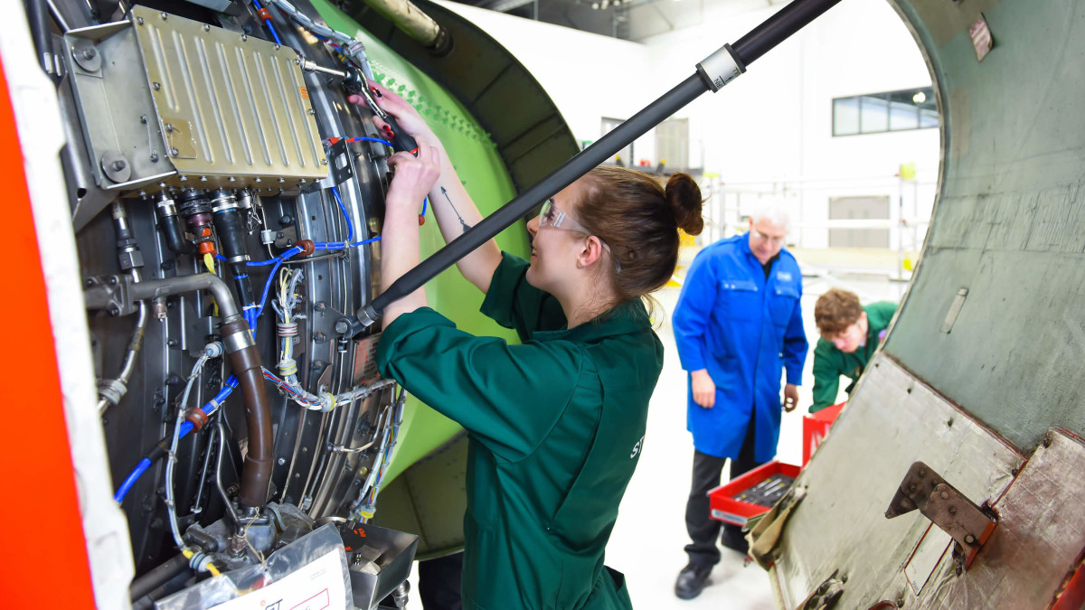
Focus ON Careers
St Robert of Newminster Catholic School and Sixth Form College
Salary:
£30-70K
Routes:
NVQ, Degree minimum
LMI:
Shortages in NE
Subject Links:
Engineering, Maths, Sciences, HSC
Sector:
Engineering
Skills Required:
Communication, Practical, Thinking
Ever thought about becoming an engineering
There are plenty of jobs within the engineering industry, both for graduates and for apprentices. If you’re studying for your A levels or equivalent there are two main routes for you to choose from. You could either go to university to study for an engineering degree before starting work or join a higher apprenticeship or degree apprenticeship programme with an engineering employer after sixth form, which would mean you could earn and learn at the same time.
Choosing between university and an apprenticeship scheme isn’t necessarily straightforward. You’ll need to consider a range of factors, including the level of qualification included in any apprenticeship or school leaver programme and your future earnings.

Slide 8
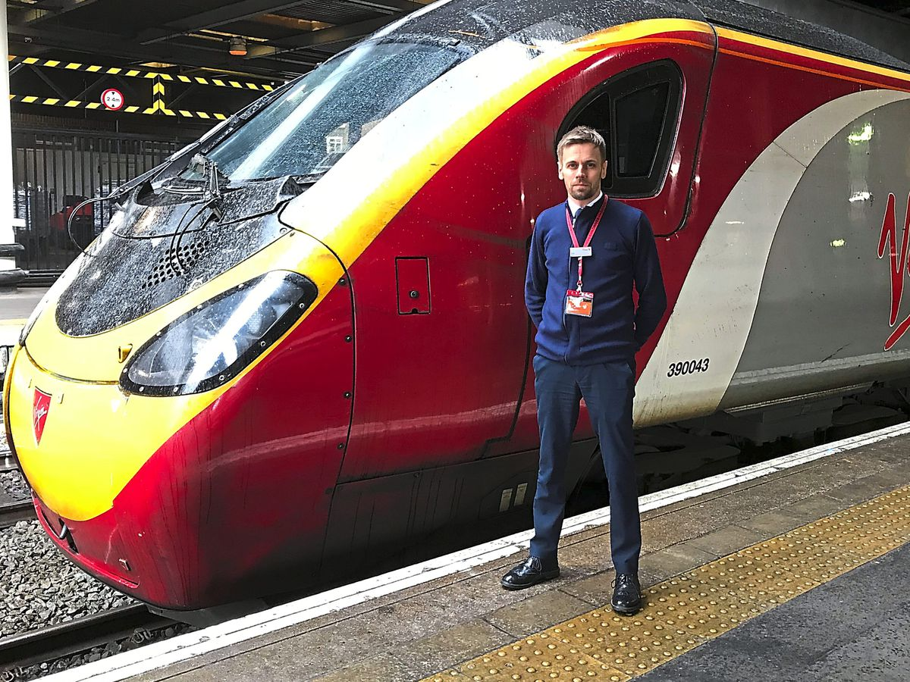
Focus ON Careers
St Robert of Newminster Catholic School and Sixth Form College
Salary:
£20-60K
Routes:
No minimum Requirement
LMI:
No shortage
Subject Links:
Maths, English
Sector:
Travel
Skills Required:
Communication, Logical Thinking
Ever thought about becoming a train driver
As you can imagine, many people worry that they do not have the life experiences to answer these types of questions. The simple answer is that they need to go out there and get the experience necessary.
The simple fact is this: you are applying for a position that carries a huge amount of responsibility and as such, it is vital that you have the knowledge, skills and experiences to do the job safely and competently.
If you don’t currently have the experiences to answer the questions then you need to find ways of gaining the required level of experience.

Slide 9

Focus ON Careers
St Robert of Newminster Catholic School and Sixth Form College
Salary:
£60-100K
Routes:
Degree minimum
LMI:
No shortage
Subject Links:
Sciences, Maths, Geography
Sector:
Hospitality & Travel
Skills Required:
Communication, Analytical, Thinking
Ever thought about becoming a pilot
The most common route to becoming a commercial pilot is through a cadetship scheme either after A levels or post-degree. Like most major airlines, my company occasionally recruits through a ‘future pilot programme’. The scheme provides a tax-efficient loan for training and some assurance of a contract on attainment of a licence. Commercial licences cost over £100,000 so before engaging in such a scheme a candidate needs to weigh up the benefits against the risk of not gaining a contract or not completing the training.

Slide 10

Focus ON Careers
St Robert of Newminster Catholic School and Sixth Form College
Salary:
£20-40K
Routes:
NVQ / Degree minimum
LMI:
No shortage
Subject Links:
Sciences, Sociology, Psychology
Sector:
Healthcare
Skills Required:
Communication, Listening, Thinking
Ever thought about becoming a social worker
To qualify as a dentist you need to complete a dental course, which usually lasts five years and leads to a bachelor's degree (either BDS or BChD).
There are four year courses available at Aberdeen, Kings, Liverpool and UCL dental schools for students with prior qualifications, for example a degree in Biomedical Sciences.
Dentistry is one of the most popular degrees in the UK and there is lots of competition for places. The Dental Schools Council offers some useful information about different courses and entry requirements.

Slide 11

Focus ON Careers
St Robert of Newminster Catholic School and Sixth Form College
Salary:
£40-70K
Routes:
Degree minimum
LMI:
No shortage
Subject Links:
Sciences, Maths
Sector:
Healthcare
Skills Required:
Communication, Thinking, Analytical
Ever thought about becoming a pharmacologist
Science subjects in your A levels, – to get you onto a pharmacy degree. University entry requirements vary, but a typical course might ask for chemistry plus at least one out of biology, maths or physics. A few courses will accept biology instead of chemistry, or consider psychology as an alternative ‘second’ subject. Depending on the university, generally A or B grades are required.

Slide 12

Focus ON Careers
St Robert of Newminster Catholic School and Sixth Form College
Salary:
£20-40K
Routes:
No minimum Requirement / NVQ
LMI:
No shortage
Subject Links:
Maths, English, History
Sector:
Business
Skills Required:
Communication, Thinking, Listening
Ever thought about becoming an admin assistant
You need an approved social work qualification – either a BA undergraduate degree or a postgraduate masters degree – to register as a social worker. You’ll also need to be able to explain why you want to go into social work and what you have to offer, as well as being able to give examples that show you have the emotional resilience needed to do the job.
You’ll need some experience of social work or social care before applying, which could be obtained through paid work, placements or volunteering. Personal experience such as caring for a friend or relative could also be relevant.

Slide 13

Focus ON Careers
St Robert of Newminster Catholic School and Sixth Form College
Salary:
£30-60K
Routes:
NVQ / Degree minimum
LMI:
No shortage
Subject Links:
Sciences, Maths
Sector:
Construction
Skills Required:
Communication, Practical, Thinking
Ever thought about becoming a surveyor
The typical job title for a property professional is surveyor, sometimes known as a general practice surveyor. They work to become chartered surveyors. If they work for a private property employer, their role is to make the most money possible out of a piece of land or property on behalf of clients. Clients include the land or property’s owners; people or companies looking to rent or buy land or property; or wealthy individuals or investment management groups who want to invest in a property.

Slide 14

Focus ON Careers
St Robert of Newminster Catholic School and Sixth Form College
Salary:
£20-40K
Routes:
No Minimum – Role Dependent
LMI:
Shortage
Subject Links:
Construction, Maths, English
Sector:
Construction
Skills Required:
Practical, Thinking, Problem Solving
Ever thought about becoming a construction worker
Construction jobs are essentially about being able to say ‘I helped build that!’. Construction involves designing and building the ‘built’ environment around us: not only skyscrapers, football stadiums and bridges, but also houses, factories, hospitals, schools, railways, tunnels, piers, dams, coastal defences and energy generation plants.
A project can be a ‘new build’, a renovation or a refurbishment. Larger construction companies specialise in particular ‘markets’ or sectors – for example, healthcare projects. Some work in a range of sectors while other companies provide expertise in just one or two areas. Many construction professionals specialise in a particular type of project over time.

Slide 15

Focus ON Careers
St Robert of Newminster Catholic School and Sixth Form College
Salary:
£60-100K
Routes:
Degree minimum
LMI:
No shortage
Subject Links:
Maths, English
Sector:
Finance
Skills Required:
Problem Solving, Communication, Mathematical
Ever thought about becoming a bank manager
Retail bankers work in the many branches that are dotted on high streets and in town centres across the UK. They can also be found at banks’ national call centres and in their in-store branches launched in conjunction with established shops, such as Marks & Spencer. Retail banks have several different areas you could work in, including customer service, sales, marketing and IT. Roles in investment banking exist in investment banks, such as Goldman Sachs and J.P. Morgan, and the investment banking arms of banks that also have a retail wing, namely Barclays and HSBC. Investment banks also have several parts, so employment opportunities will span different divisions.

Slide 16

Focus ON Careers
St Robert of Newminster Catholic School and Sixth Form College
Salary:
£20-30K
Routes:
No Qualification Req
LMI:
No shortage
Subject Links:
Geography, Maths
Sector:
Hospitality & Travel
Skills Required:
Communication, Thinking, Listening , ICT
Ever thought about becoming a tour operator
You could seek to start work full-time in hospitality or travel as a school leaver with GSCEs or A levels, as a graduate or after postgraduate study. The nature of your qualifications and experience will affect which roles you will be considered for and your level of seniority and salary when you start work.
If you have a part-time job in a café or restaurant you already have a foothold in the industry that will help you when it comes to applying for jobs, whether you do so as a school leaver with A levels or as a graduate. Gaining relevant work experience is really important if you want a career in this sector, as is having a customer-focused attitude.

Slide 17

Focus ON Careers
St Robert of Newminster Catholic School and Sixth Form College
Salary:
£15-25K
Routes:
No Qualifications Req
LMI:
No shortage
Subject Links:
Maths, English
Sector:
Retail
Skills Required:
Communication, Thinking, Listening
Ever thought about becoming a retail assistant
Retail apprenticeships typically involve working in a particular retail role four days a week and going to college one day a week. The retailer pays for your training and pays you a wage. The aim is to train you up to do a specific job function, eg become a buyer.
There are three types of apprenticeship available: intermediate, advanced and higher. However, retailers tend to refer to them as level 2, level 3 and level 4 respectively. Level 4 apprenticeships tend to be aimed at those students with A levels – usually you need a minimum of two A levels or a certain number of UCAS points. You only need GCSEs to get onto a level 3 apprenticeship, but some retailers will accept you onto them if you have A levels.

Slide 18

Focus ON Careers
St Robert of Newminster Catholic School and Sixth Form College
Salary:
£30-80K
Routes:
Level 2 / 3 / 4
LMI:
Shortage in NE
Subject Links:
Engineering / Business Studies
Sector:
Engineering
Skills Required:
Communication, Practical, Thinking, ICT
Ever thought about becoming a project manager
Many people working in business jobs have a degree, but it’s possible to get in without one.
If you’re not sure which area of business you want to work in, some training programmes aimed at non-graduates offer the opportunity to try out different jobs in different functions. Marketing, HR and sales are often options. PR and management consulting don’t tend to be. For most other opportunities you need to know which type of business job you want before you apply.

Slide 19

Focus ON Careers
St Robert of Newminster Catholic School and Sixth Form College
Salary:
£30-50K
Routes:
Degree minimum
LMI:
No shortage
Subject Links:
English, MFL
Sector:
Public Sector
Skills Required:
Communication, Thinking, Listening
Ever thought about becoming a translator
Want to work for central government? Consider applying for the Civil Service, which does the practical and administrative work of government. The highly sought-after Civil Service Fast Stream recruits graduates to work in in many different roles in a range of government departments, with specialist programmes in everything from providing the government with statistics to training to work in the Houses of Parliament. In the past, the Civil Service has run a 'fast track apprenticeship scheme'.

Slide 20

Focus ON Careers
St Robert of Newminster Catholic School and Sixth Form College
Salary:
£20-50K
Routes:
NVQ / Degree
LMI:
No shortage
Subject Links:
Sociology, Psychology, English
Sector:
Business
Skills Required:
Communication, Thinking, Organisational
Ever thought about working in pr
Public relations, or PR, is about maintaining or improving the reputation of an organisation by influencing how other people perceive it. According to the Public Relations and Communications Association (PRCA), PR is about how organisations communicate with the public, promote themselves and build a positive image. There is crossover with marketing, since the influence gained may make all the difference when people are deciding which supermarket to shop in, or which company to do business with.
PR activity is usually planned in advance but a PR expert can also be called upon to manage an organisation’s response to a crisis.

Slide 21
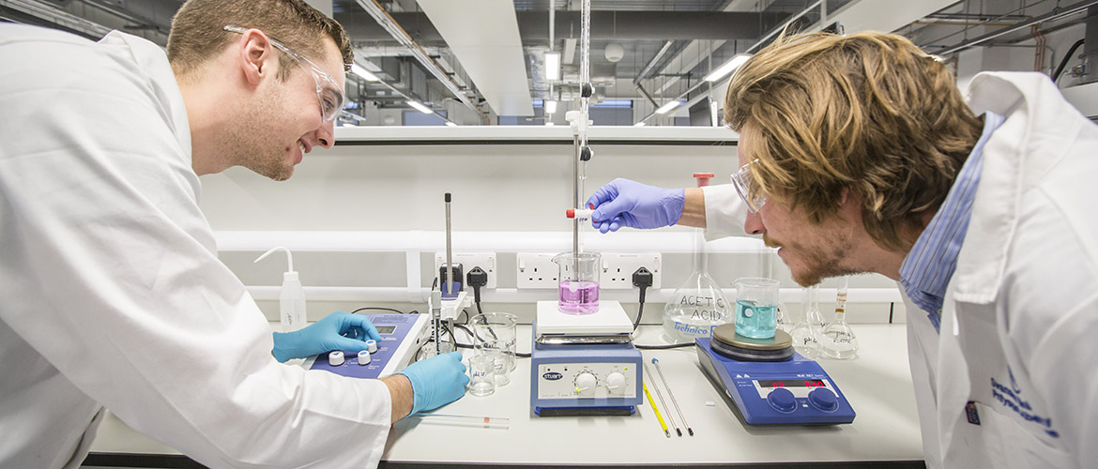
Focus ON Careers
St Robert of Newminster Catholic School and Sixth Form College
Salary:
£30-80K
Routes:
NVQ / Degree minimum
LMI:
Shortage in NE
Subject Links:
Sciences, Engineering, Maths
Sector:
Engineering
Skills Required:
Communication, Practical, Thinking, Logical
Ever thought about becoming a chemical engineer
Some engineers have NVQs; others have masters degrees or PhDs. You can join the industry at any level, and often have the chance to study for further qualifications once you’re in. Generally speaking the more senior you become the more opportunity you will have to take on management responsibilities and to be involved in finding novel ways of doing things.
To succeed as an engineer you’ll need sound business sense. Most engineers work in the private sector, where the key goal is to make money. As an engineer you might help your employer to turn a profit by creating a product that clients will pay for, or by finding a more cost-effective way of doing so.

Slide 22

Focus ON Careers
St Robert of Newminster Catholic School and Sixth Form College
Salary:
£15-30K
Routes:
No Qualifications Req
LMI:
No shortage
Subject Links:
Practical Based
Sector:
Retail
Skills Required:
Maths, Logical, Thinking
Ever thought about becoming a delivery driver
The retail industry offers a wide variety of jobs that go beyond customer service and the shop floor. You could be working behind the scenes to design new products, helping to attract more customers or making sure stores stay profitable. Although product sales are what keep retailers in business, there is plenty of work that has to be done before goods even hit the shelves.
Logistics is defined as organising the transportation of products from manufacturers to distributors in the most cost-effective, fast and environmentally friendly way possible.

Slide 23

Focus ON Careers
St Robert of Newminster Catholic School and Sixth Form College
Salary:
£20-70K
Routes:
Vocational Qualification
LMI:
Medium shortage
Subject Links:
Food Tech, Sciences
Sector:
Hospitality
Skills Required:
Communication, Practical, Thinking
Ever thought about becoming a chef
If you’re looking for a fast-paced, hands-on role that involves lots of contact with people, this could be the right career area for you. It’s also a good choice if you’re interested in work-based training or vocational study and looking for an area where you’ll have the chance to progress and gain responsibility early on. Depending on your role, perks of the job could include the chance to work abroad or discounted holidays or travel.

Slide 24
Focus ON Careers
St Robert of Newminster Catholic School and Sixth Form College
Salary:
£20-70K
Routes:
NVQ or Degree
LMI:
Huge shortage
Subject Links:
IT, Maths, Computer Science
Sector:
IT
Skills Required:
Communication, Logical, Thinking
Ever thought about working in it
IT employers use a range of online tests and individual assessments to decide who they want to give a place on a higher apprenticeship, degree apprenticeship or sponsored degree programme. These tests vary between companies but we can give you an idea of what to expect.
A typical application process for an apprenticeship at a technology employer may involve: an online application form (or you may be able to upload a CV), online assessment tests, one or more interviews (these might be face-to-face, over the phone, or using a video-call service) and an assessment centre. These application processes can be extensive, but think about each stage as another opportunity to impress technology recruiters.

Slide 25
To discuss any of the pathways in this presentation
Speak to your tutor or contact Tracey Green our Careers Advisor
REMEMBER: You can request an independent Careers Interview with Tracey Green at any time by completing a postcard request in the main school library.

