Slide 1
Refugees & Asylum Seekers
Monday 19th June 2023
SIGN OF THE CROSS AND GATHER
Our prayers today and this week focus on those people who are forced to leave their countries and homes to find places of refuge and safety. Too often, negative attitudes are displayed to people who simply want a safe place for them and their families.
RESPONSE
God of love,
We pray for refugees around the world. May they be welcomed with open arms. May their needs for food, shelter, clothing and love be met. We pray that the world will have compassion. We pray that the world will take action on their behalf. In Jesus’ name, Amen.

Slide 2
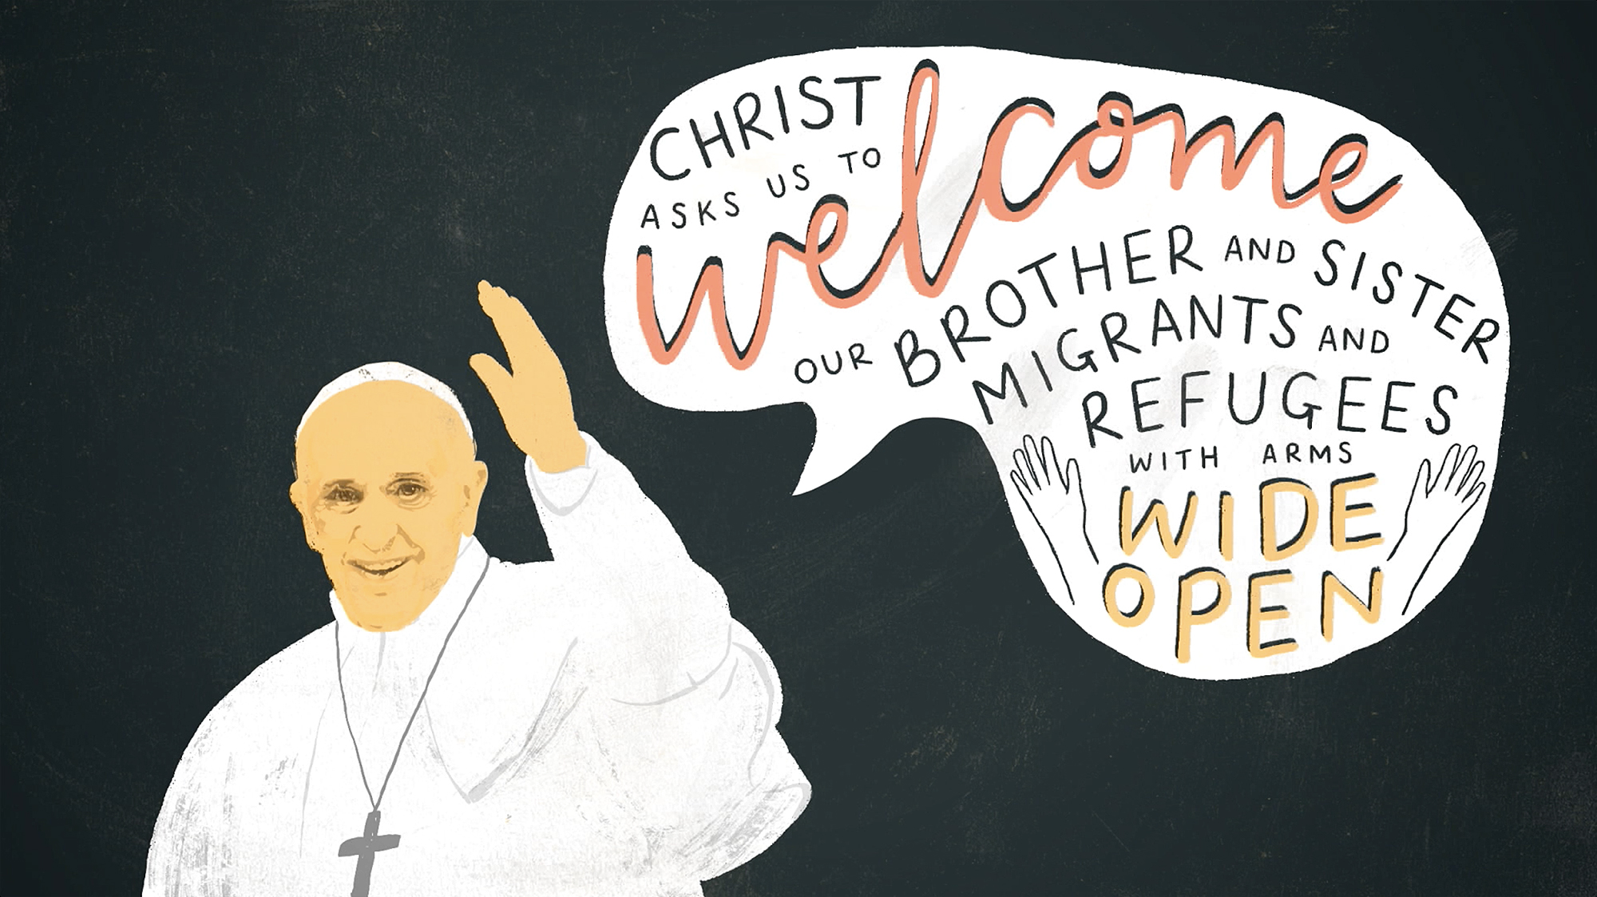
Pope Francis: Love your neighbour
Tuesday 20th June 2023
SIGN OF THE CROSS AND GATHER
Our prayers focus on Pope Francis and the importance of showing love to our neighbour. Jesus taught us that everyone is our neighbour, irrespective of their race, religion or culture.
WE LISTEN
Love the Lord your God with all your heart and with all your soul and with all your mind and with all your strength.’ The second is this: ‘Love your neighbour as yourself.’ There is no commandment greater than these.”
Matthew 12:30-31
RESPONSE
Jesus, you know what it is like to be hungry and thirsty. You know the plight of the stranger who is made unwelcome. You know the suffering of all who have lost everything. We pray that by welcoming refugees we may show love for our neighbour and draw closer to you. Amen.
MISSION
Demonstrate love of neighbour this week. Aspire to show respect and kindness to all. Welcome people who are lonely, support people who are suffering, stand alongside people who need a friend.

Slide 3
The people of Ukraine
Wednesday 21st June 2023
SIGN OF THE CROSS AND GATHER
Our prayers today focus on those affected by the conflict in Ukraine. Many people have had to leave their country, homes and families to seek safety. We pray for those impacted…
RESPONSE
Loving God, We pray for the people of Ukraine, for all those suffering or afraid, that you will be close to them and protect them.
We pray for the world that in this moment of crisis, we may reach out in solidarity to our brothers and sisters in need.
May we walk in your ways so that peace and justice become a reality for the people of Ukraine and for all the world.
Amen.

Slide 4
The Lampedusa Cross
Thursday 22nd June 2023
SIGN OF THE CROSS AND GATHER
Our prayers today focus on Francesco Tuccio. After the sinking of a ship carrying over 400 people, in which 311 died in 2013, he began to help and support those people seeking refuge and asylum.
RESPONSE
Share the Journey
Dear God, you share the journey with migrants and refugees. Pour out your Spirit upon world leaders. May they see the tragedies of our human family, and be moved to respond with wisdom, compassion and courage. Move us to welcome our neighbours, and so bear witness to your love.
Amen

Slide 5
Respect & Integrity
Friday 23rd June 2023
SIGN OF THE CROSS AND GATHER
Our prayers today focus on the school values of respect and integrity. These values are important because they ensure that all people are treated with dignity.
WE LISTEN
“Migrants and refugees are are children, women, and men who leave or are forced to leave their homes for various reasons, who share a legitimate desire for knowing and having, but above all for being more.”
Pope Francis
RESPONSE
Dear God,
Help me to live each day with integrity. To make decisions that are kind. To treat people and speak to people positively. Help me to see beyond labels and accept that all people are created in your image.
Amen
MISSION
Your prayers this week gave you an insight into the lives of people who have suffered as they have had to leave their country seek safety elsewhere. Imagine if you ever found yourself in this situation. How would you want people to treat you?

